Slide 1
Architecture & Construction:
  Working as a Team

Slide 3

Teams
  Are a group of people collaboratively working together toward a common goal
  In the design field this is usually some type of building project
  Teams can vary greatly in size depending on the task
  Teams can also be very dynamic by changing, adding or removing members throughout a certain timeframe
  Teams are a very important aspect in just about any profession

Slide 4
Team Roles
  With most teams, individuals are assigned a role
  Each team member’s role will contribute to the team as a whole toward a common goal
  Most roles are decided according to the overall task of the team
  Most of the time, team members’ roles are dictated by their strengths, but it is common to see someone put into a role that challenges their weaknesses to make them a better team member

Slide 5
Team Roles
  Developing a good team can be difficult
  When involving different people into something, they all bring different opinions, skills, points of view, attitudes and work habits to the table
  A successful team finds a way to accommodate and utilize all the differences, or establishes rules or norms that allow everyone to work together cooperatively
  Many times, you may not have the option to select your team members and are forced to find ways to work together

Slide 6
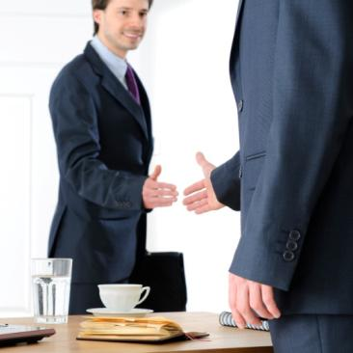
Teams in Industry
  The architectural field and professional design fields all utilize and promote teams and team work
  Architects and designers internally work in teams to achieve a common goal
  Usually, jobs are so vast and have so many details or areas to cover, that it is very daunting for a single person to tackle such work

Slide 7
Teams in Industry
  Not only do they work with each other, but they also have to work with other professions
  This in turn, creates larger teams of people working toward a common goal.
  Sometimes this can create conflict, depending on the techniques and structures of the teams, or because of their priority of goals
  Teams can conflict if they do not establish “rules” or standards that help guide and balance the teamwork

Slide 8
Team Benefits
  Working in teams creates a sense of unity and togetherness. “We are all in this together”
  When a team member is weak or lacking in one area, someone else is usually there to help or pick up the slack
  If a team is strong and well structured, they can accomplish just about anything

Slide 9
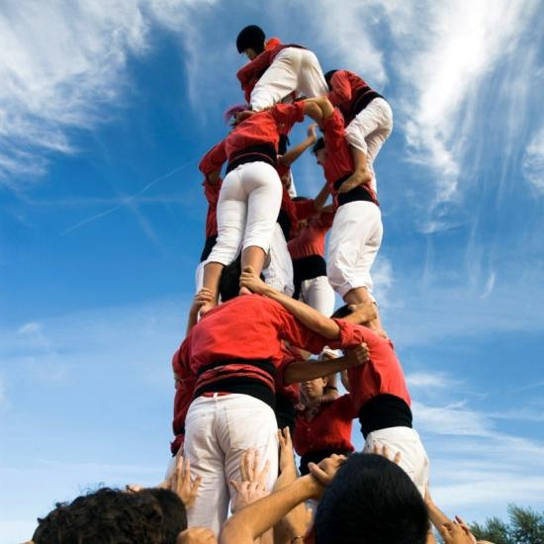
Build Time!
  Let’s create our teams and assign roles to begin our house of cards.

