Slide 1
Flexible Manufacturing
Blueprints in Manufacturing

Slide 3
How to Read Blueprints
3
1/8
1/4-20 THREADS 3/4” DEEP
3/8
1
1/2” ROUND STOCK
1/4-20 THREADS
3/4” DEEP
HAMMER HANDLE
2 1/2
1 1/8
3/4 SQUARE STOCK
6
HAMMER HEAD
1/4” ROUND STOCK
1/4-20 THREADS X 3/4 LENGTH BOTH ENDS
HAMMER SHANK

Slide 4
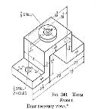
How to Read Blueprints
Describe the part to be made; show dimension, location, material, and finished part
3
1 ½
⅞
2 ⅞
2 ⅞
7 ½
¼
2 Dia.
⅞ DRILL
½ DRILL
2 HOLES
3
¾
2 ½
2 ½

Slide 5
How to Read Blueprints
Dimensions show the total size of the part.
The outside dimension is usually the total size.
3
1 ½
⅞
2 ⅞
2 ⅞
7 ½
¼
2 Dia.
⅞ DRILL
The support would need to be machined from a piece
5¾” X 2½” X 3”.
½ DRILL
2 HOLES
3
¾
2 ½
2 ½

Slide 6
How to Read Blueprints
Locations are for machining the part to shape or for locating placement of other features.
The two ½” holes are drilled 1 ½” from the edge and 2 ⅞” from the center line of the part.
3
1 ½
⅞
2 ⅞
2 ⅞
7 ½
¼
2 Dia.
⅞ DRILL
½ DRILL
2 HOLES
3
¾
2 ½
2 ½

Slide 7
Hammer Handle
3
1/4-20 THREADS 3/4” DEEP
1/2” ROUND STOCK
What is the diameter of the round stock used to make the handle?
What is the length of the material?
What is the size of the threads in the end?

Slide 8
Hammer Handle
3
1/4-20 THREADS 3/4” DEEP
1/2” ROUND STOCK
What is the diameter of the round stock used to make the handle? 1/2”
What is the length of the material? 3”
What is the size of the threads in the end?
1/4”- 20 threads and 3/4” deep

Slide 9
Hammer Head
1/8
What is the stock size for the head?
What is the length of the head?
What is the measurement for the placement of the hole?
3/8
1
1/4-20 THREADS
3/4” DEEP
2 1/2
1 1/8
3/4 SQUARE STOCK

Slide 10
Hammer Head
1/8
What is the stock size for the head?
3/4” square stock
What is the length of the head?
1/2”
What is the measurement for the placement of the hole?
1-1/8” up and 3/8” in from the side
3/8
1
1/4-20 THREADS
3/4” DEEP
2 1/2
1 1/8
3/4 SQUARE STOCK

Slide 11
Lines Used in a Blueprint
Line | Name | Explanation
 | Object | Dark heavy line that denotes the edge of an object.
 | Hidden | Dark heavy dash that denotes an edge behind or inside the object.
 | Center | A line that is thinner than an object line with a dash in the center of the line to denote the center of the part or circle.
 | Extension | A thin line extending an edge from the object for dimensions to touch.
 | Dimension | A set of arrows pointing to the extension line with a dimension in the middle.
 | Cutting Plan | The heaviest line on a drawing showing where a section is to be cut out of the object.
 | Section | Thin lines at a diagonal showing the cut portion of an object.
 | Leader | A straight line with an arrow extending from it to point to a dimension or note.

Slide 12
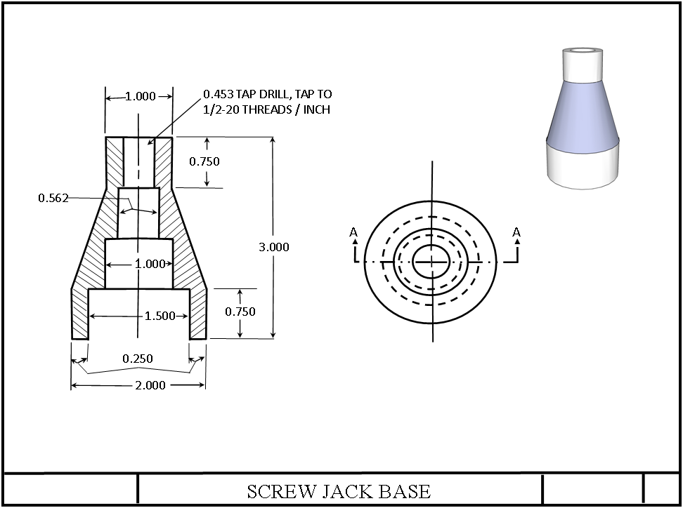
Screw Jack Base Plans
Extension line
Leader line
Notes
Object line
Cutting plane line
Hidden line
Center line
Section line
Dimension line

Slide 13
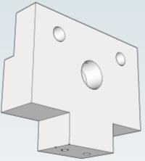
Identify the Type of Lines
B.
#8 – 32 SETSCREW
DRILL #29 (0.136) HOLE
DRILL #3 BIT X.50 DEEP,
TAP TO 1/4 – 28 THREAD SIZE
A.
0.25
0.375
F.
1.25
0.75
BORE 0.50 DIA. X 0.375 DEEP HOLE
0.25
0.50
1.50
0.375
C.
DRILL TWO,
0.25 HOLES
0.75
2.00
1.00
0.50
E.
1.00
0.75
D.
2.50

Slide 14
Identify the Type of Lines
Leader
#8 – 32 SETSCREW
DRILL #29 (0.136) HOLE
DRILL #3 BIT X .50 DEEP,
TAP TO 1/4 – 28 THREAD SIZE
Object
0.25
0.375
Extension
1.25
0.75
BORE 0.50 DIA. X 0.375 DEEP HOLE
0.25
0.50
1.50
Dimension
0.375
DRILL TWO,
0.25 HOLES
0.75
2.00
1.00
0.50
Hidden
0.75
1.00
Centerline
2.50

Slide 15
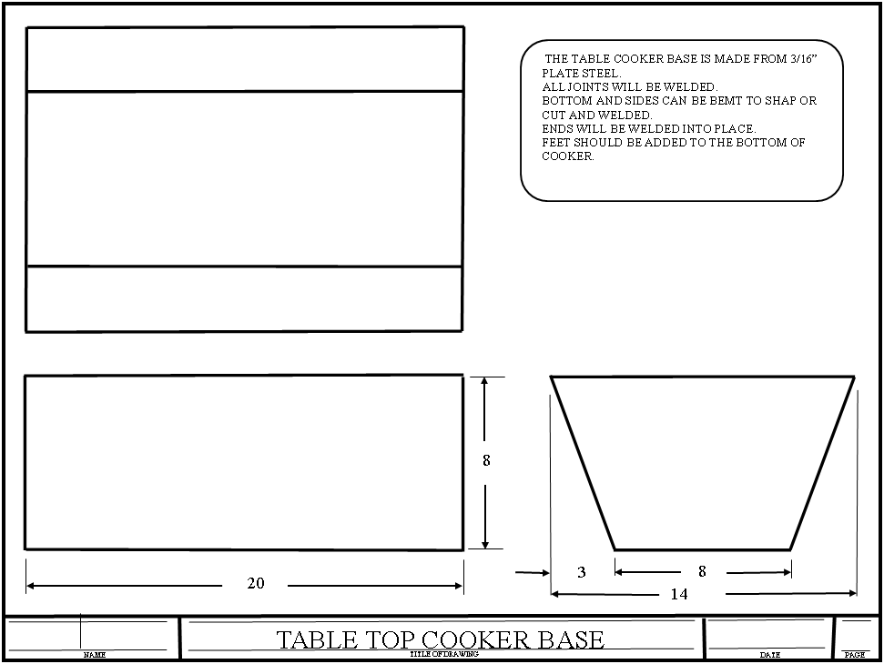
Metal sizes needed to make the cooker base

Slide 16
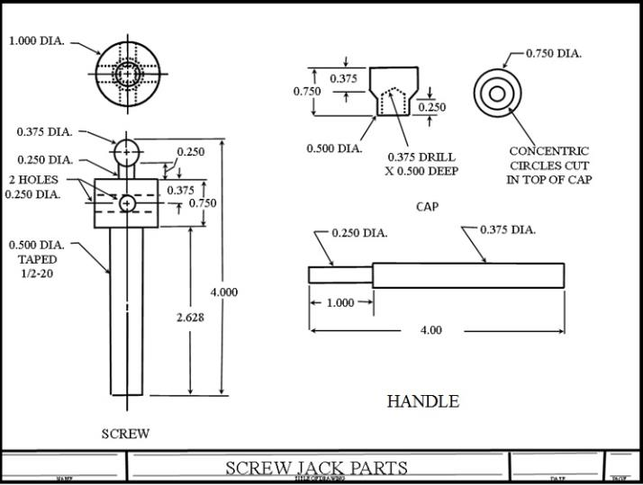
Handout for Blueprint Reading

Slide 17
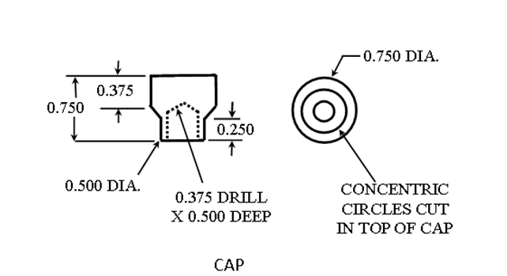
Handout for Blueprint Reading
What sized piece of aluminum will be needed to machine the cap?
What size and how deep is the hole drilled in the bottom?

Slide 18
Handout for Blueprint Reading
What sized piece of aluminum will be needed to machine the cap?
3/4” diameter X 3/4” long
What size and how deep is the hole drilled in the bottom?
0.375 Drill X 0.500” Deep

Slide 19
Using Charts
Vise Bill of Materials
PART NUMBER | QUANITY | NAME | SIZE
1 | 1 | BASE | ¾ X 2 ½ X 5
2 | 1 | FIX JAW | ¾ X 2 ½ X 2
3 | 1 | MOVABLE JAW | ¾ X 2 ½ X 2
4 | 1 | FRONT JAW | ¾ X 2 ½ X 2
5 | 1 | SCREW | 1 ¼ DIA X 3 ¾
6 | 1 | HANDLE | ⅜ DIA X 3
7 | 2 | JAW FACES | ½ X 1 X 2 ½
8 | 1 | JAW LOCK | ⅛ X ¾ X 1 ½
9 | 7 | FASTENER | ¼ – 28 BOLTS X ¾ LONG
10 | 1 | SETSCREW (NOT SHOWN) | ⅛ SETSCREW X ¾ LONG
19

Slide 20
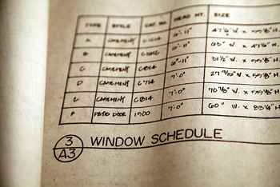
Charts
List information in table form.
There are different types of charts: Bill of Materials, Tap Sizes, Drill Sizes, and Feed and Cut Rates.
The Bill of Materials will give you part sizes, types of material, and finishes for all the different parts.
The other charts give information on sizes needed to make a part or standards used in the manufacturing.
Thread Size | Drill Size | Decimal Equivalent | National
¼ - 20 | #7 | 0.2010 | Course
¼ -28 | #3 | 0.230 | Fine
5/16 - 18 | F | 0.2570 | Course
5/16 - 24 | I | 0.2720 | Fine
3/8 -16 | 5/16 | 0.3125 | Course
3/8 - 24 | Q | 0.3320 | Fine
7/16 - 14 | U | 0.3320 | Course
7/16 - 20 | 25/64 | 0.3906 | Fine
½ - 13 | 27/64 | 0.4219 | Course
½ - 20 | 29/64 | 0.4531 | Fine
PART NUMBER | QUANITY | NAME | SIZE
1 | 1 | BASE | ¾ X 2 ½ X 5
2 | 1 | FIX JAW | ¾ X2 ½ X2
3 | 1 | MOVABLE JAW | ¾ X2 ½ X2
4 | 1 | FRONT JAW | ¾ X2 ½ X2
5 | 1 | SCREW | 1 ¼ DIA X 3 ¾
6 | 1 | HANDLE | ⅜ DIA X 3
7 | 2 | JAW FACES | ½ X 1 X 2 ½
8 | 1 | JAW LOCK | ⅛ X ¾ X 1 ½
9 | 7 | FASTNER | ¼ –28 BOLTS X ¾ LONG
10 | 1 | SETSCREW (NOT SHOWN) | ⅛ SETSCREW X ¾ LONG

Slide 21
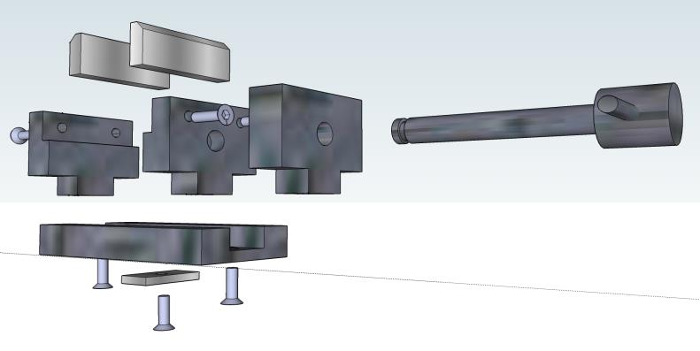
Exploded View of Vise Parts
7
4
6
3
2
5
1
8
9
The Bill of Materials is filled out about each part.

Slide 22
Vise Bill of Materials
PART NUMBER | QUANITY | NAME | SIZE
1 | 1 | BASE | ¾ X 2 ½ X 5
2 | 1 | FIX JAW | ¾ X 2 ½ X 2
3 | 1 | MOVABLE JAW | ¾ X 2 ½ X 2
4 | 1 | FRONT JAW | ¾ X 2 ½ X 2
5 | 1 | SCREW | 1 ¼ DIA X 3 ¾
6 | 1 | HANDLE | ⅜ DIA X 3
7 | 2 | JAW FACES | ½ X 1 X 2 ½
8 | 1 | JAW LOCK | ⅛ X ¾ X 1 ½
9 | 7 | FASTENER | ¼ – 28 BOLTS X ¾ LONG
10 | 1 | SETSCREW (NOT SHOWN) | ⅛ SETSCREW X ¾ LONG

Slide 23
Fill in the Bill of Material for the Base
SCREW JACK PARTS LIST
NAME | MATERIAL | LENGTH | DIAMETER | FINISH
BASE | ? | ? | ? | ?

