Slide 1
Civil and Criminal Justice Systems
Correctional Services

Slide 3
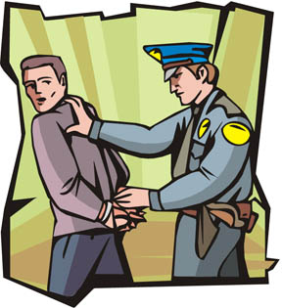
National and International Policies
Drug Policies
The war on drugs
Increased drug arrests
Mandatory sentencing
Less prison space for violent offenders
The result is prison overcrowding
Sentencing Policies
Mandatory sentencing fills beds
More money to build new prisons
Advocates for alternatives to incarceration
Probation
Drug treatment programs
Community supervision

Slide 4
National and International Policies
Globalization Policies
Labor, capital goods, and service across borders
Create multinational criminal organizations
More federal crime impacts the Federal Bureau of Prisons

Slide 5
Lawsuits
Ruiz v. Estelle (1980)
Longest running in U.S. history
Issue - Cruel and Unusual punishment (8th amendment)
Overcrowding – 2–3 inmates in a single cell
Security – too few guards; run by inmates known as “building tenders”
Inadequate healthcare – insufficient number of professional staff, lack of psychiatric care
Unsafe working conditions
Severe and arbitrary discipline procedures

Slide 6
Lawsuits
Ruiz v. Estelle (1980)
Longest running in U.S. history
Court Ruling
Limited inmate population to 95% capacity
Created a need for construction of new prisons
Separated hardcore offenders that require a higher level of supervision
Hired more guards
Improved medical conditions

Slide 7
Statutory Laws: Executions
Hanging
The method of execution in Texas from 1819–1923
Were carried out in or by the county in which the crime was committed
Lethal Injection
Texas amended the Penal Code in 1973, reinstating the death penalty
The state adopted lethal injection as the method of execution in 1977
January 12, 1996 – close friends and relatives of victims are now allowed to witness executions

Slide 8
Statutory Laws: Executions
Electric Chair
Texas authorized its use in 1923
All executions were moved to Huntsville
The state became responsible for execution
The first 5 offenders were put to death on 2/8/1924
The last electrocution completed 7/30/1964
It was declared unconstitutional under the 8th amendment in 1972
Offenders on death row received commuted sentences; now housing offenders for life

Slide 9
Executive Intervention
Governor
Clemency
An act of mercy lessening the punishment given to a defendant
Since 1976, 276 death row offenders received clemency for “humanitarian” reasons
Doubts about an offender’s guilt
Doubt about the death penalty process
Commutation of a sentence
Reduction of legal penalties
Often conditional
Ex: death sentence changed to life sentence

Slide 10
Executive Intervention
Governor
Pardon
Release from punishment
Exempt from penalty
An act of clemency
Restores civil rights
Conditional Pardon
Impose a lesser punishment or other obligation

Slide 11
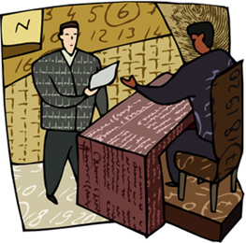
Executive Intervention
President
Reprieve
Temporarily postpones a sentence
Does not change the sentence
Does not forgive a crime
Courts
Stay of Execution
A court order
Temporarily suspends execution of a court judgment or other court order

Slide 12
Criminal Law
Prevents harm to society
Establish prohibited conduct
Includes the definitions of offenses, general principles, or criminal responsibility
Ex: murder, assault, and criminal trespass

Slide 13
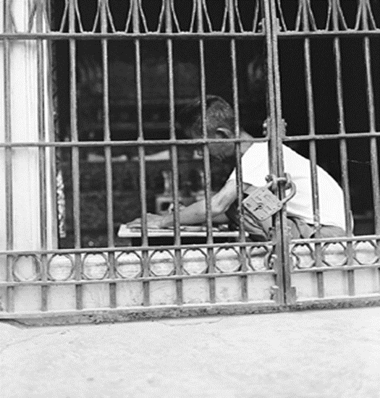
Criminal Law
Regulates conduct
Fines
Imprisonment
State brings charges
Level of Proof
Beyond a Reasonable Doubt
Judgment
Guilty
Not Guilty
Criminal Law Video

Slide 14
Civil Law
Defines the personal and property rights of individuals
The right of individual to seek redress or right to prevent a wrong
Any action other than criminal proceedings
Examples: divorce, child custody, injunctions, and personal damage

Slide 15
Civil Law
Actions by correctional staff can become civil liability actions commonly resulting in civil action:
Improper use of force
Wrongful death
Civil rights violations
Official misconduct
Sexual harassment
Discrimination
Defines the legal significance of public and private acts
Regulates conduct through injunctions and monetary damage awards
Level of proof required is usually Preponderance of Evidence but depends on what the injured party is asking for
The party found liable must compensate the wronged party
Verdict rendered by
Judge or
Jurors (5 out of 6, or 10 out of 12)

Slide 16
Changes Affecting Corrections
Civil lawsuits
Case law
Legislation
Societal views
Prison Policies
Financial Impact
Special Prison Populations

Slide 17
Civil Lawsuits
Alleged violations of civil rights or constitutional rights
Reviewed by a court
Judgment rendered
Action is taken to a remedy situation
Civil Rights Act 1983
Ruiz v. Estelle

Slide 18
Case Law
Ruffin v. Commonwealth, VA
Convicted felons forfeit liberty and personal rights
Only allowed laws afforded to humanity
1900s – offenders denied access to court for matters of treatment of imprisonment
1960s – constitutional protections apply to inmates
The Supreme Court rejected the “hands-off” approach

Slide 19
Legislation
Laws are added, changed, or deleted
Insanity Defense Reform Act of 1984
U.S. Federal Courts
Affirmative defense
A defendant with severe mental disease or deficits
Unable to understand the nature and quality of the wrongfulness of his acts
Mandatory sentencing guidelines
New laws enacted

Slide 20
Societal Views
1950s – scholars and the public understood that social influences play an important role in crime causation
Public scrutiny, along with state and national watchdog groups, affect sentencing, findings, and legislation

Slide 21
Prison Policies
Incidents that dictate a need for change
Riots
Contraband
Ex: cell phones
Hostage situations
Staff injury or death
Unethical behavior by staff

Slide 22
Financial Impact
Current trends indicate that an economic recession tends to increase the number of property crimes committed, which ultimately creates a greater need in the prison
Federal, state, and local budget cuts and increases
Lawsuits cost the government millions of dollars, which takes away from other services, programs, etc.
Example: Ruiz v. Estelle lasted over a decade and major changes had to be implemented in the Texas prison system. This lawsuit overhauled the entire Texas prison system

Slide 23
Special Prison Populations
Young offenders
Violent offenders
Gang members
The Elderly
Mentally ill/handicapped
Serious medical conditions
Substance abusers
Homosexuals
Offenders with special needs, need to bring about a change to the way offenders are treated, and the programs and services that are made available to them

Slide 24
Resources
020547893X, Criminal Justice, James A. Fagin, Pearson Education, 2006.
Freeman v. TDCJ http://www.gpo.gov/fdsys/pkg/USCOURTS-txnd-7_12-cv-00085/pdf/USCOURTS-txnd-7_12-cv-00085-0.pdf
Texas Department of Criminal Justice http://www.tdcj.state.tx.us/death_row/dr_facts.html
www.deathpenaltyinfo.org/article.php?did=126&scid=13
http://www.laits.utexas.edu/txp_media/html/just/features/0505_01/ruiz.html
Do an Internet search for the following:
Ehow 6593493 policies impact criminal justice system
Comprehensive crime control act of 1984
US courts and prison reform Ruiz Estelle Helen Clark Molanphy
Answers topic stay of execution 2
Criminal law uslegal federal insanity defense reform act

