Slide 1
Geometry in Architecture
Lesson 1

Slide 3
Geometry in Architecture
I. Terms
a. Asymmetry – not equally distributed on either side of a central axis
b. Axis – a fixed line along which distances are measured or to which positions are referred

Slide 4
Geometry in Architecture
I. Terms
c. Balance – forms visually or physically distributed to establish a state of harmony or equilibrium
d. Basic form – general shape created by the major elements of a building

Slide 5
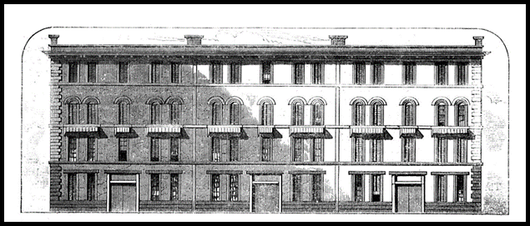
Geometry in Architecture
I. Terms
e. Bay – a vertical organization of elements in a building which is repeated horizontally
f. Compatible – different shapes/forms used harmoniously within the context of a structure

Slide 6
Geometry in Architecture
I. Terms
g. Elevation – any of the sides of a building
h. MFormal – marked by form or ceremony
i. Geometric – relating by measurement and pattern of individual shapes

Slide 7
Geometry in Architecture
I. Terms
j. Informal – not according to prescribed forms
k. Line – visual expression of direction or movement
l. Pattern – configuration of elements or characteristics

Slide 8
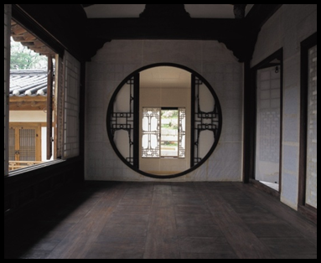
Geometry in Architecture
I. Terms
m. Proportion – relationship of a part to a whole or to another part
n. Symmetry – referring to parts that are the same on either side of a central axis

Slide 9
Geometry in Architecture
I. Terms
o. Tension – any strained relationship between elements
p. Texture – character of a building’s surface as determined by the degree of smoothness or roughness
q. Tripartite – made up of or divided into 3 parts

Slide 10
Geometry in Architecture
II. Two dimensional shapes
Triangle
Circle
Square

Slide 11
Geometry in Architecture
III. Three dimensional solids
Cone
Pyramid
Sphere
Cylinder
Cube

Slide 12
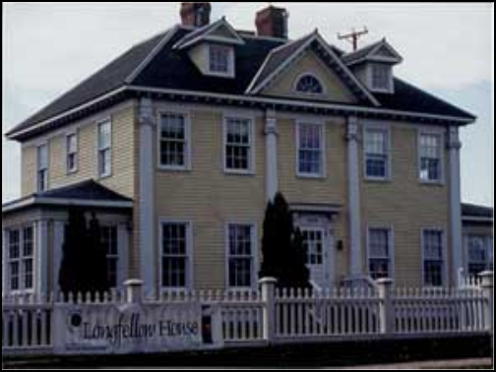
Geometry in Architecture
IV. Apply terms to the existing structures
*88 Wood Street – asymmetry, basic form
Longfellow house – formal, symmetry

Slide 13
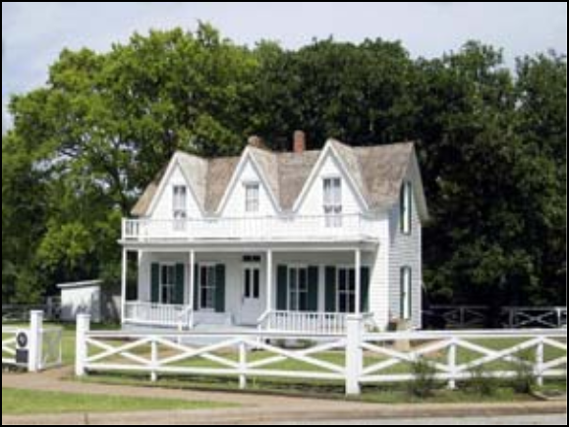
Geometry in Architecture
IV. Apply terms to the existing structures
Eisenhower birthplace – tripartite, proportion

Slide 14
Geometry in Architecture
IV. Apply terms to the existing structures
*Church of san Spirito – axis, balance
*Dome of the Rock – pattern, texture
*Robie House – line
*Isaac Bell House – compatible shapes

Slide 15
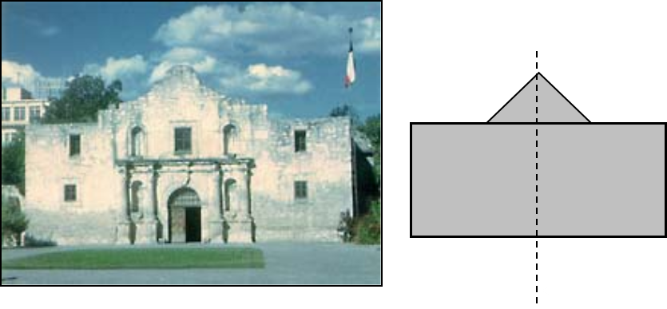
Geometry in Architecture
V. Analyze relationships between geometric elements
The Alamo
Axis of Symmetry

Slide 16
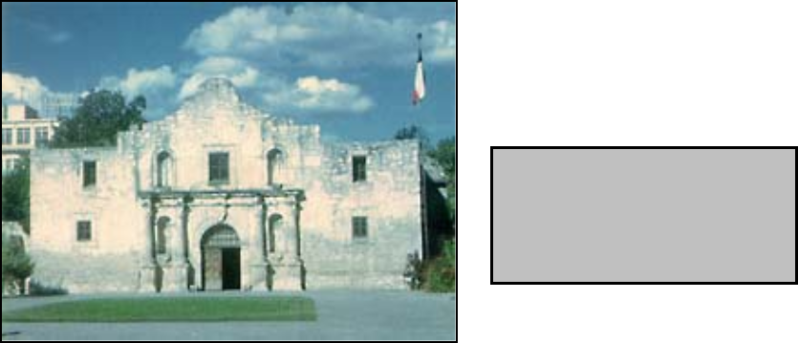
Geometry in Architecture
V. Analyze relationships between geometric elements
The Alamo
Basic form

Slide 17
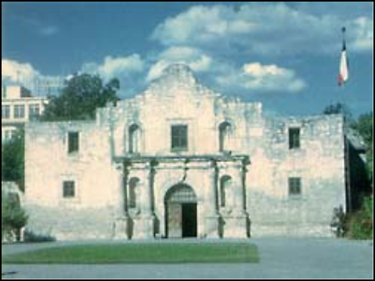
Geometry in Architecture
V. Analyze relationships between geometric elements
The Alamo
Balance

Slide 18
Geometry in Architecture
V. Analyze relationships between geometric elements
The Alamo
Formal

Slide 19
Geometry in Architecture
V. Analyze relationships between geometric elements
The Alamo
Pattern

Slide 20
Geometry in Architecture
V. Analyze relationships between geometric elements
The Alamo
Proportion

Slide 21
Geometry in Architecture
V. Analyze relationships between geometric elements
The Alamo
Tripartite

Slide 22
Geometry in Architecture
V. Analyze relationships between geometric elements
*Sta. Maria Novella
Axis
Balance
Basic form
Formal

Slide 23
Geometry in Architecture
V. Analyze relationships between geometric elements
*Sta. Maria Novella
Pattern
Proportion
Symmetry
Tripartite

Slide 24
Geometry in Architecture
VI. Diagram facades of structures using geometry – Sketch of relationships analyzed in step V.
The Alamo
Axis
Balance
Basic form
Formal

Slide 25
Geometry in Architecture
VI. Diagram facades of structures using geometry – Sketch of relationships analyzed in step V.
The Alamo
Pattern
Proportion
Symmetry
Tripartite

Slide 26
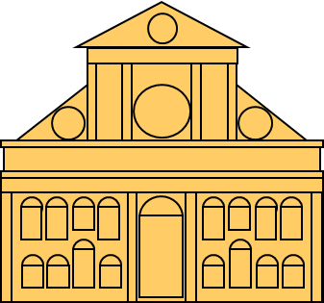
Geometry in Architecture
VI. Diagram facades of structures using geometry – Sketch of relationships analyzed in step V.
*Sta Maria Novella
Axis
Balance
Basic form
Formal

Slide 27
Geometry in Architecture
VI. Diagram facades of structures using geometry – Sketch of relationships analyzed in step V.
*Sta Maria Novella
Pattern
Proportion
Symmetry
Tripartite

