Slide 1
Infection Control in Correctional Facilities

Slide 3
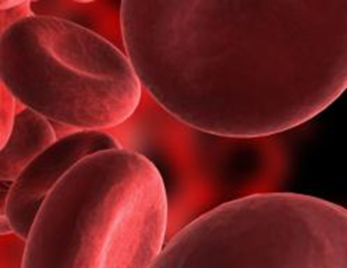
Blood-Borne Pathogens
  Diseases transmitted through
    Blood
    Semen
    Vaginal secretions
    Amniotic (birth) fluid
    Other internal body fluids
  Caused by viruses

Slide 4

Blood-Borne Pathogens
  Are NOT found in:
    Tears
    Sweat
    Urine
    Feces
    Nasal secretions
    Sputum
    Vomit
    Saliva
  Any unknown bodily fluids should be treated as infectious.

Slide 5

Blood-Borne Pathogens
  Human Immunodeficiency Virus (HIV)
  Attacks the immune system
  Weakens victims until they become unable to fight off even minor infections
  Once the immune system is severely weakened, the victim is said to have AIDS
  Human Immunodeficiency Virus (HIV)
  Death is usually caused by opportunistic infections (cancer, pneumonia, and others)
  Progresses very slowly
  Early signs and symptoms are easily missed
  There is no cure

Slide 6
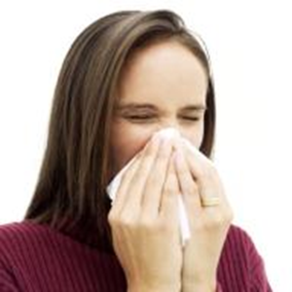
Blood-Borne Pathogens
  Human Immunodeficiency Virus (HIV)
  Symptoms:
    Early signs can be flu-like symptoms, six weeks to three months after infection
    Contract illnesses that do not normally affect the general population

Slide 7
Blood-Borne Pathogens
  Human Immunodeficiency Virus (HIV)
  Symptoms:
    Later stages of HIV and AIDS may include:
    Chronic yeast infections or thrush (yeast infection of the mouth)
    Fever and/or night sweats
    Easy bruising
    Bouts of extreme exhaustion
    Unexplained body rashes
    Appearance of purplish lesions on the skin or inside the mouth
    Sudden unexplained weight loss
    Chronic diarrhea lasting for a month or more

Slide 8
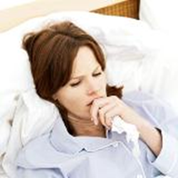
Blood-Borne Pathogens
  Human Immunodeficiency Virus (HIV)
  Symptoms:
    Kaposi's Sarcoma
    Pulmonary tuberculosis
    Candiasis of the esophagus, trachea, bronchi or lungs
    Toxoplasmosis of the brain
    Severe bacterial infections
    Invasive cervical cancer
    Lymphoma
    Recurrent pneumonia

Slide 9
Blood-Borne Pathogens
  Hepatitis B Virus (HBV)
  Attacks and damages the liver
  The liver is necessary for survival
  95% of victims recover with no permanent liver damage
  Symptoms may last for several months and may include:
    Fatigue
    Jaundice
    Enlarged liver
  About 5% of HBV infections become chronic

Slide 10
Blood-Borne Pathogens
  Hepatitis C Virus (HCV)
  Also attacks and damages the liver
  About 80% of HCV infections become chronic
  Approximately 20% of HCV infections result in
    Cirrhosis of the liver or
    Liver cancer leading to liver failure
  Two results
    A liver transplant or
    Death

Slide 11
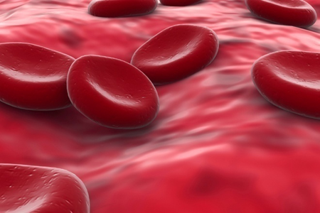
Blood-Borne Pathogens
  Route of Transmission
  Cause infection by entering the bloodstream
  Transmitted through contact with
    Blood
    Other possible infectious material
    Broken skin or
    Mucus membranes

Slide 12
Blood-Borne Pathogens
  Route of Transmission
  Mucus membranes are the lining areas of the body not covered by skin
  Include:
    Membrane inside the eyelid that surrounds the eye
    Inside of the nose or mouth
    Inside of the penis, vagina, or rectum
  Are very porous, allowing viruses to enter the body
  Some risk created by the prolonged exposure of these fluids with unbroken skin

Slide 13

Blood-Borne Pathogens
  Route of Transmission
  Typical methods of infection are caused by direct exposure through:
    Unprotected sex
    Needle sticks
    Improper handling or splashes of infected body fluids onto broken skin and/or mucus membranes

Slide 14

Blood-Borne Pathogens
  Prevention
  Replace personal protective equipment when it is damaged
  Clean and disinfect when it is dirty or contaminated
  Ensure that spills of blood or other personal infectious material are cleaned immediately

Slide 15
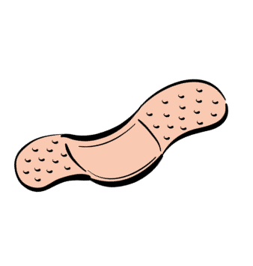
Blood-Borne Pathogens
  Prevention
  Cover broken skin with bandages (or other barriers)
  Avoid inadvertent contact of these areas with contaminated fluids and items
  Treat bandages as a part of your uniform
  Use them routinely for even the smallest cuts
  Cover larger areas with dressings
  Cover dry, cracked skin
  Liquid bandages work well for large areas of cracked skin or large abrasions

Slide 16


Blood-Borne Pathogens
  Prevention
  Needle sharing is the number one method of HCV infection. Any item contaminated with blood or other possibly infectious material is a potential source of infection including:
    Razors
    Toothbrushes
    Other sharp items
  Don’t share needles of any kind.

Slide 17


Blood-Borne Pathogens
  Prevention
  Avoid contact with possibly infectious body fluids through:
    Abstinence
    Monogamy
    Limiting the number of sexual partners
    Using barrier devices such as dental dams or condoms to prevent the direct contact of these fluids with the mucus membranes and skin.

Slide 18
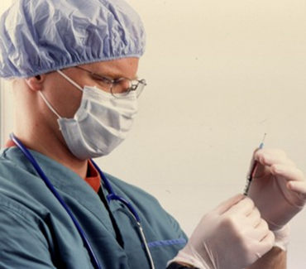
Blood-Borne Pathogens
  Precautions
  Vaccinations
    BV vaccination will prevent HBV infection.
    There is no vaccination for HCV or HIV.
  A good rule of thumb is to assume that all persons are infected.
  Use personal protective equipment
    Gloves
    Face shields
    Face Masks

Slide 19
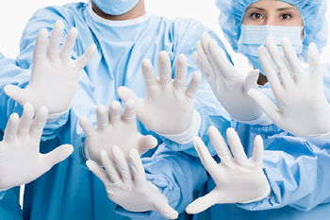
Blood-Borne Pathogens
  Precautions
  Gloves
    Barriers for your hands
    Prevent blood from entering your body through breaks in your skin
    Remove carefully so that the exterior of the glove doesn’t come into contact with your skin
    Always wash your hands after removing your gloves!

Slide 20

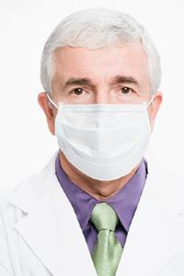
Blood-Borne Pathogens
  Precautions
  Face Shields
    Protect the mucus membranes of the face, and any broken skin on the face, from splashes
    Visors, goggles, and glasses
  Precautions
  Face Masks
    There are types of face masks:
    Surgical-style prevent you from inhaling contaminants.
    Most have a bendable nosepiece and an adjustable elastic strap.
    A CPR mask is used to give breaths while doing CPR.

Slide 21
Blood-Borne Pathogens
  Treatment
  Occupational Exposure – reasonable, anticipated skin, eye, mucous membrane, or parenteral contact with blood or other potentially infectious materials that may result from the performance of an employee’s duties.
  Parenteral – piercing mucous membranes or the skin through such events as needle sticks, human bites, cuts, and abrasions.
  Whenever an occupational exposure has occurred, you must know what to do.

Slide 22
Blood-Borne Pathogens
  Treatment
  Remove the blood or possibly infectious material.
  Wash the affected area immediately. Flush the eyes, nose, or mouth with clean water.
  Seek first aid or medical treatment, if necessary.
  Let the medical staff determine if you have been occupationally exposed. Time is of the essence. If preventive action for HIV is required, it is best to start within two hours of exposure.

Slide 23
Blood-Borne Pathogens
  Treatment
  Ensure the area is cleaned to prevent others from being exposed.
  If a supervisor or coworker is available, let them see what happened, but don’t delay cleaning the area or seeking medical attention to let someone witness what happened.
  Report the incident to your supervisor as soon as possible.
  Get a baseline blood test done within ten days for any future workman’s compensation claims.

Slide 24
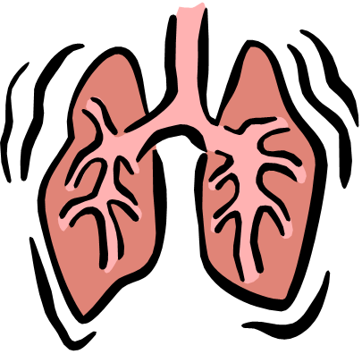
Tuberculosis
  Tuberculosis (TB) is an infectious disease caused by bacteria, unlike the blood-borne pathogens which are caused by viruses. TB is a potentially lethal infection of the lungs, although it infects other parts of the body on rare occasions.

Slide 25
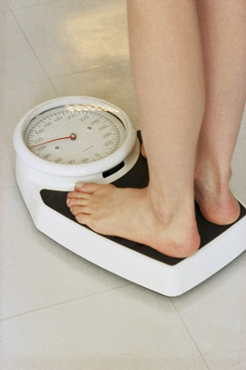
Tuberculosis
  Symptoms
  Common cough with a progressive increase in production of mucus
  Coughing up blood
  Fever
  Loss of appetite
  Weight loss
  Night sweats
  Sharp pain in the chest when breathing deeply or coughing

Slide 26
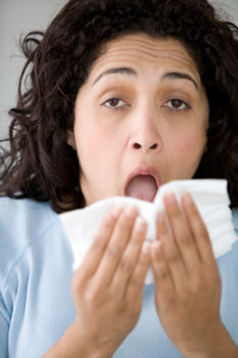
Tuberculosis
  Routes of Transmission
  Spread by inhaling particles containing the bacteria.
  The particles are caused by coughing, sneezing, or speaking to someone in the infectious stage of the disease.

Slide 27
Tuberculosis
  Prevention
  Infection can be prevented by not inhaling the bacteria.
  Keep your immune system strong. Many times the body is able to fight off TB exposures.
  A person should wear a surgical mask when in close contact with an infected person.
  Infected persons must wear a mask when being transported outside of isolation, either in a hospital room or a secluded cell area.

Slide 28
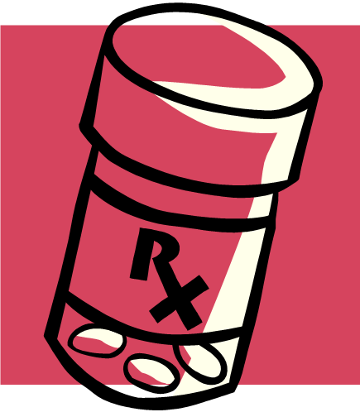
Tuberculosis
  Treatment
  Medication

Slide 29
Methicillin Resistant Staphylococcus Aureus
  Methicillin Resistant Staphylococcus Aureus (MRSA)
    Is the common name for bacteria staph
    Refers to particular strains of this bacterium that have become resistant to the most common antibiotics used to treat them
    Is potentially more dangerous and difficult to treat than a typical staph infection
    Typically infects wounds, and is therefore most often seen in skin infections
    Can infect other parts of the body, including the blood, which can be deadly
  The strain of MRSA that is predominant in the Texas Department of Corrections still responds to several antibiotics.

Slide 30

Methicillin Resistant Staphylococcus Aureus
  Symptoms
  Small red bumps that resemble pimples, boils, or spider bites
  Shortness of breath
  Fever
  Cough
  Chills

Slide 31


Methicillin Resistant Staphylococcus Aureus
  Routes of Transmission
  Transmitted by wounds that allow the bacteria access to the body.
  Comes from direct contact, as the bacteria is not airborne.
  The most common way for the bacteria to enter the body is through the hands.
  Sharp items could also be contaminated, and transfer into the body when a person gets cut.

Slide 32
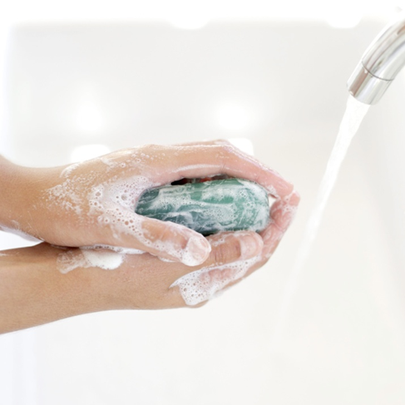
Methicillin Resistant Staphylococcus Aureus
  Prevention
  Frequent hand washing helps prevent the disease, since the hands are the most common route of infection.

Slide 33
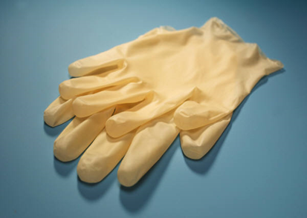
Methicillin Resistant Staphylococcus Aureus
  Precautions
  You should wear gloves whenever they might come in contact with another person’s wounds, sores, or wound dressings and bandages.
  You should use a new pair for each offender so that you do not contribute to the spread of MRSA by passing bacteria from one offender to another.

Slide 34
Methicillin Resistant Staphylococcus Aureus
  Precautions
  Cover any wounds or breaks in your own skin with bandages to protect them from the bacteria.
  Antibiotic ointments are effective in preventing infection in small wounds.
  Remove possible sources of infection.

Slide 35
Methicillin Resistant Staphylococcus Aureus
  Precautions
  Have all offenders dispose of soiled dressings and bandages properly.
  Ensure that disinfection procedures are strictly followed to prevent the spread of bacteria in:
    Barber shops
    Laundries
    Food services
    Housekeeping
Treatment
  Medication

Slide 36
Resources
  Texas Department of Criminal Justice http://www.tdcj.state.tx.us/

