Slide 1
Interpersonal Skillls

Slide 3
Personal Traits
  Personal ethics
  Creativity, initiative, and responsibility
  Attitude
  Self-control/orderliness
  Self-awareness and willingness to change
  Self-esteem
  Empathy

Slide 4
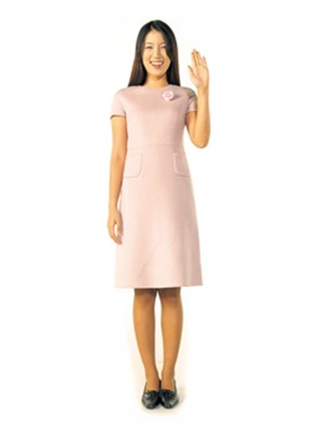
Personal Ethics
  Honesty
  Integrity
  “Play fair”

Slide 5
Creativity, Initiative, and Responsibility
  Find new ways to do your job (cuts boredom)
  Do what needs to be done without being told
  Be accountable for your actions

Slide 6

Attitude
  Develop a positive attitude
  View difficult assignments as a challenge
  Positive attitude flows over into other areas

Slide 7
Self-Control/ Orderliness
  Tactfulness…what does it mean?
  A must when dealing with difficult customers

Slide 8
Self-Awareness and Willingness to Change
  Make a list of strengths and weaknesses
  You may think you know everything!
  The first 100 years are the hardest
  Adaptable employees are valuable

Slide 9

Self-Esteem
  The way you see your self (your value)
  Demonstrate self-esteem on the job by showing confidence in your work
  Build customers’ self-esteem, too
    Call them by name if possible
    Smile and greet them

Slide 10

Empathy
  Understand another’s situation or frame of mind
  Put oneself in another’s place

Slide 11
Personal Skills
  Assertiveness
    Stand up for yourself, but do not be pushy
    Do not boss others
    Make sure you know what you are talking about
  Time Management
    Budget your time
    Do not over-commit yourself or you will regret it
    Sometimes “no” is okay

Slide 12

Goal Setting
  What do you want out of…
    Life
    Career
    Personal relationships
  Where do you plan to be in ____ years?
  Continue to ask yourself this question!

