Slide 1
INTRODUCTION TO MICROBIOLOGY

Slide 3
MEDICAL MICROBIOLOGY
WHAT IS MEDICAL MICROBIOLOGY?
WHO STUDIES MEDICAL MICRO?
WHY DO WE STUDY IT?
WHERE DO WE STUDY IT?
WHAT KNOWLEDGE WILL A STUDENT GAIN TAKING THIS COURSE?

Slide 4
MEDICAL MICROBIOLOGY
Medical Microbiology is the study of microorganisms:
Bacteria
Fungus
Parasites
Viruses
Most can only be seen with the microscope!

Slide 5
MEDICAL MICROBIOLOGY
Medical Microbiology studies are usually performed on human blood and body fluids.
Medical Laboratory Technicians and Medical Laboratory Technologists perform the studies.
Education level: 2 yr. AAS or 4 yr BS

Slide 6
MEDICAL MICROBIOLOGY
Microorganisms can cause disease in humans.
Microbiologists determine the type of microorganism causing the disease and find a drug, usually an antibiotic, to inhibit the microorganism.
Microbiologists continue to study the microorganisms through research to determine new antibiotics.

Slide 7
MEDICAL MICROBIOLOGY
Microorganisms are studied in clinical hospital laboratories, reference laboratories, and research facilities.

Slide 8
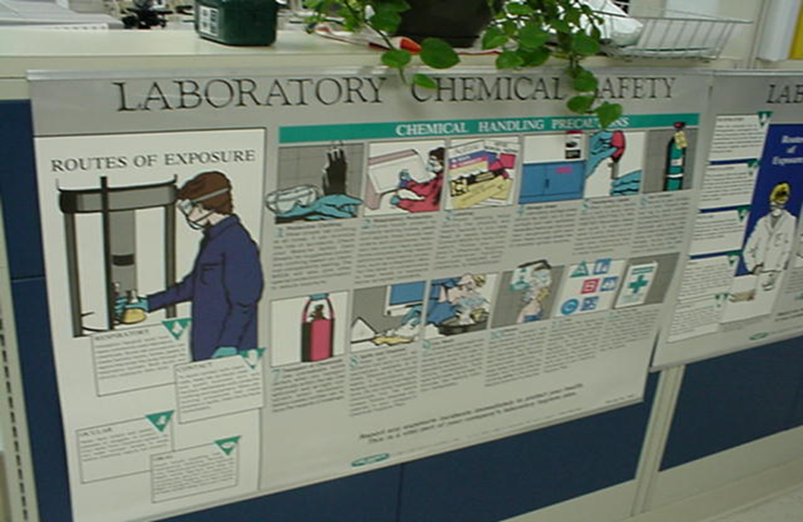
MEDICAL MICROBIOLOGY
All laboratories post signs regarding safety.

Slide 9
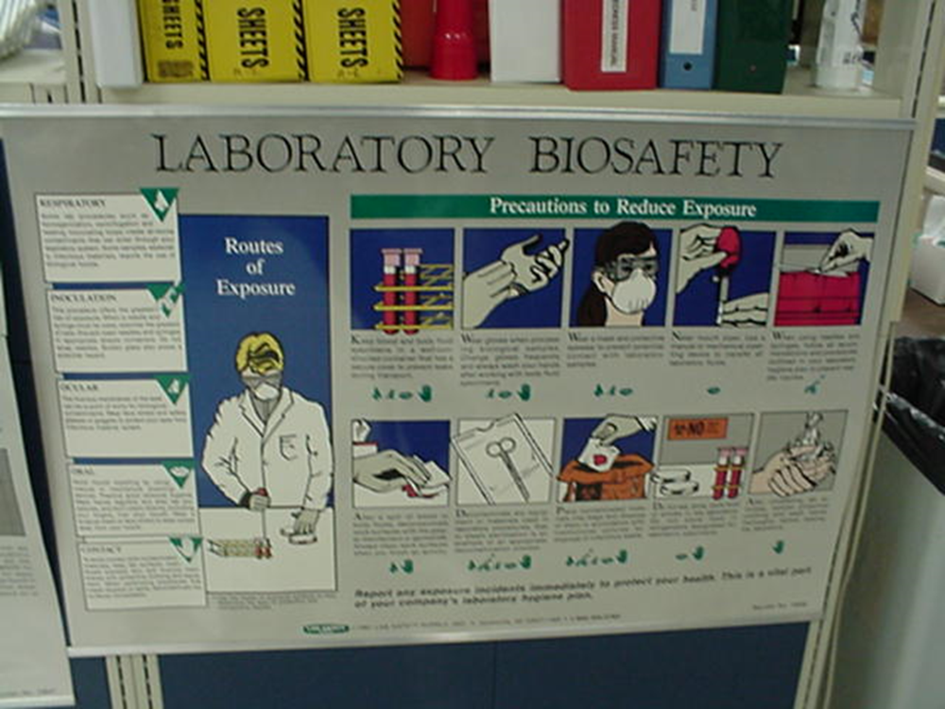
MEDICAL MICROBIOLOGY

Slide 10
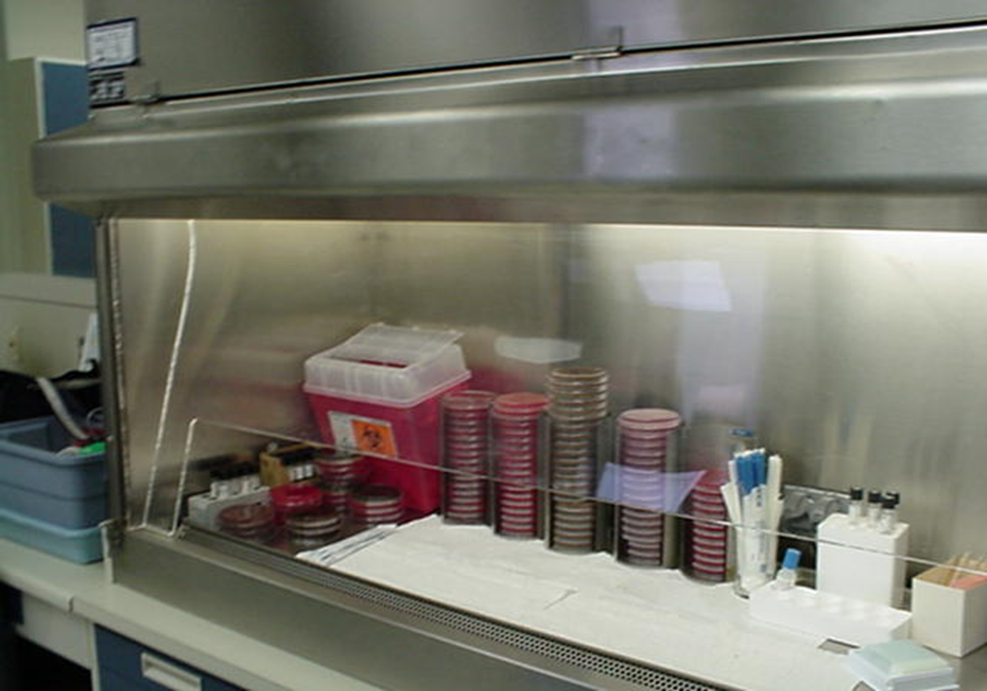
MEDICAL MICROBIOLOGY
Safety hoods are used to avoid splashing and inhaling possible pathogens.

Slide 11
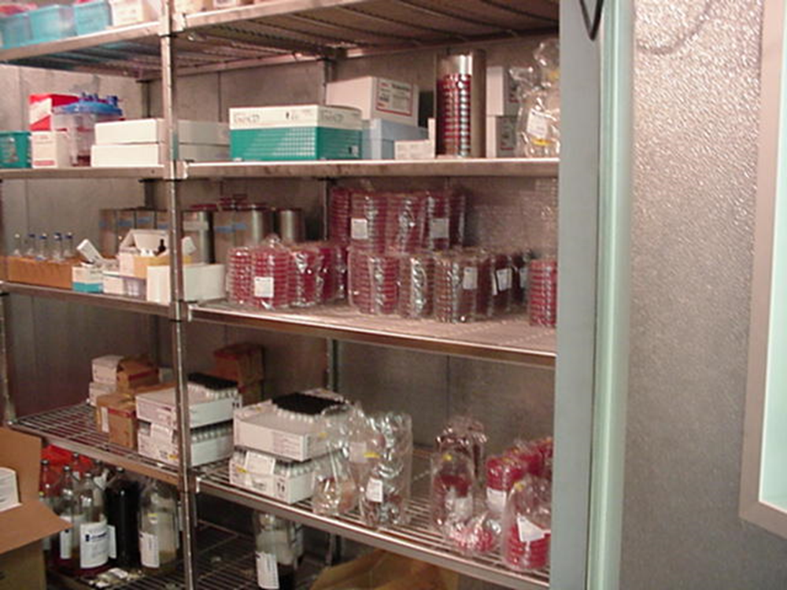
MEDICAL MICROBIOLOGY
A monitored refrigeration unit is essential for accurate results in microbiology.

Slide 12
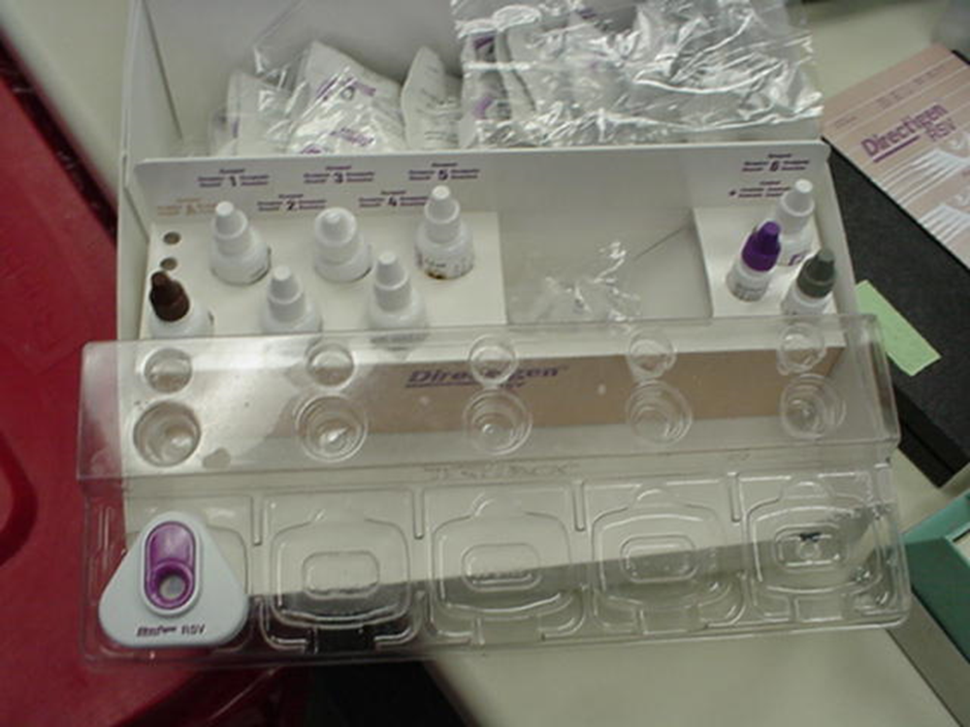
MEDICAL MICROBIOLOGY
Reagents, such as those used in this strep screen, aid in diagnosis of disease.

Slide 13
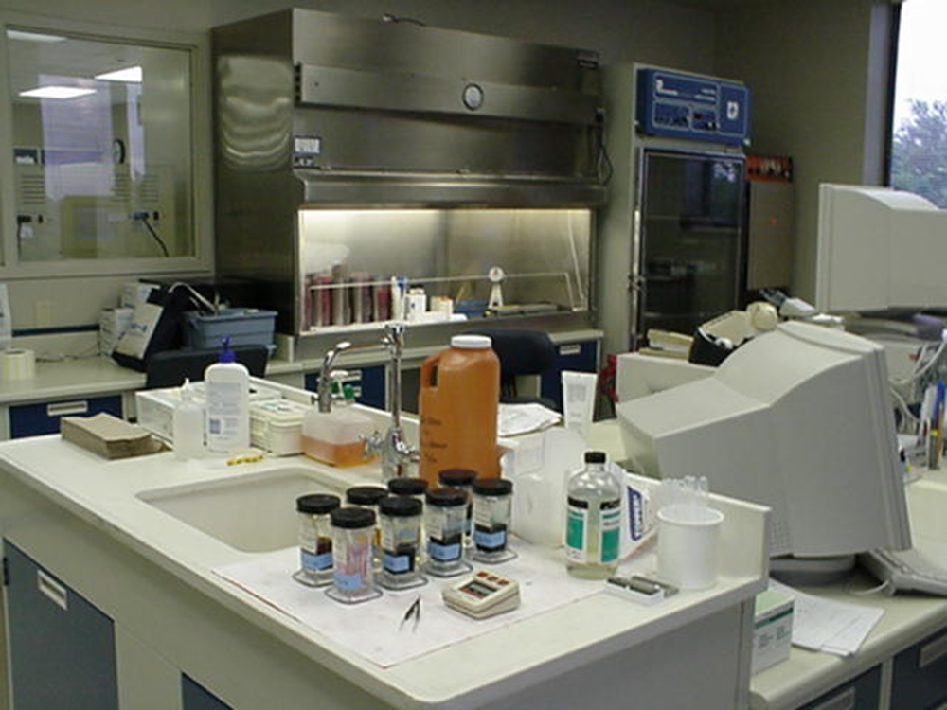
MEDICAL MICROBIOLOGY
A hospital microbiology laboratory

Slide 14
MEDICAL MICROBIOLOGY
Blood cultures are incubated and monitored electronically for bacterial and fungus growth.

Slide 15
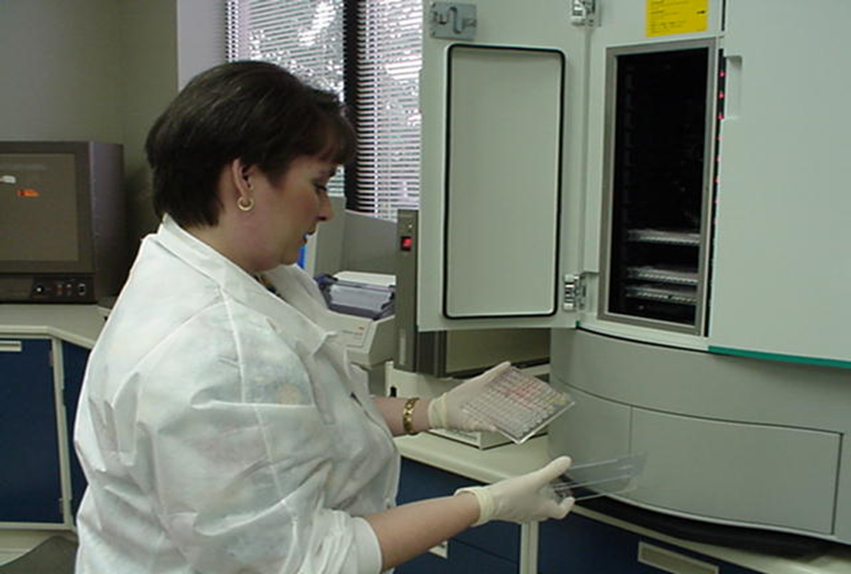
MEDICAL MICROBIOLOGY
High tech instruments are used to aid in the identification of microorganisms.

Slide 16
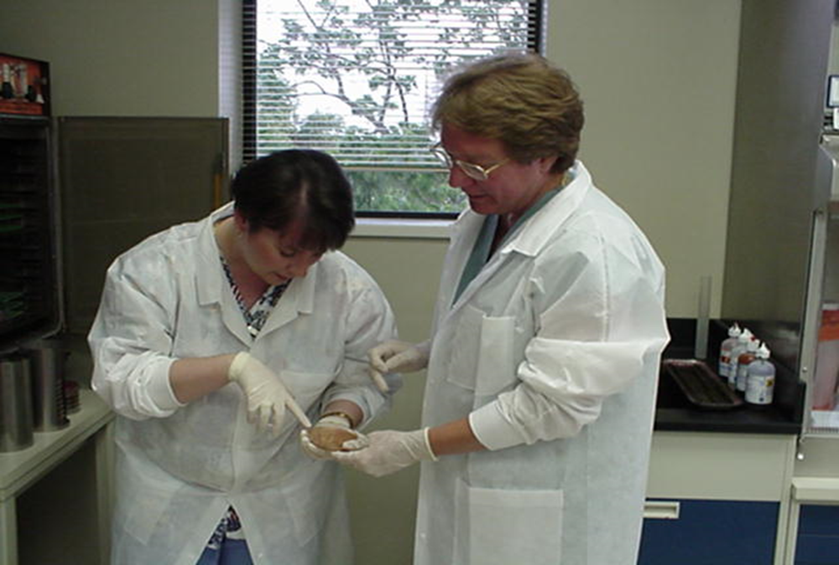
MEDICAL MICROBIOLOGY
Teamwork is essential in all types of laboratories, including the school laboratory.

Slide 17
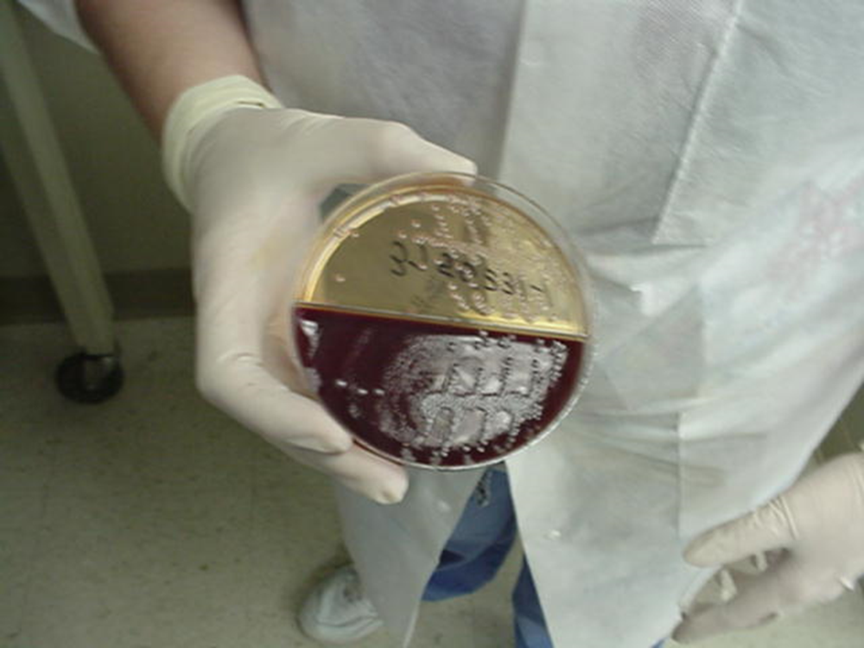
MEDICAL MICROBIOLOGY
What is growing on this agar plate?

Slide 18
MEDICAL MICROBIOLOGY
At the end of this course, you will gain knowledge in the following:
Normal flora of the human body
Microbiological disease states related to the human body
Media/Agar used to grow microorganisms
Biochemical reactions of microorganisms
Identification of microorganisms!

