Slide 1
Math for Manufacturing

Slide 3
Bell Work Activity
Answer the following questions on a sheet of paper.
  Calculate the sum of 1/2 + 1/4 =_______.
  Calculate the difference of 9.325 - 6.150 = _______.
Notes:
Use this exercise as an introduction to the Manufacturing Math Lesson by discussing how important it is to understand how to calculate basic math functions used in manufacturing.
Answers
3/4
3.175

Slide 4
Warm-Up Activity : Terms
There are several important terms and definitions students need to know.
  Complete Manufacturing Math Terms and Definitions.
  Students may work in groups.
Notes:
Webster’s new compact office dictionary (2003). New York, NY: Houghton Mifflin
Harcourt Publishing Co.
Definitions make a great warm-up activity.

Slide 5
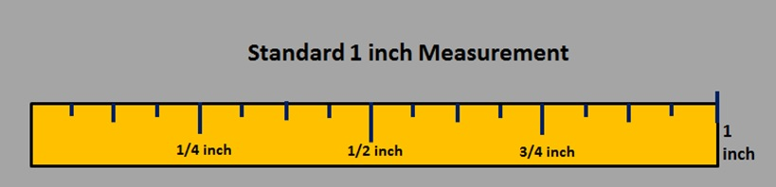
Using a Standard Measuring Ruler
The lines on this illustration represent the following measurements in sequence:
1/16, 1/8, 3/16, 1/4, 5/16, 3/8, 7/16, 1/2, 9/16, 5/8, 11/16, 3/4, 13/16, 7/8, 15/16, and 1 inch.
Notes:
The common, standard measurement system used in the United states is called the English Standard Measurement System. It was adopted from England in the 1800s. We continue to use it, despite the worldwide use of the metric system. The cost of full conversion to another system would be very expensive.
Discuss the increments on the example above. Ensure each student understands how to measure the length of an object.
Remind students that the increments are the same even if you are measuring multiple inches or feet. For example: 5 and 1/2 inches OR 2 feet, 2 1/4 inches.

Slide 6
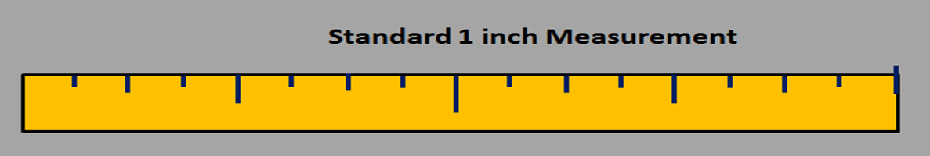
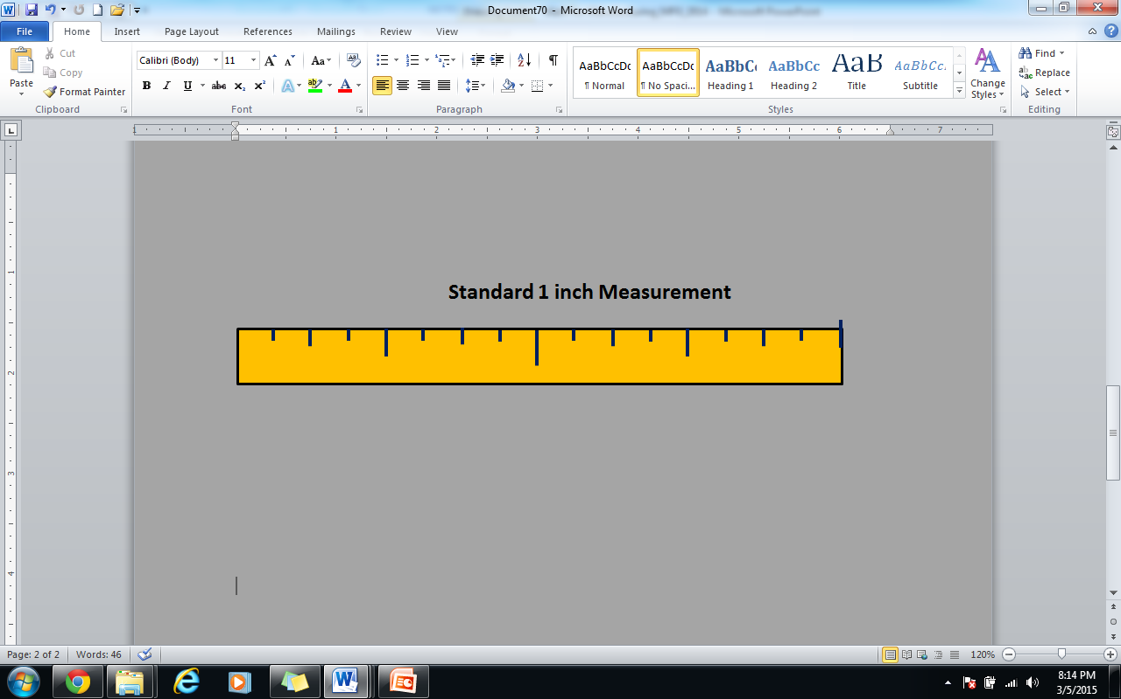
Using a Standard Measuring Ruler
A.
B.
C.
Notes:
Discuss the ruler measurements with the class. Ensure that they understand how to count the increments on the ruler.
A) 3/16
B) 3/8
C) 7/8

Slide 7

Calculating Fractions: Addition
Like Fractions
  $\frac{5}{2}$ + $\frac{4}{2}$ = $\frac{9}{2}$
Unlike Fractions
  $\frac{3}{4}$ + $\frac{7}{8}$ = $\frac{6}{8}$ + $\frac{7}{8}$ = $\frac{13}{8}$
Notes:
NOTE:
Discuss how theses problems are calculated.
Like fractions: Add the numerators and carry over the sum of the numerators over the like denominator.
For unlike fractions, we must simplify the fractions. Find the Least Common Multiple (LCM) for the denominators (4 and 8); 8 is the LCM. We can then say 4 into 8, two times, so 2 x 3 = 6; and then 8 into 8, one time, so 1 x 7 = 7. Then add the numerators, and carry over the like denominator.

Slide 8

Calculating Fractions: Addition
Like Fractions
  $\frac{5}{4}$ + $\frac{10}{4}$ = ______
Unlike Fractions
  $\frac{2}{9}$ + $\frac{1}{3}$ = ______
Notes:
Have student calculate these problems in class.
Answers
Like Fractions: 15/4 OR 3 and 3/ 4 (our first answer is an improper fraction). We get a proper fraction by dividing 15 by 4; 4 goes into 15 three times, which is 12; 3 is left over, so we carry the leftover number over the denominator (4) and rewrite the fraction as 3 ¾.
Unlike Fractions: 5/9

Slide 9

Calculating Fractions: Subtraction
Like Fractions
  $\frac{7}{13}$ - $\frac{4}{13}$ = $\frac{3}{13}$
Unlike Fractions
  $\frac{4}{5}$ - $\frac{5}{7}$ = $\frac{28}{35}$ - $\frac{25}{35}$ = $\frac{3}{35}$
Notes:
Discuss how theses problems are calculated.
Like Fractions: Subtract the numerators and carry the numerator difference over the like denominator.
Unlike fractions: We must simplify the fractions. Find the Least Common Multiple (LCM) for the denominators (5 and 7); 35 is the LCM. We can then say 5 into 35, seven times, so 7 x 4 = 28; and then 7 into 35, five times, so 5 x 5 = 25; We can then subtract the numerators 28 – 25 = 3; carry 3 over the like denominator 35 for the answer 3/35

Slide 10

Calculating Fractions: Subtraction
Like Fractions
  $\frac{7}{13}$ - $\frac{4}{13}$ = _____
Unlike Fractions
  $\frac{1}{2}$ - $\frac{3}{7}$ = _____
Notes:
Have students calculate these problems in class.
Answers
12/15
1/14

Slide 11
Calculating Decimals: Addition
Example
  5.275
+ 8.374
13.649
Practice Problems
  A) 4.162 B) 0.334 C) 6.476
+ 3.219 +4.375 +2.097
Notes:
When adding decimals, ensure the decimal point remains in place and use standard addition and carry over principles. Have students calculate the practice problems in class.
Answers
A) 7.381
B) 4.709
C) 8.573

Slide 12
Calculating Decimals: Subtraction
Example
  71.547
    - 60.894
  10.653
Practice Problems
  A) 15.536 B) 57.874 C) 89.365
- 12.234 - 45.309 - 72.631
Notes:
When subtracting decimals, ensure the decimal point remains in place and use standard subtraction and carry over principles. Have students calculate the practice problems in class.
Answers
A) 3.302
B) 12.565
C) 16.734

Slide 13
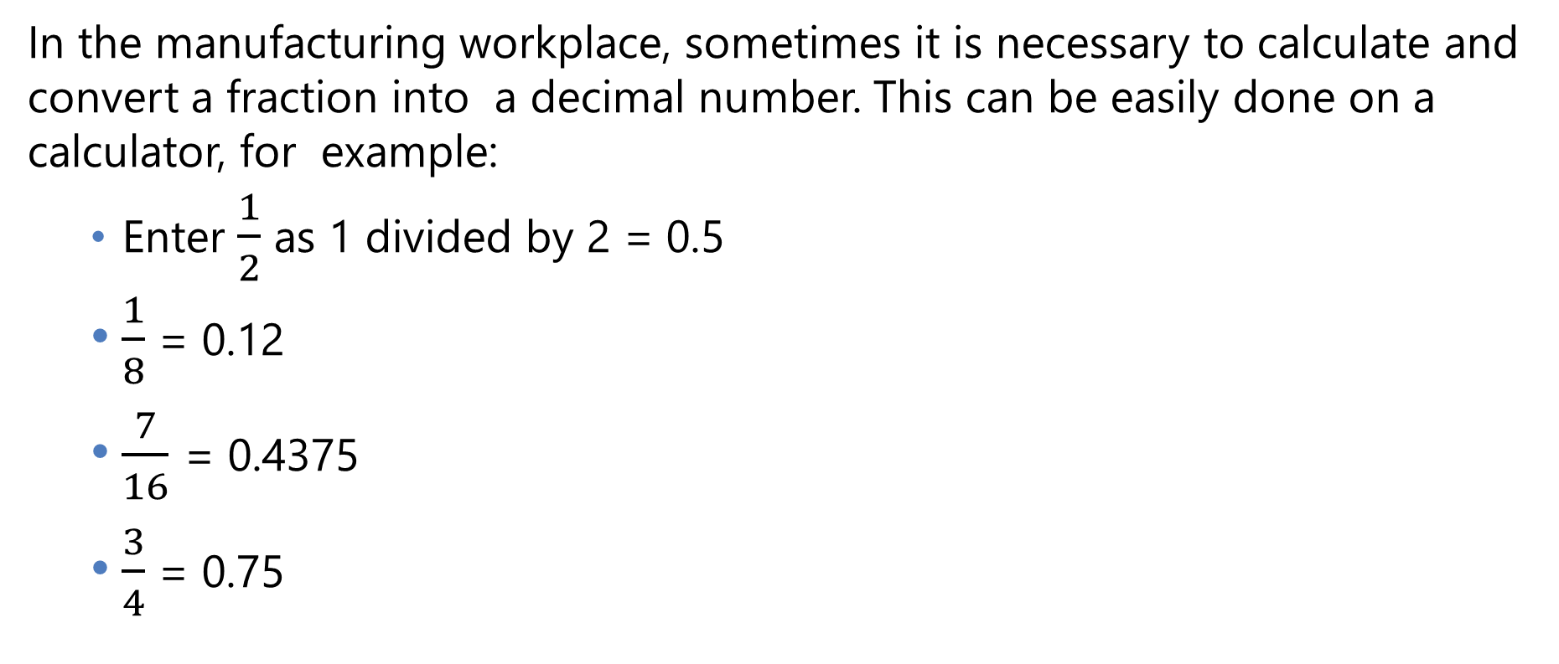
Converting Fractions to Decimals
In the manufacturing workplace, sometimes it is necessary to calculate and convert a fraction into a decimal number. This can be easily done on a calculator, for example:
    Enter $\frac{1}{2}$ as 1 divided by 2 = 0.5
    $\frac{1}{8}$ = 0.12
    $\frac{7}{16}$ = 0.4375
    $\frac{3}{4}$ = 0.75

Slide 14
Converting Fractions to Decimals
Calculate
  Find a number and multiply that number with the denominator of a fraction to make the denominator equal to 10, 100, 1000, or any 1 followed by 0s.
  Multiply both the numerator and the denominator by that number.
  Next, write down only the top number, put the decimal point in the correct spot (one space from the right hand side for every zero in the bottom number).

Slide 15

Converting Fractions to Decimals
Example
  $\frac{3}{4}$ x $\frac{25}{25}$ = $\frac{75}{100}$ = 0.75
Problems: Convert the fractions to decimals.
  $\frac{3}{8}$ = ____
  $\frac{11}{16}$ = ____
  $\frac{5}{8}$ = ____
Notes:
Answers to practice problems:
A) .375
B) .6875
C) .625

