Slide 1
Skeletal Pathology

Slide 3
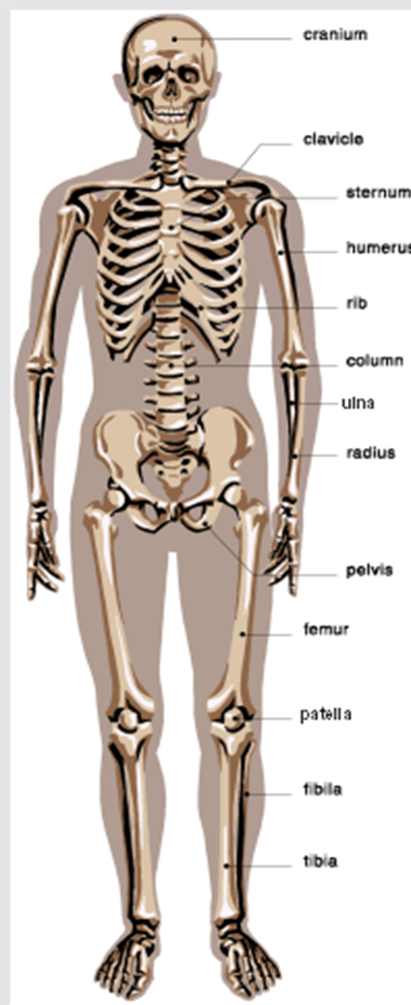
Skeletal system has 206 bones

Slide 4
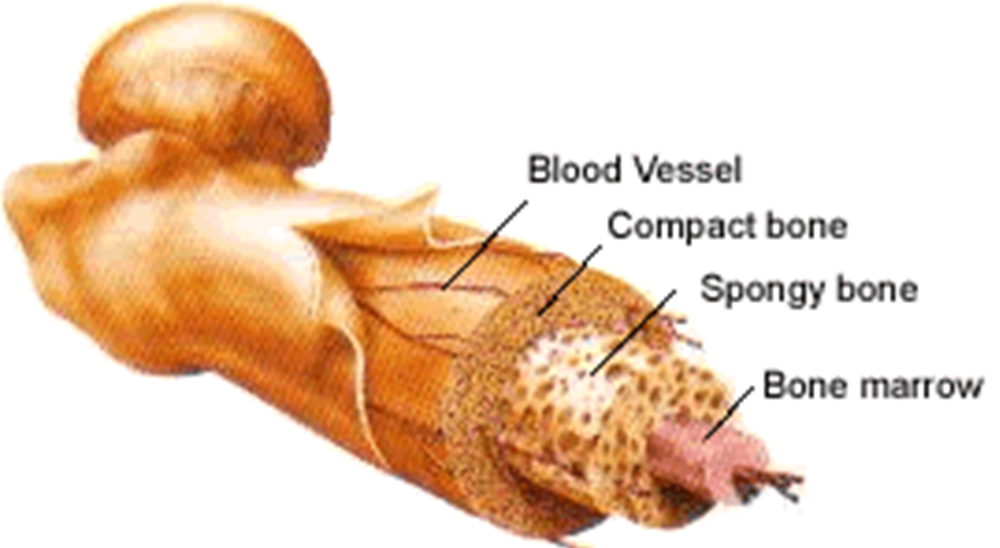
Anatomy of Bone

Slide 5
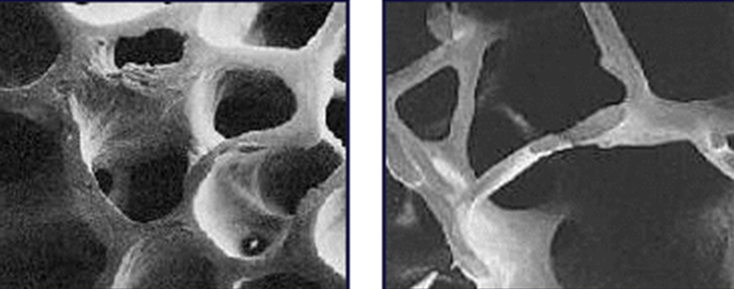
Osteoporosis-disease characterized by low bone mass & structural deterioration of bone tissue

Slide 6
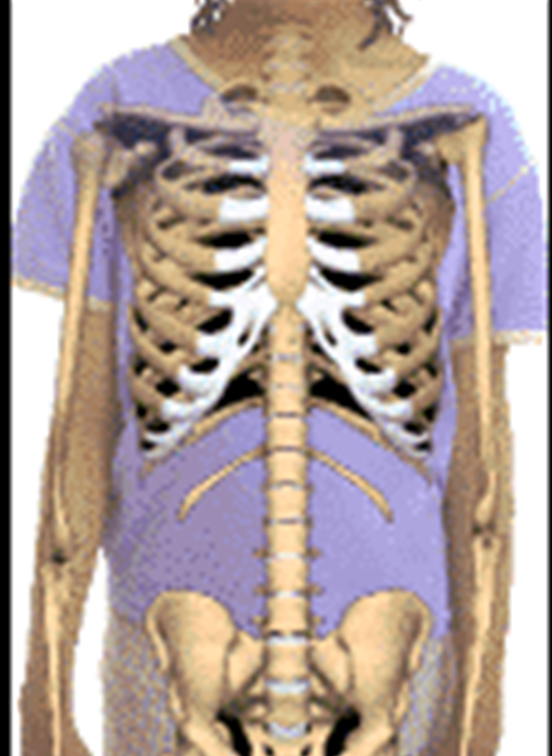
Skeletal pathology

Slide 7
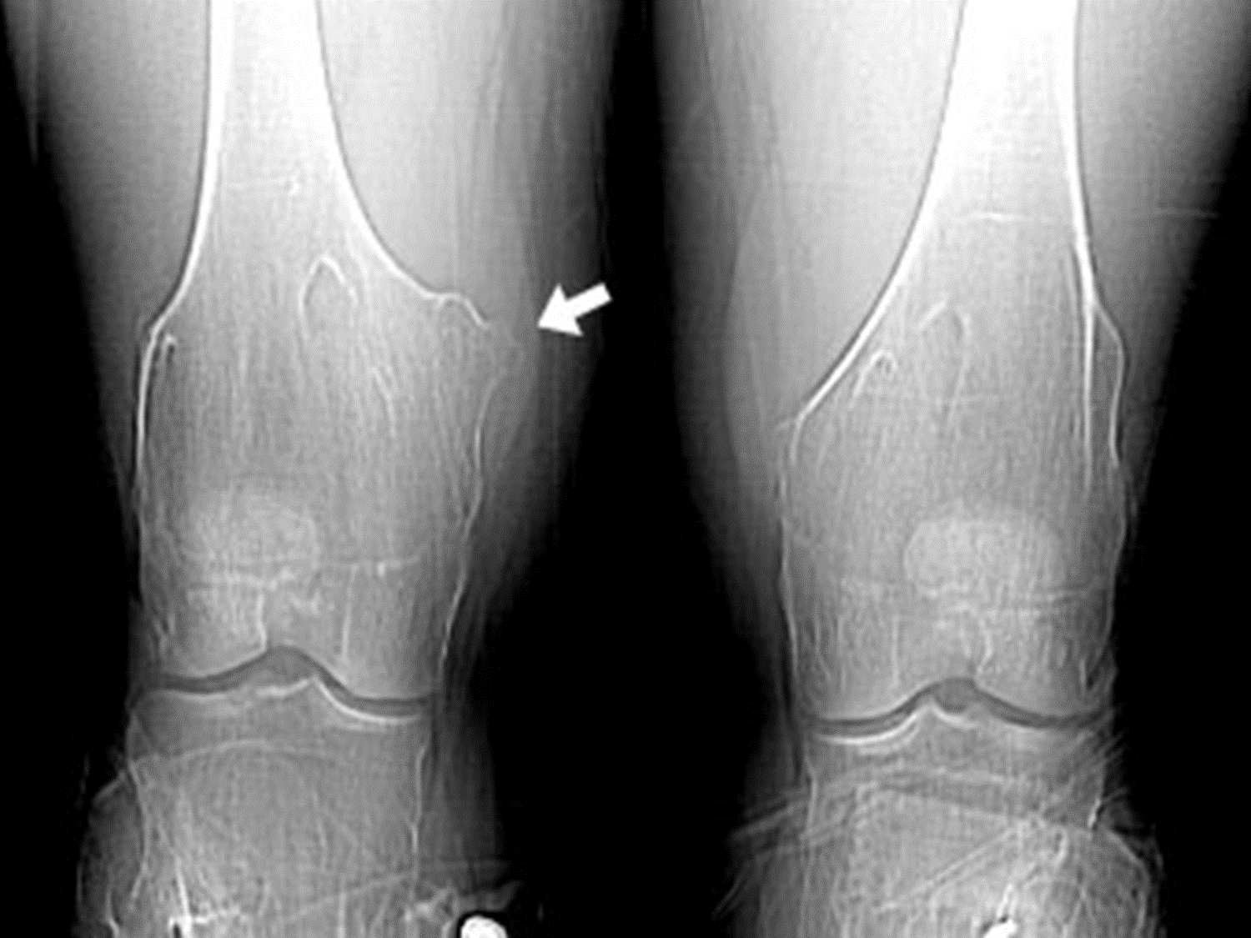


Slide 8
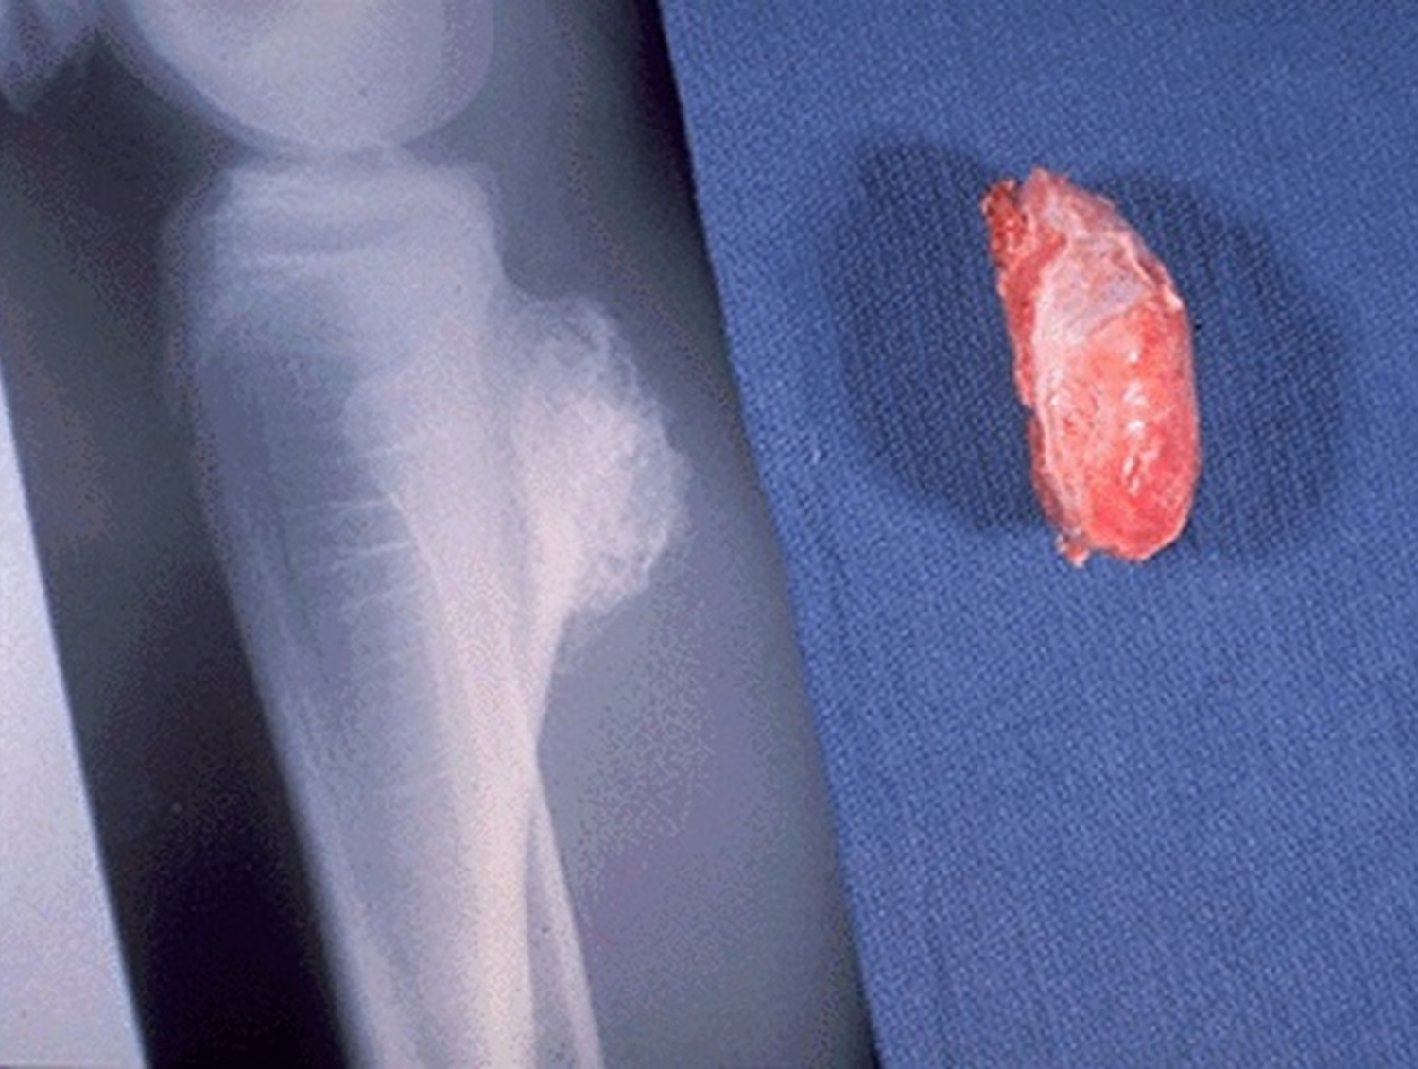
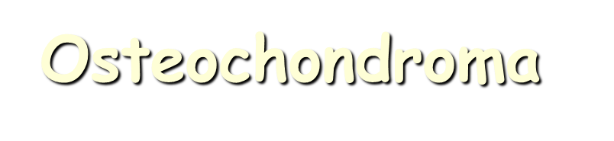
Notes:
This is an osteochondroma of bone. This lesion appears as a bony projection (exostosis). Most are solitary, incidental lesions that may be excised if they cause local pain. There is a rare condition of multiple osteochondromatosis marked by bone deformity and by a greater propensity for development of chondrosarcoma.

Slide 9
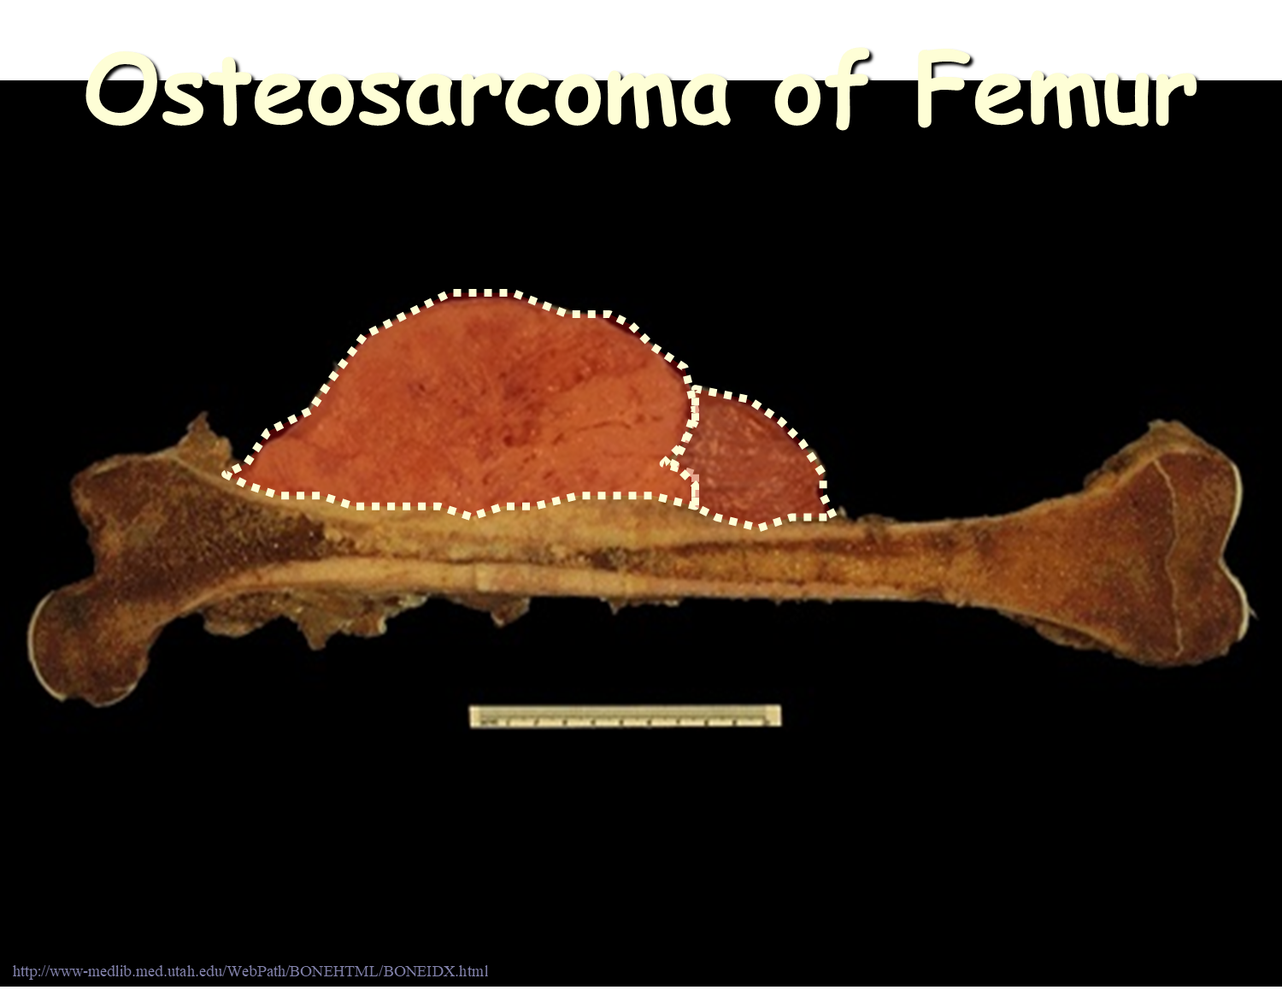
Notes:
This femur has a large eccentric tumor mass arising in the metaphyseal region. This is an osteosarcoma (a variant known as parosteal osteogenic sarcoma) of bone. These tumors most often occur in young persons (note that the epiphysis seen at the right is still present).

Slide 10
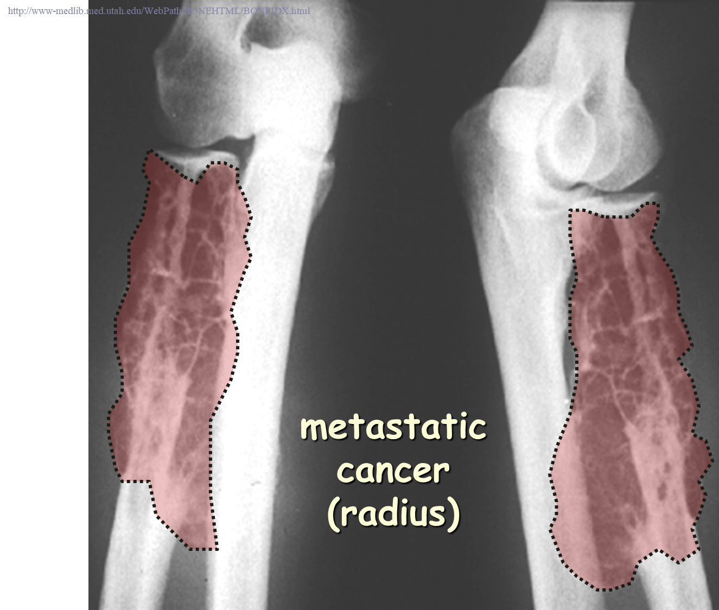

Slide 11
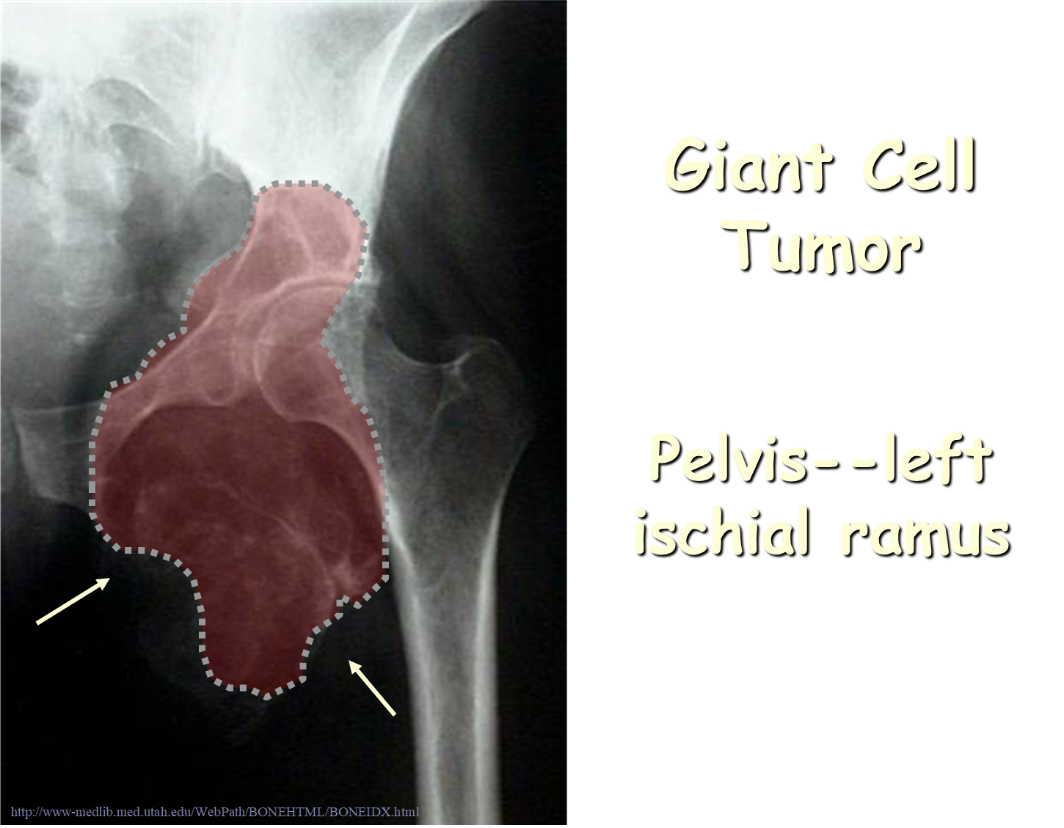

Slide 12
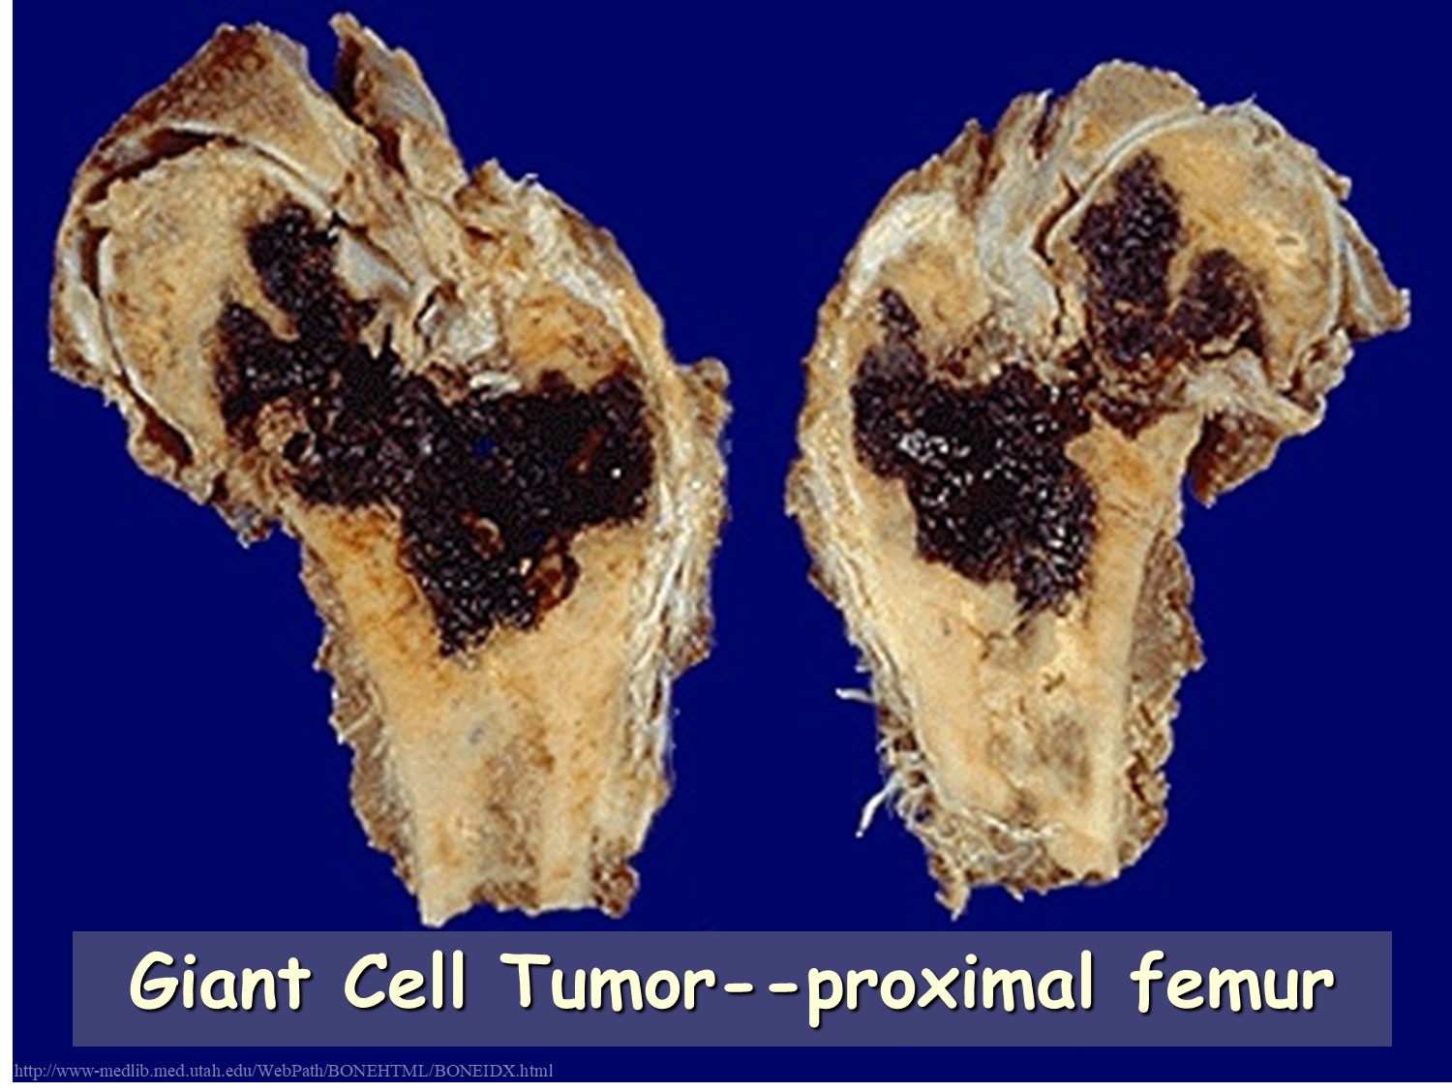
Notes:
Here is a giant cell tumor of bone. The proximal femur has been amputated and cut in half to reveal an irregular dark red-black hemorrhagic mass in the epiphyseal region. Giant cell tumors are lytic on radiography.

Slide 13
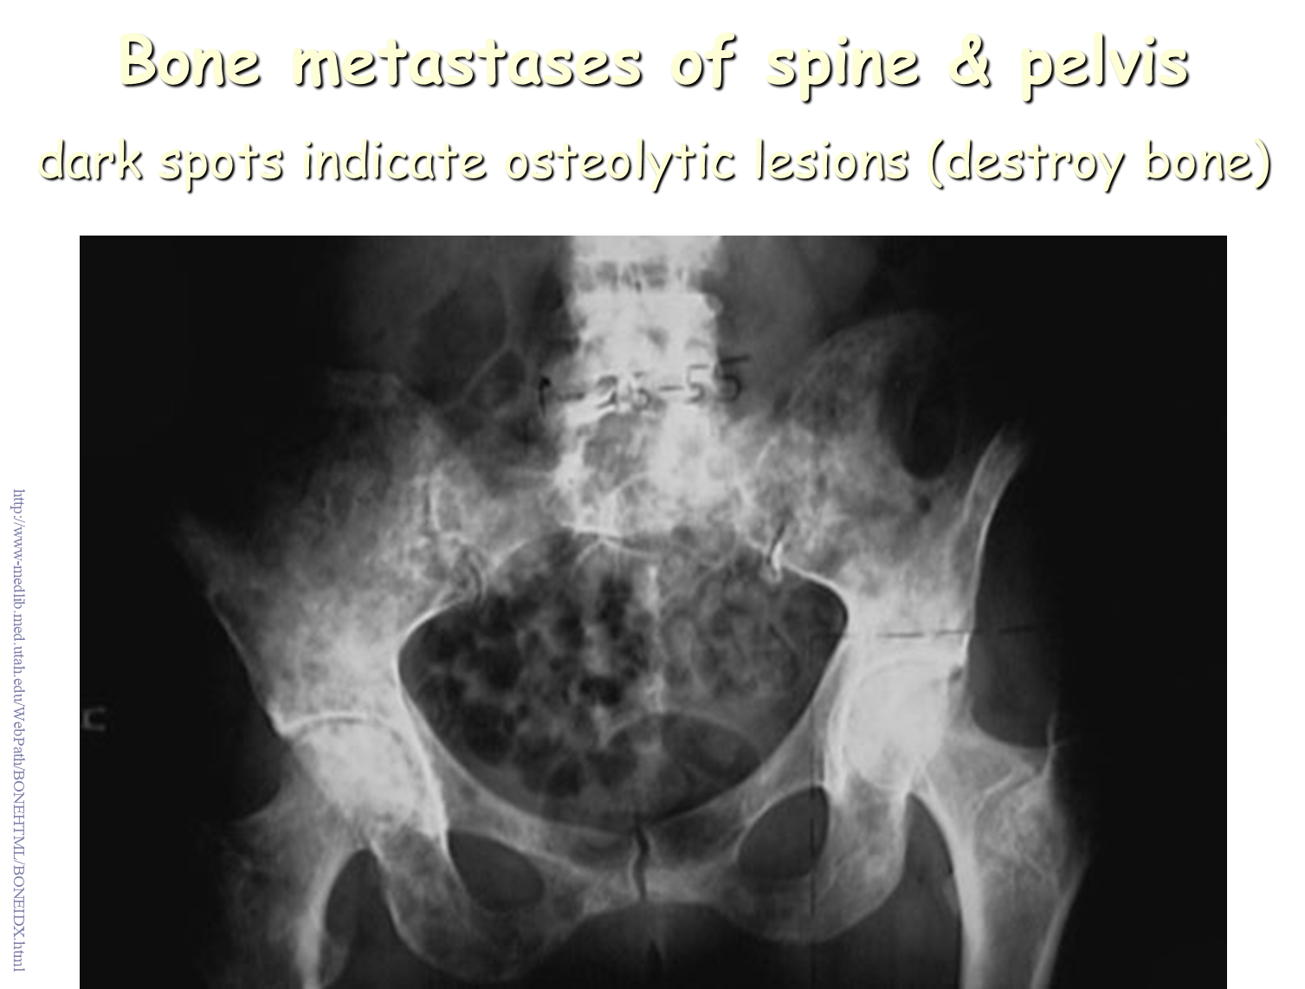
Notes:
Here is a closer view of bone metastases. Virtually all bone metastases are from carcinomas. The primary sites of carcinomas that commonly go to bone are: breast, prostate, kidney, thyroid, lung. Renal cell carcinomas tend to be osteolytic (they destroy the bone) whereas prostatic adenocarcinomas tend to be osteoblastic (they initiate new bone formation).

Slide 14
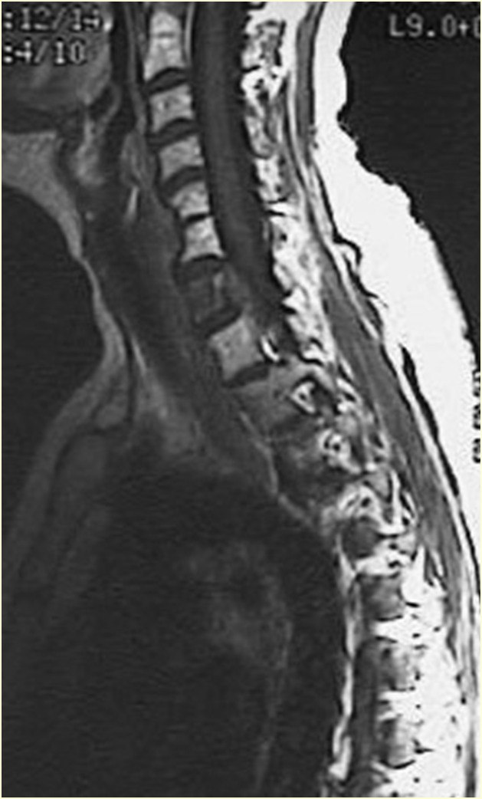
MRI scan of spine demonstrates metastatic lesion destroying C7
Notes:
This magnetic resonance imaging (MRI) scan of the spine in sagittal view demonstrates a metastatic lesion destroying C7 (the first cervical vertebra is not visible in this view, and there is partial congenital fusion of C5-C6).

Slide 15
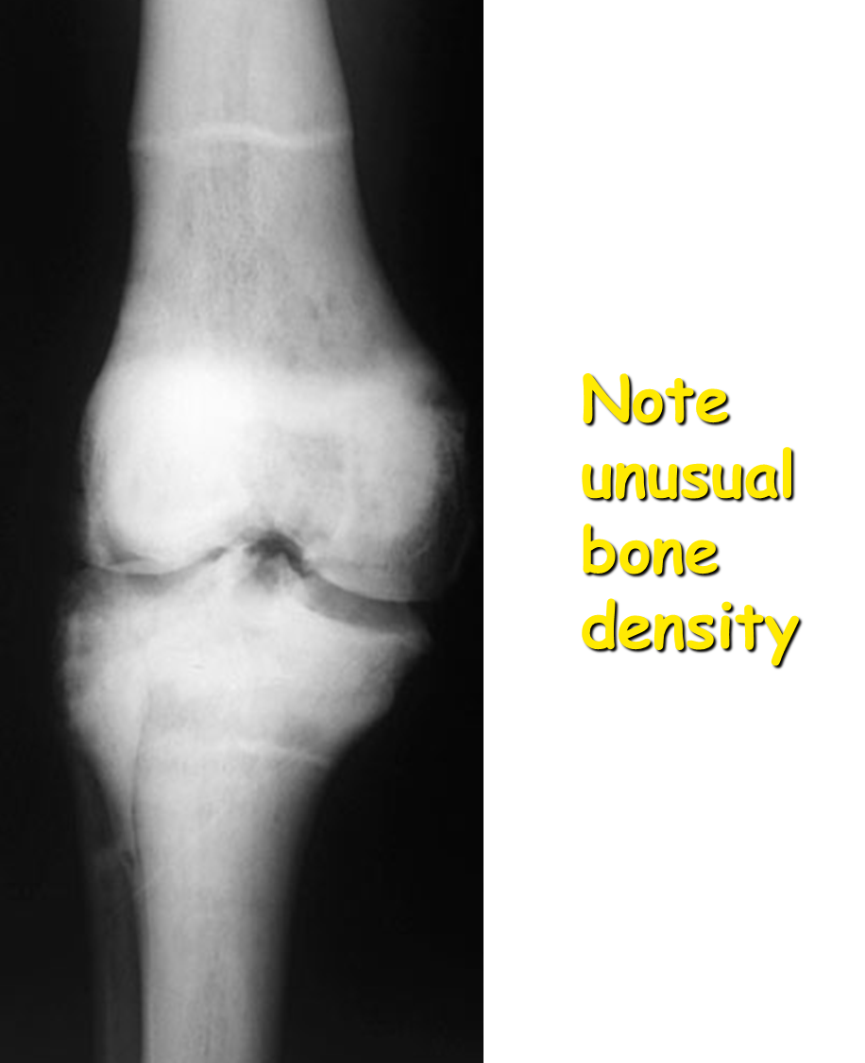

Osteopetrosis
  Failure of osteoclastosis
Notes:
Osteopetrosis leads to failure of osteoclastosis. The entire bone remodeling process leaves individual with short, weak, unusually shaped bones. The following abnormalities are often seen with osteopetrosis:
Bones are very dense.
Bones tend to fracture easily. (often with a linear fx)
As bones grow, a proper medullary space is not formed. Without a proper medullary space for the marrow, the patient will develop anemia, increased problems with infections, and bleeding problems. Because of these complications, few patients with this disorder survive childhood and the teens, unless they have the "tarda" form of the disease.
The nutrient foramina may not grow as the patient and their nerves grow, leading to foraminal stenosis, especially at the skull base.

Slide 16
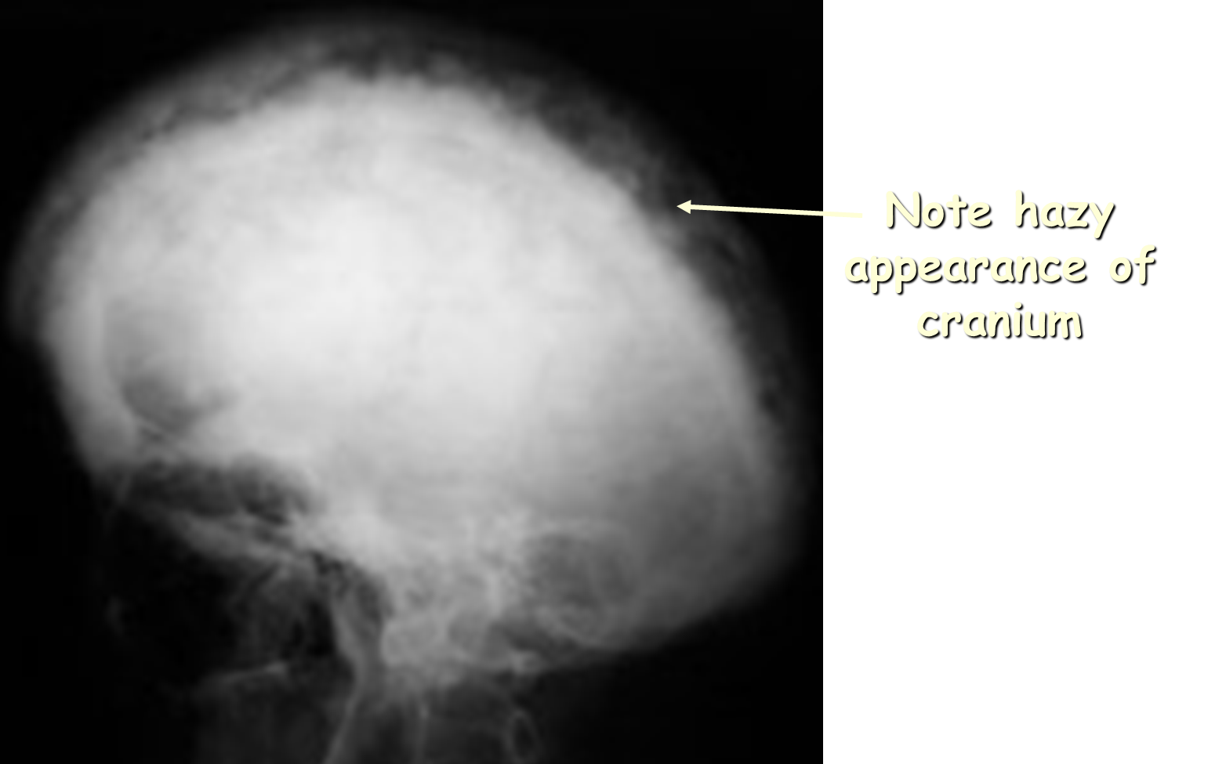
Paget’s Disease
Notes:
Paget’s is an osteitis deformans of unknown cause characterized by excessive and abnormal bone remodelling. Complications associated with Paget's disease include fractures, skeletal deformities, neoplasms and joint malformations.
Lateral radiograph of the skull demonstrates a thickened calvarium and fluffy radiodense regions which is referred to as a "cotton-wool" appearance.

Slide 17
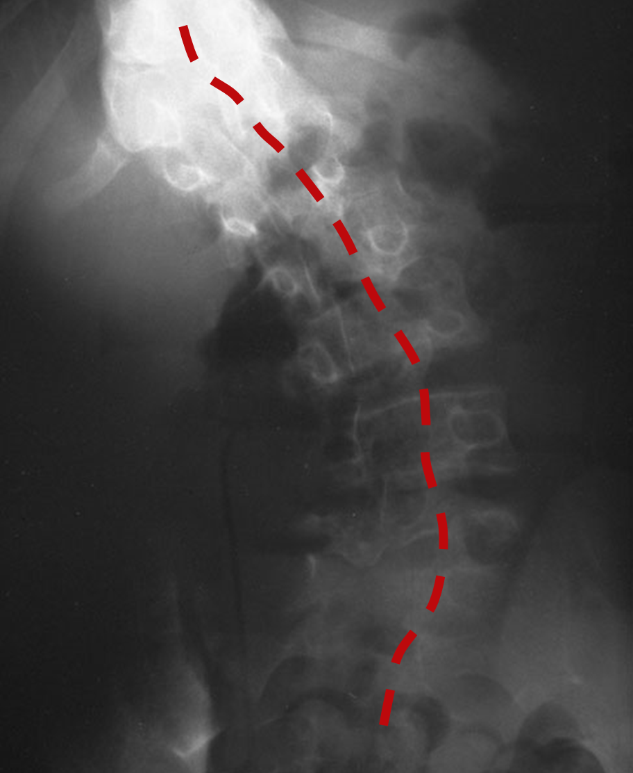
Radiograph--Scoliosis
(lateral curvature of spine)

Slide 18
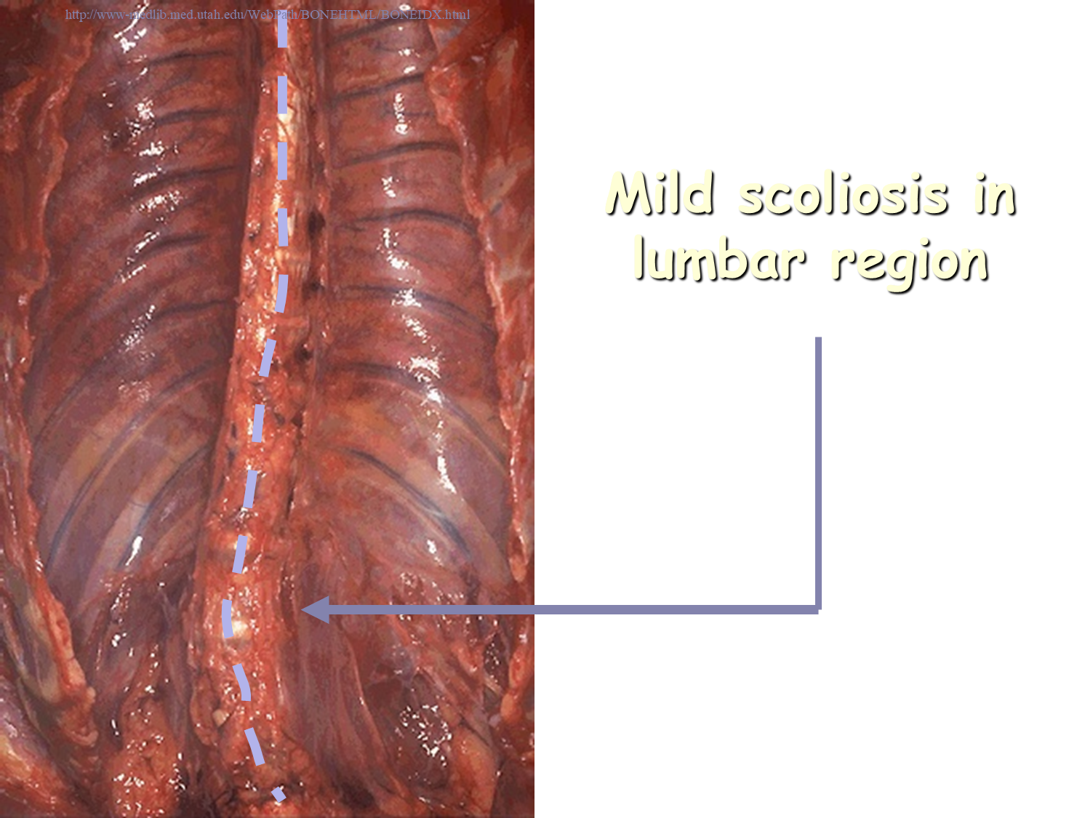
Mild scoliosis in lumbar region
Notes:
The curvature of the vertebral column seen here is known as scoliosis. In this case, the curve to the left in the lower lumbar region is not pronounced, and this person will be unlikely to have complications. Larger curves can progress and cause serious deformity.
10 xray slide-Curvature of the vertebral column is demonstrated here, typical for scoliosis.

Slide 19
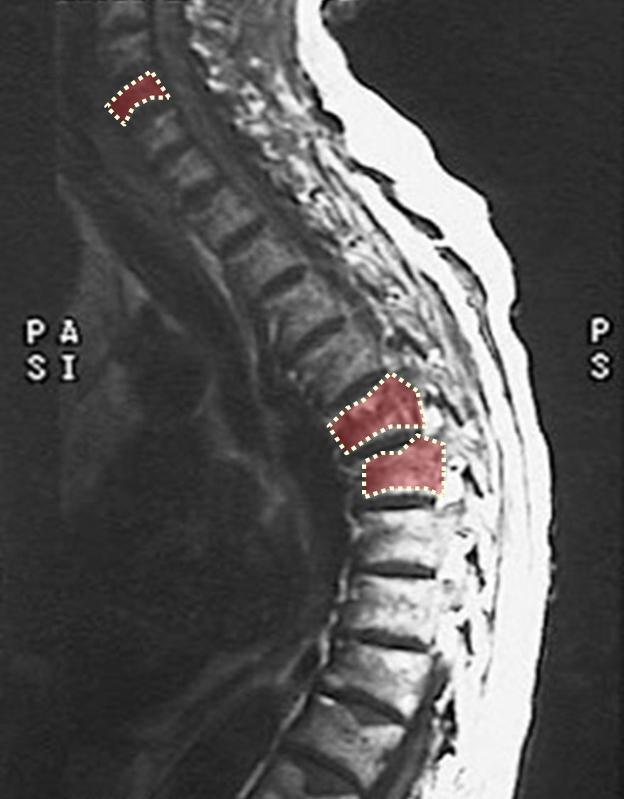
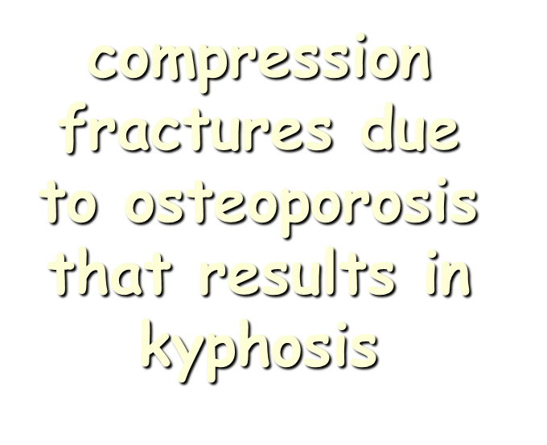
MRI of Spine
Notes:
This MRI of the spine demonstrates marked kyphosis with compressed fractures. Such a finding can be seen as a consequence of osteoporosis.

Slide 20
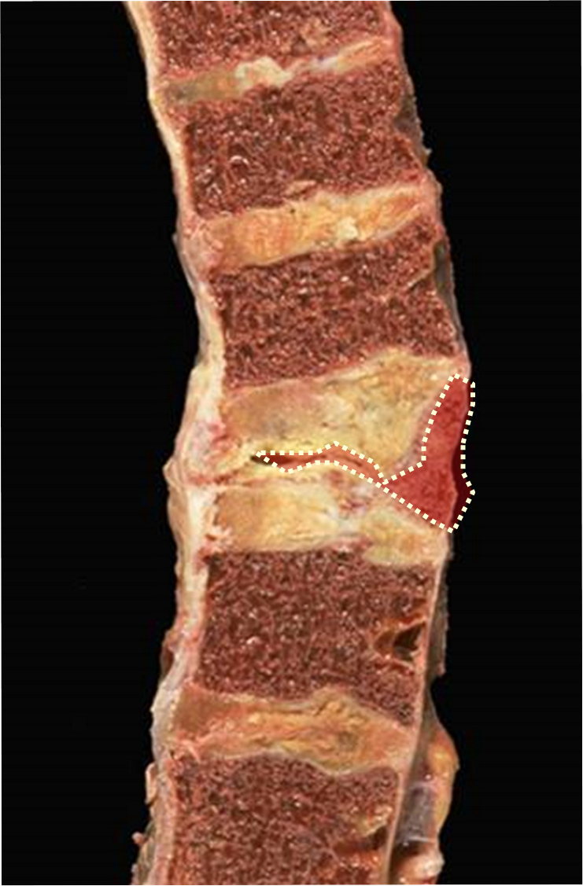


Compression Fx.
Collapse of vertebra
Notes:
Here is a "compressed" fracture of the vertebral column. The middle vertebral body shown here is greatly reduced in size. Such fractures are common in persons with osteoporosis in which there is accelerated bone loss, particularly older women, and can occur with even minor trauma.

Slide 21
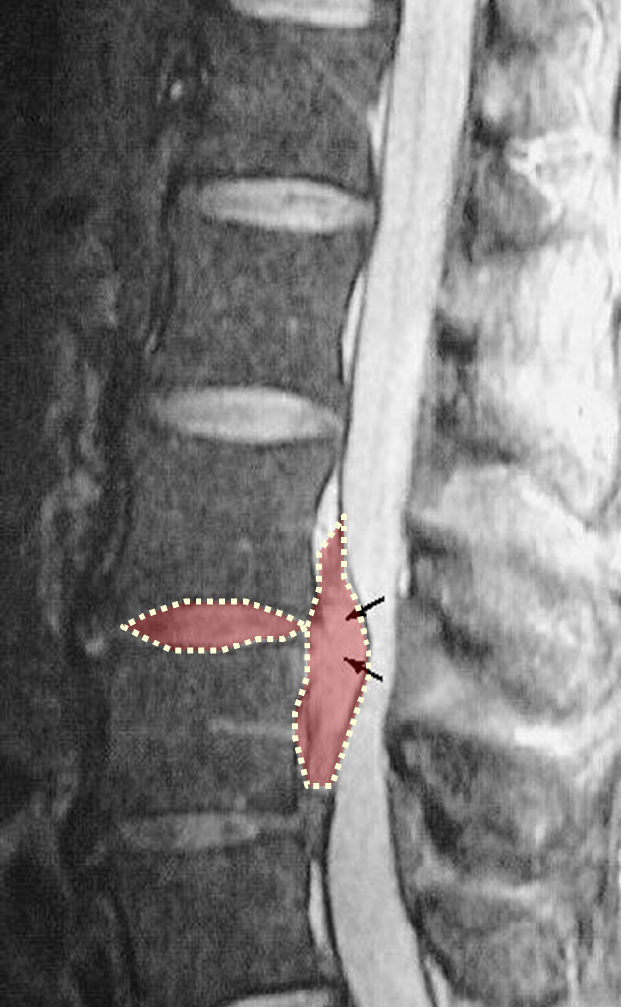
Herniated disk compressing spinal cord.
Notes:
Note the herinated L3-L4 intervertebral disk (arrow) compressing the spinal cord.

Slide 22
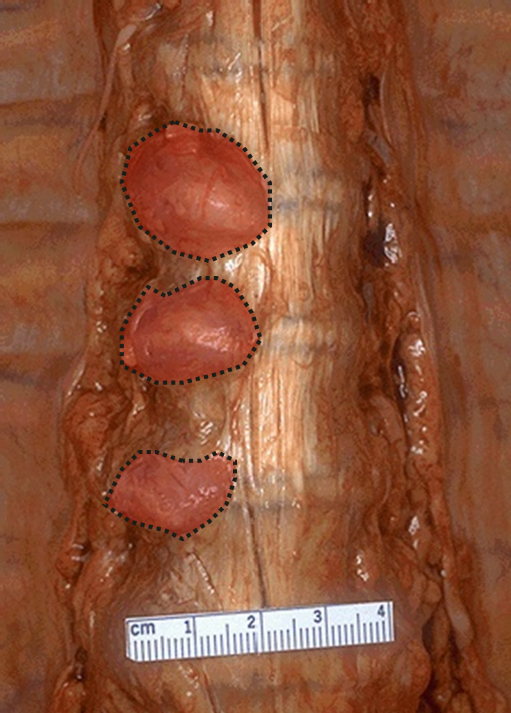
Osteoarthritis of vertebral column
Notes:
The knobby excresences at the left side of this vertebral column are due to degenerative osteoarthritis. This is the pronounced "lipping" of the vertebral bodies.

Slide 23
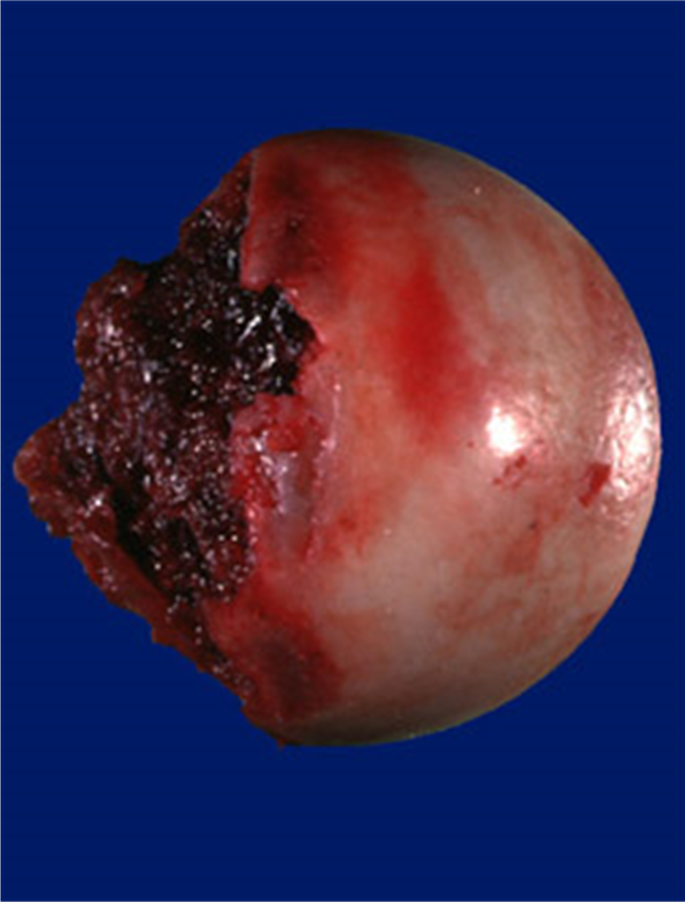
Normal femoral head removed after fracture.
Note smooth articular cartilage.
Notes:
The femoral head (removed because of fracture) shows smooth, glistening articular cartilage.

Slide 24
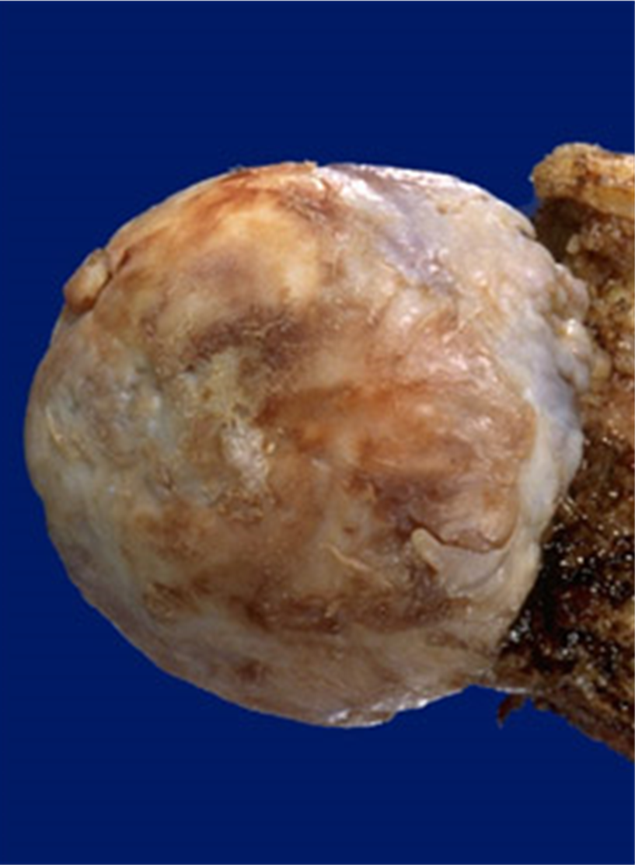
Arthritic femoral head removed due to disease.
Note rough articular surface.
Notes:
Femoral head shows a rough, eburnated, irregular appearance typical for osteoarthritis.

Slide 25
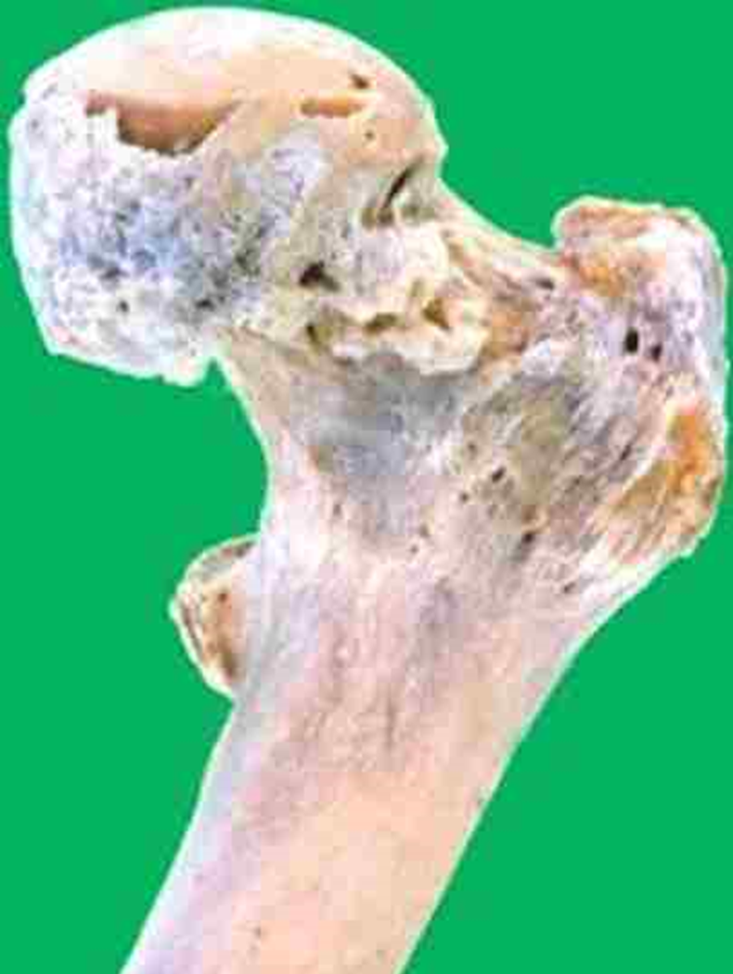

Osteoarthritis (proximal femur)
Osteoarthritis (proximal femur)
Notes:
Note rough, irregular surface on femoral head and greater trochanter.

Slide 26
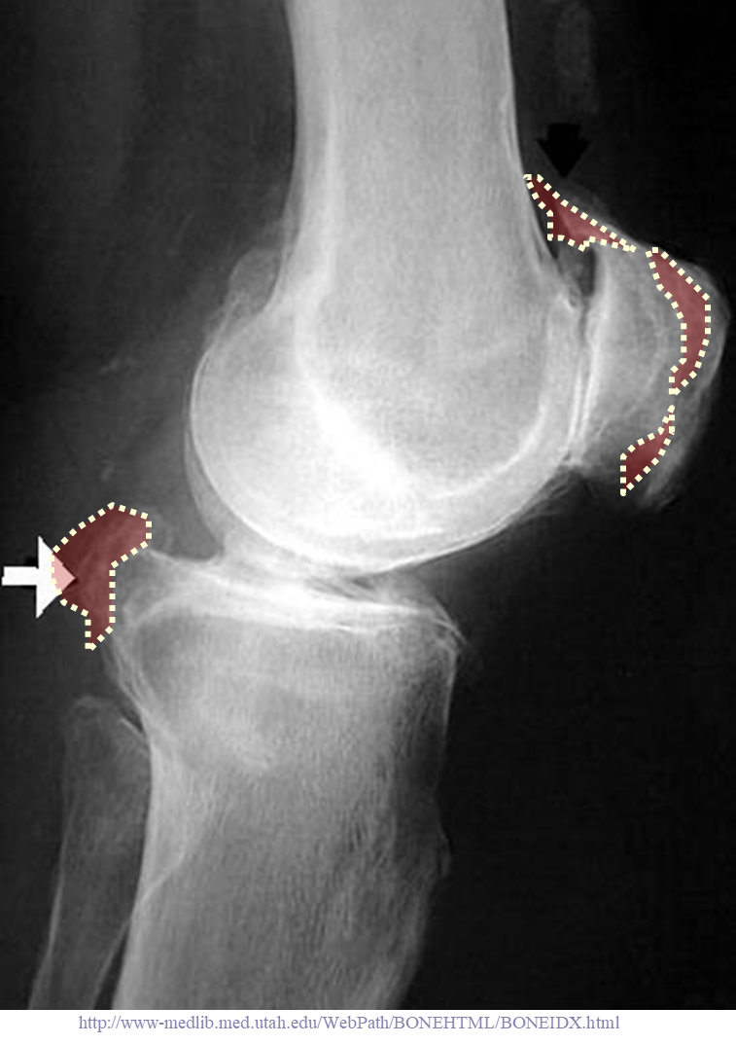
Osteoarthritis anterior/superior patella & posterior tibia

Slide 27
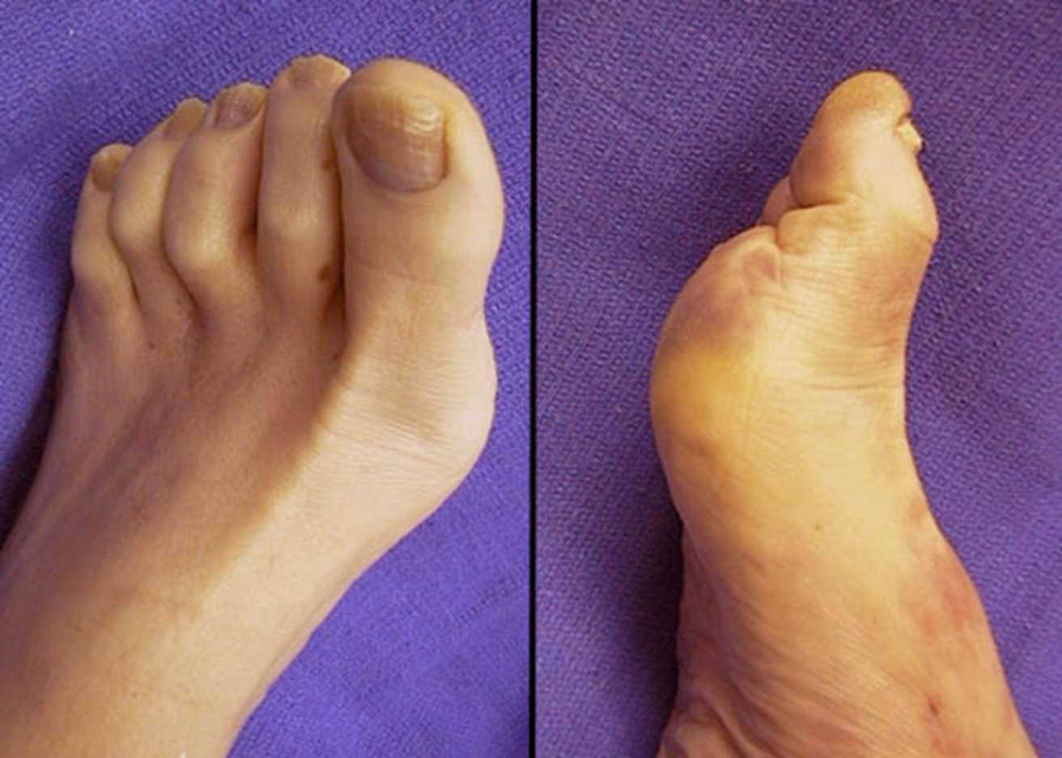
Bunions
Notes:
The deformity of the foot shown here is known as a "bunion" and represents protrusion of the MP joint. Such a deformity makes walking more difficult and can produce a thick callus or ulceration when the bunion makes shoes ill-fitting. This lesion can be lessened by surgical correction.

Slide 28
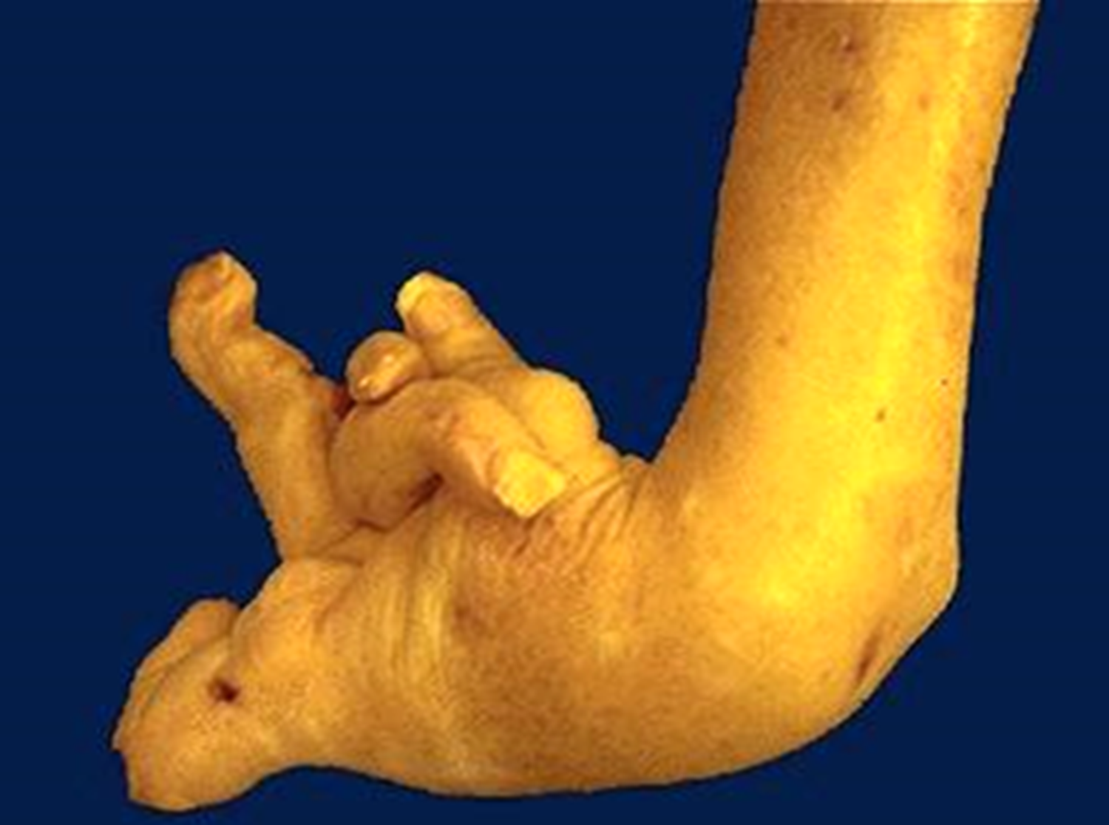
Rheumatoid Arthritis
Notes:
This deformity of the hand is due to rheumatoid arthritis (RA). This autoimmune disease leads to synovial proliferation and joint destruction, typically in a symmetrical pattern involving small joints of hands and feet, followed by wrists, ankles, elbows, and knees. Rheumatoid factor can be identified serologically in most, but not all, RA patients.

Slide 29
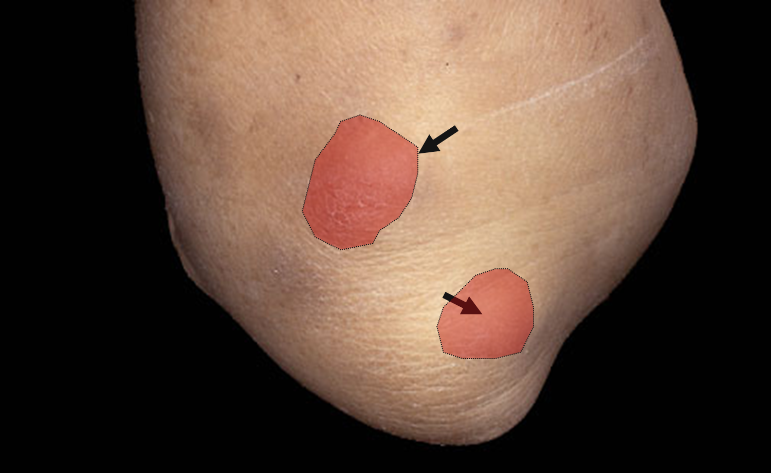
Rheumatoid nodules at pressure points of elbows
Notes:
Sometimes persons with rheumatoid arthritis (RA) have rheumatoid nodules form in subcutaneous locations at pressure points, such as the elbow shown here. Rheumatoid nodules may also appear viscerally, such as on the pleura of the.
lung

Slide 30
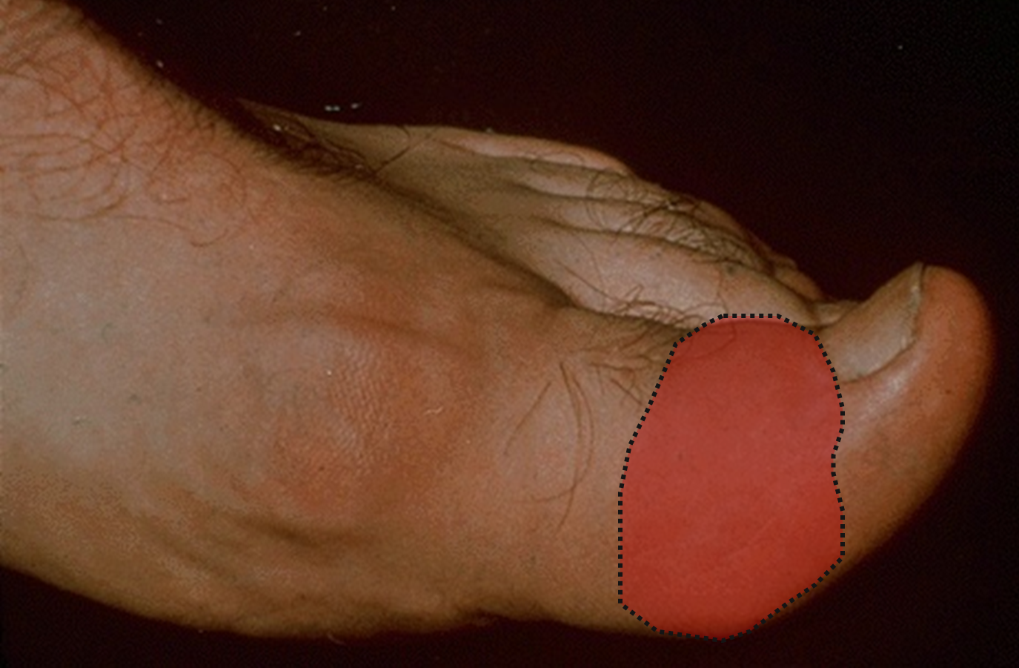
Gout from sodium urate crystals deposited in joints.
Notes:
This is gout. Gouty arthritis results from deposition of sodium urate crystals in joints. The joint most often affected is the first MP joint (big toe) as seen here. Acute attacks are characterized by severe pain, swelling, and erythema of the joint.

Slide 31
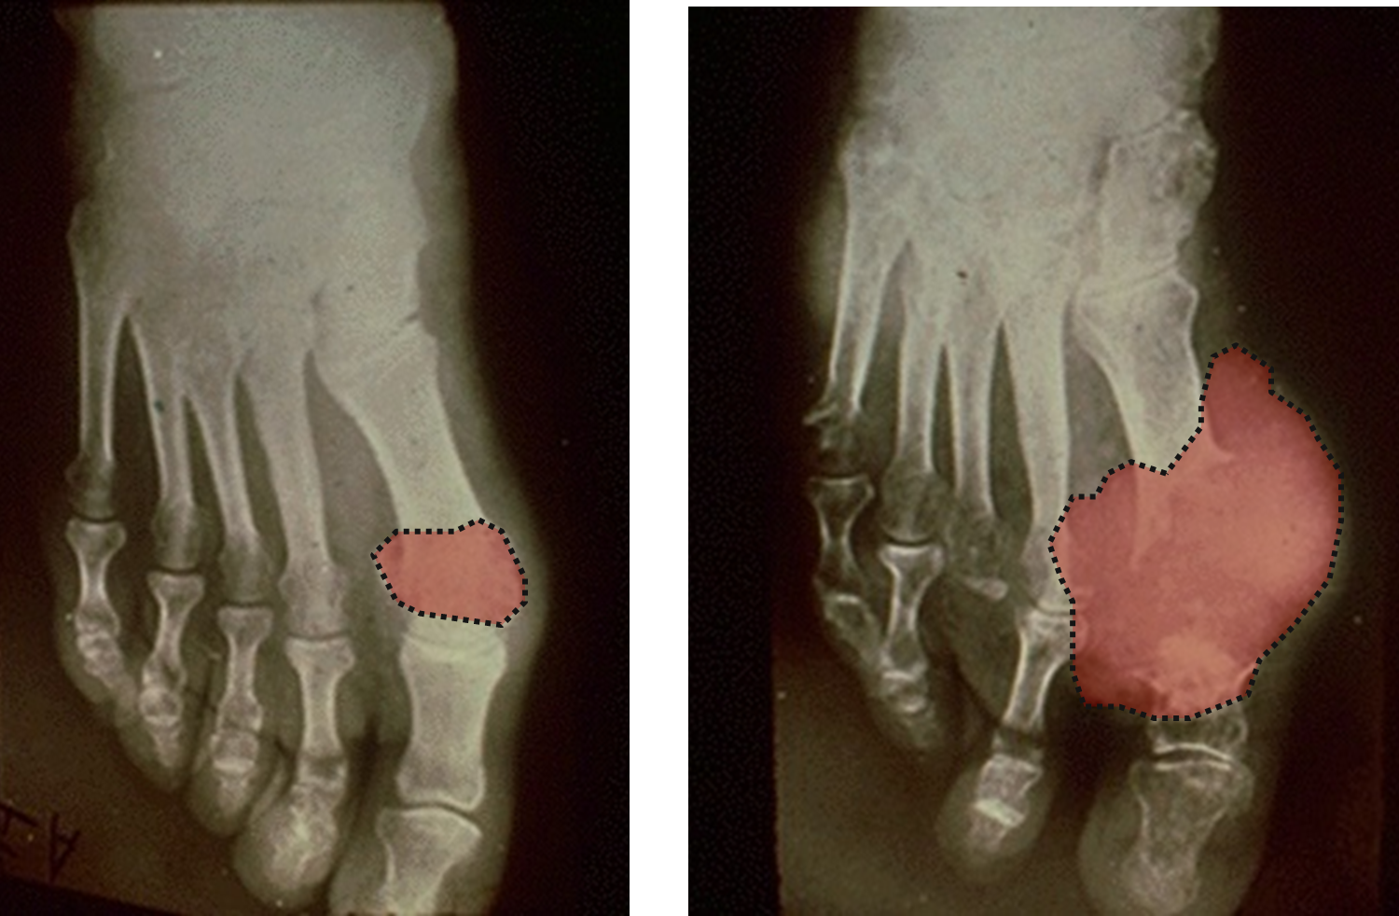
Chronic gout eventually destroys bone.
Notes:
Chronic gout leads to deposion of urates into a chalky mass known as a "tophus". Such tophi can destroy the joint and adjacent bone as seen here radiographically in sequential radiographs of the same foot (the patient did not have two right feet). In most, but not all, cases there is hyperuricemia.

