Slide 1
The History of Modern Manufacturing

Slide 3
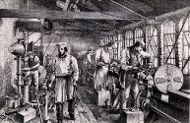
Modern Manufacturing
Modern Manufacturing started with Henry Ford’s use of the assembly line and arranging equipment close to that line.
Improvements to this industrial process is ongoing, even today.

Slide 4
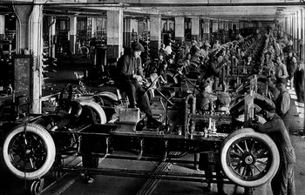
Modern Manufacturing
Henry Ford developed the assembly line to produce Model T cars at a cheap price.
His development of a plant where the equipment is located near the line increased the production rate and started modern manufacturing.

Slide 5
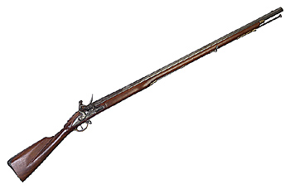
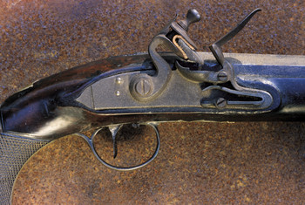
Modern Manufacturing
Eli Whitney started the use of interchangeable parts to manufacture guns for the US government.

Slide 6
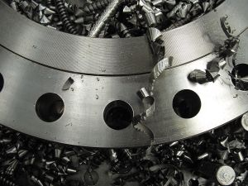
Modern Manufacturing
Sakichi Toyoda, founder of Toyota visited the Ford Rouge plant and took the ideas of Ford back to Japan.
He and his company improved the methods of the Toyota Production System.

Slide 7
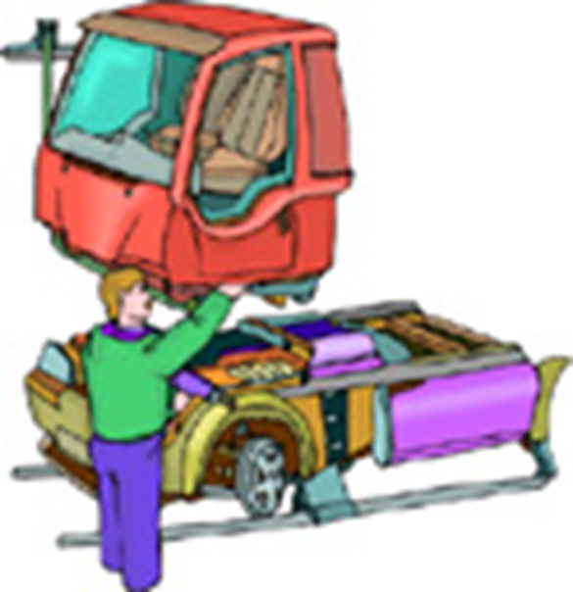
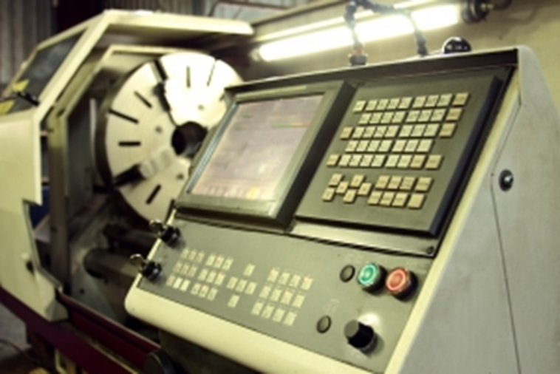
Modern Manufacturing
Toyota Production System is a manufacturing method that tries to reduce waste of materials, processing time, and workers’ time.
Computer Numerical Control machines entered the manufacturing plants in 1970, making these machine more productive than manual machines.

Slide 8
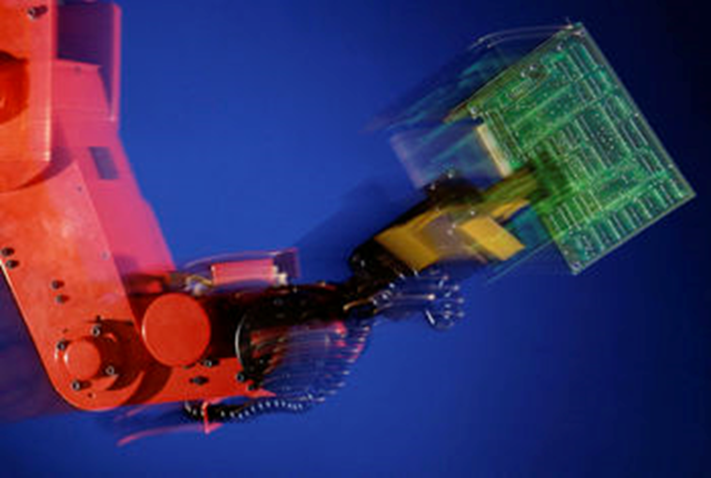
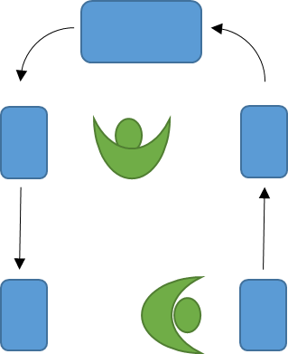
Modern Manufacturing
Industrial Robots started completing dangerous and repetitive tasks on an assembly line at General Motors (1962).
Work cell is an arrangement of machines that will produce a part within the cell. The machines will be CNC and a person or robot could load materials into the cell and remove finished parts.

Slide 9
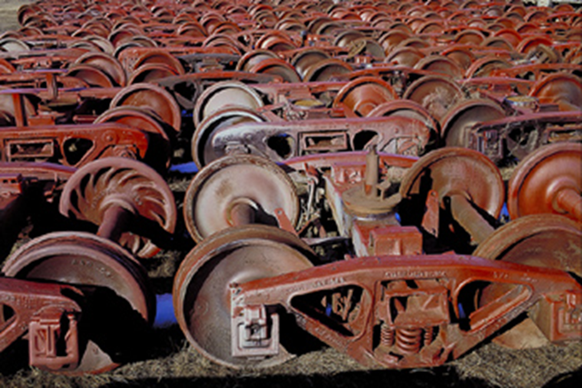
Modern Manufacturing
Lean Manufacturing is a method of producing products when a customer orders it. This requires predicting customer demand, but saves storage cost of unwanted products.

Slide 10
Careers in Modern Manufacturing
Computer Aided Designer
CNC operator
Manufacturing Technologist
Logistician
Supply Manager
Expeditor
Quality Control Manager
Robotics Technician
Cost Estimator
Industrial Safety and Health Engineer
Tool and Die Maker
Machinist
Industrial Production Manager
Industrial Engineer

Slide 11
Resources
http://www.assemblymag.com/articles/85640-timeline-50-years-of-economic-change-and-manufacturing-progress
http://www.lean.org/WhatsLean/timeline.cfm

