Slide 1
Tiny Houses:
  Living Large in a Small Space Project

Slide 3
Tiny Houses:
Living Large in a Small Space Project
  You should now be more familiar with what tiny houses are, their functions, and why they are becoming more popular in construction and design.
  With this knowledge you will design your own tiny house.
  While designing your tiny house, please keep in mind what was discussed in the multimedia presentation.

Slide 4
Components of the Project
  You will be graded on six components for your tiny house design.
  The components are:
    Design plan for your tiny house
    Floor plan
    Budget with construction and décor materials for your tiny house, including eco-friendly items
    Interior décor design board of your tiny house
    Marketing promotion to sell your tiny house
    Plan and implement a 3D model of your tiny house
  You will use the provided planning sheets to help you in the planning process of each component

Slide 5
Criteria of Components
  Tiny House Plans
  Floor Plan
  Materials Budget (Construction and Décor)
  Interior Décor Sample Board
  Interior Décor Design Board
  Marketing Promotion
  Three-Dimensional Model

Slide 6
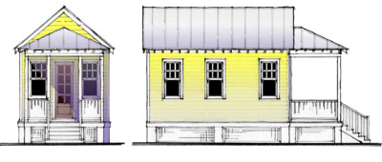
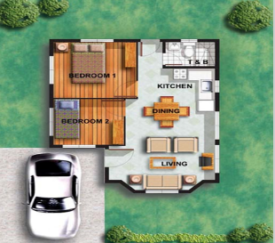
Tiny House Plan
  Use the tiny house plan worksheet to help you plan your house.
  You will include:
    Size of the house
    Sketch of how the house will look
    Material list
  This plan will guide you into the other components of the project

Slide 7
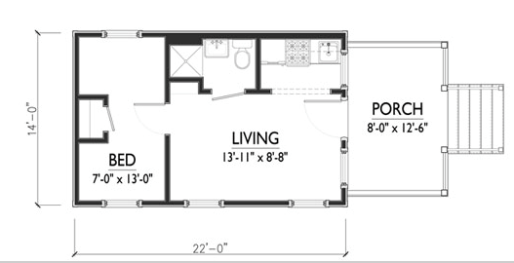
Floor Plan
  You will use graph paper and an architect’s scale to create a scale drawing of your tiny house
  Include the following:
    Measurements
    Window and door placement
    Storage
    Total square footage
    Room dimensions
    Correct labeling
    Must include a living area, bedroom, kitchen, bathroom, and storage

Slide 8
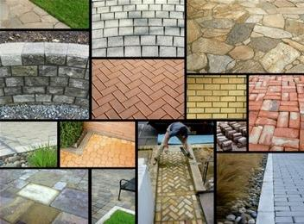
Materials Budget (Construction and Décor)
  Use the budget planning worksheet to determine the price of your tiny house
  The detailed budget plan of construction and décor will include:
    Construction supplies
    Tools and equipment
    Furniture
    Appliances
    Backgrounds
    Accessories
    Lighting

Slide 9
Interior Décor Sample Board
  You will use the planning worksheet to plan your board. This will help you when you are researching and finding pictures and samples.
  Using a poster board, you will display samples of the décor for the inside of your tiny house.
  You will need to keep the principles and elements of design in mind when designing the interior of your tiny house.

Slide 10
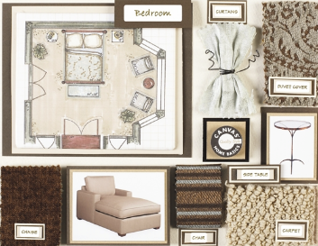
Interior Décor Sample Board
  You will need to include the following on your board:
    Color Scheme
    Furniture
    Wall Coverings
    Floor Coverings
    Window Coverings
    Accessories
    Lighting

Slide 11
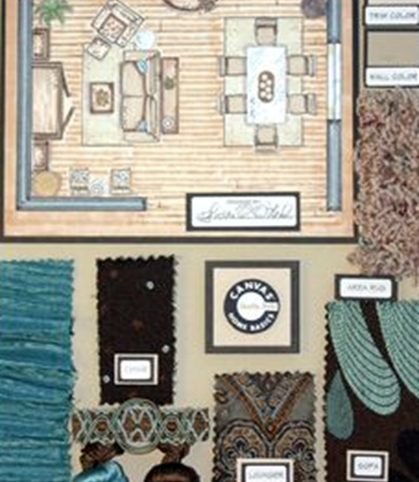
Interior Décor Design Board (Continued)
  Include design samples such as wallpaper, paint, fabrics, and other materials to create a pleasing visual on your design board.
  Pictures of furniture, accessories, and lighting should also be included. You may find pictures in design magazines or on the Internet.
  Floor Plan
  Your design board needs to be neat, organized, and pleasing to the eye.

Slide 12

Marketing Promotion
  Now that your house is planned, you will need to come up with a marketing campaign to sell your house to the public.
  You will need to create a sales promotion to get the attention of individuals who are seeking to purchase a tiny house.
  You will use the planning sheet provided to help you plan your advertisement.

Slide 13
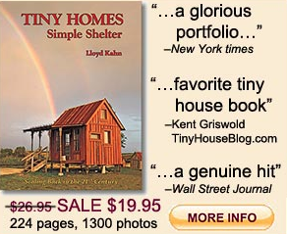
Marketing Promotion
  Create an advertisement using the media to promote your tiny house. This can be a newspaper/magazine advertisement, billboard, television commercial, direct mail ad, or website.
  The advertisement needs to contain:
    Unique name for your house
    Floor plan
    Sketch of outside of house
    Slogan
    Use of color
    Price

Slide 14
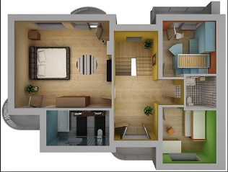
Three-Dimensional Model
  You will create a 3D miniature model of the outside as well as the inside décor of your tiny house using your sketches and floor plan as a guideline.
  You will use the planning sheet to create a written plan of how you will create your model, which will include:
    Size of the model
    What materials will you use to build the model
    Sketch of model - inside and outside
  Be sure your structure is neat and attractive

