Slide 1
Tissues: The Living Fabric
  Anatomy & Physiology

Slide 3
Tissues
  Cover
  Support
  Movement
  Control

Slide 4
Tissues
  Groups of closely associated cells that are similar in structure and perform a common or related function

Slide 5
Histology
  Study of tissues

Slide 6
Epithelial Functions
  Protection
  Absorption
  Filtration
  Excretion

Slide 7
Specialized Characteristics
  Cellularity
  Contacts
  Polarity
  Vascularity
  Basement Membrane

Slide 8
Classification Criteria
  Cell Shape
    squamous
    cuboidal
    columnar
  Cell Arrangement
    simple
    stratified

Slide 9
Simple Epithelia
  Simple Squamous
    thin, permeable
  Simple cuboidal
    secretion, absorption

Slide 10
Simple Epithelia
  Simple Columnar:
    secretion, absorption;
    microvilli, goblet cells

Slide 11
Simple Epithelia
  Pseudostratified Columnar:
    secretion, absorption;
    respiratory tract

Slide 12
Stratified Epithelia
  Stratified Squamous
    thick
    protective

Slide 13
Stratified Epithelia
  Stratified Cuboidal
    rare
    large ducts of some glands

Slide 14
Stratified Epithelia
  Simple Columnar:
    rare
    large ducts, some glands

Slide 15
Stratified Epithelia
  Transitional
    lining of urinary organs
    stretchable

Slide 16
Connective Tissue
  Most abundant & widely distributed tissue
  Binding & support, protection, insulation
  Widely separated cells with abundant intercellular matrix
  Matrix fibers: collagen, elastic, reticular

Slide 17
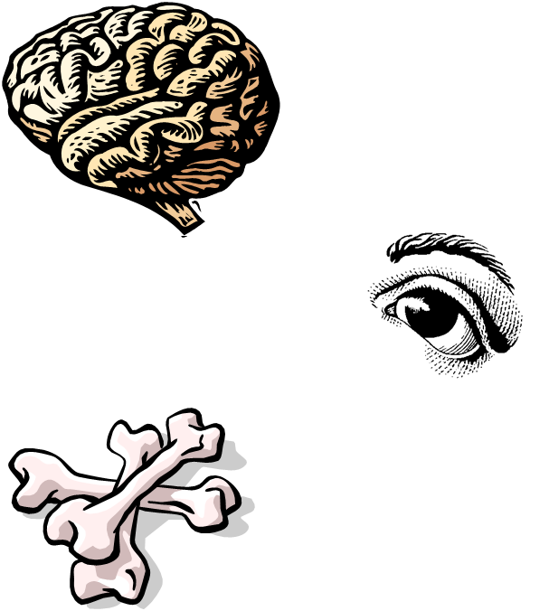
Soft Connective Tissue
  Areolar: wraps and cushions organs, nerves
  Adipose: fat, food/energy reserve, insulation, padding; under skin, around eyes, kidneys
  Reticular: soft internal skeleton of lymph nodes, spleen, bone

Slide 18
Dense Regular Connective Tissue
  Withstands tension in one direction
  Tendons, ligaments, fasciae, aponeuroses

Slide 19
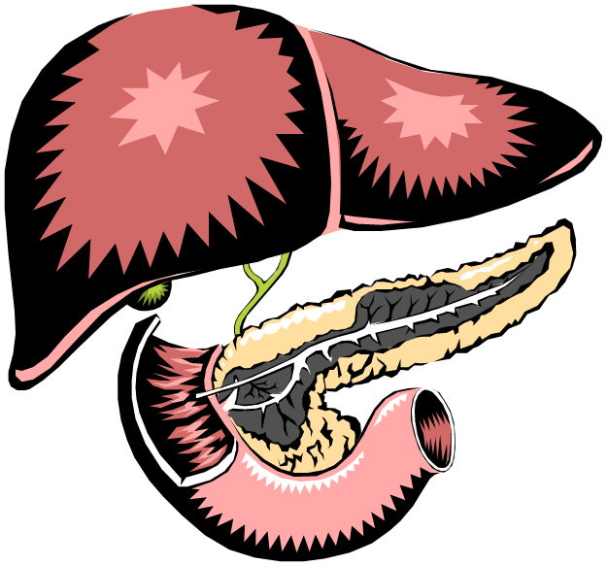
Dense Irregular Connective Tissue
  Withstands tension in multiple directions
  Dermis of skin, digestive tract, fibrous capsule of organs and joints

Slide 20
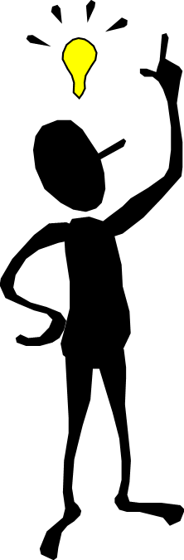
Hard Connective Tissue
  Cartilage: tough, elastic material found between vertebrae, at ends of long bones, nose, ears, larynx
  No nerves
  Poor blood supply
  Heals poorly

Slide 21
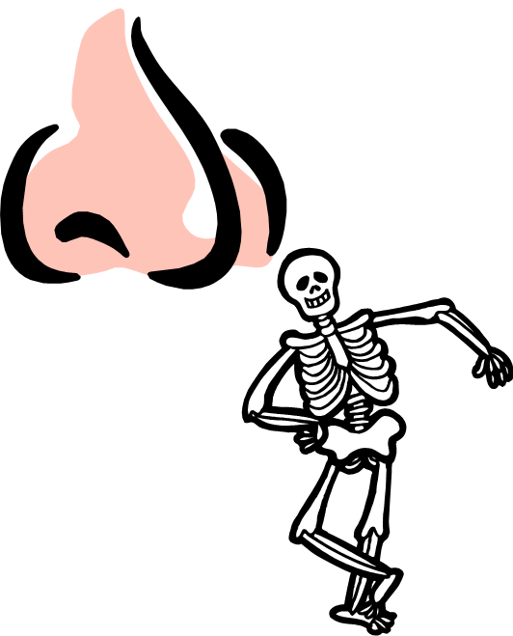
Hyaline Cartilage
  Embryonic skeleton
  End of long bones
  Ribs
  Nose
  Trachea
  Larynx
  Support, reinforce, cushions

Slide 22
Elastic Cartilage
  Ear
  Epiglottis
  Maintains shape
  Allows flexibility

Slide 23
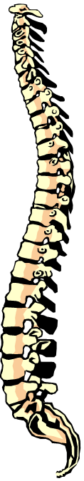
Fibrocartilage
  Intervertebral discs
  Pubic symphysis
  Discs of knee joints
  Strength and absorption of compressive shock

Slide 24
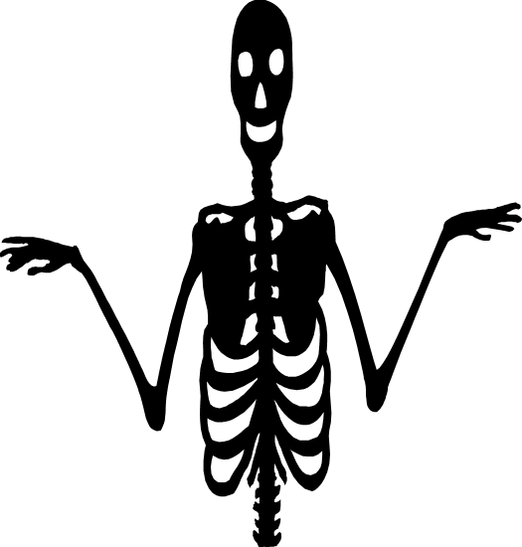
Osseus/Bone
  Calcium salts
  Nerves
  Blood vessels
  Body structure/support
  Calcium storage
  Hematopoiesis

Slide 25
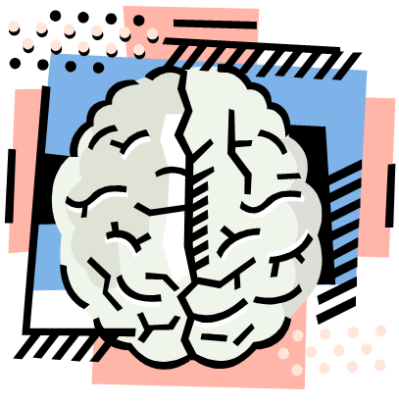
Nervous Tissue
  Made up of special cells called neurons and neuroglia (support cells)
  Transmits messages throughout the body
  Reacts to stimuli
  Brain, spinal cord, nerves

Slide 26
Muscle Tissue
  Highly cellular
  Well vascularized
  Power and movement through contractions
  3 types

Slide 27
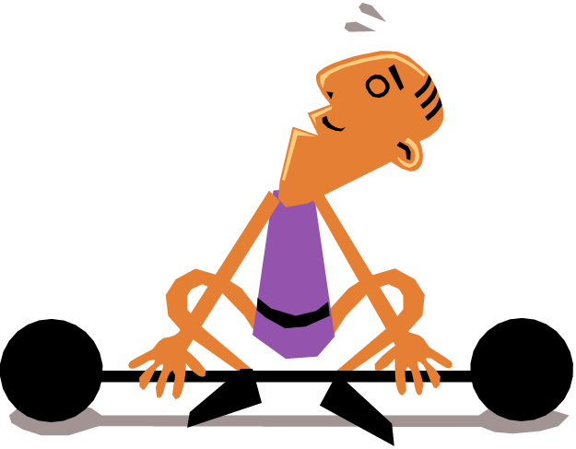
Skeletal Muscle
  Attaches to bone
  Striated
  Voluntary

Slide 28
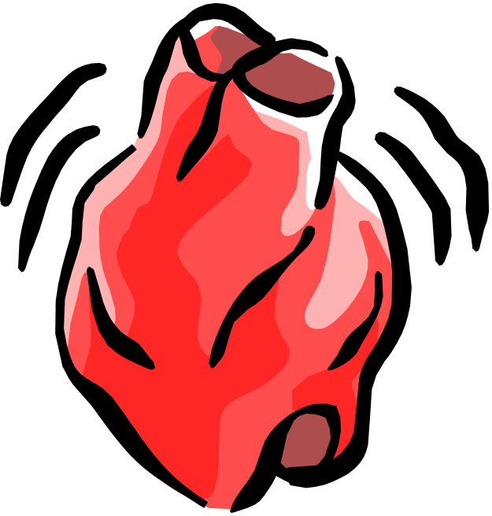
Cardiac Muscle
  Causes heart to beat
  Striated
  Involuntary

Slide 29
Visceral/Smooth
  In walls of hollow, internal organs
  Digestive tract, urinary tract, uterus, blood vessels
  No striations
  Involuntary

Slide 30
Epithelial Membranes
  Combinations of epithelial tissue and connective tissues
  5 types

Slide 31
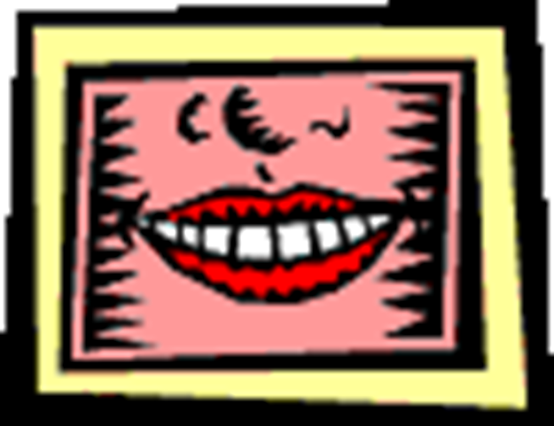
Mucous Membrane
  Lines body cavities
  “Wet” membrane
  Absorption and secretion

Slide 32
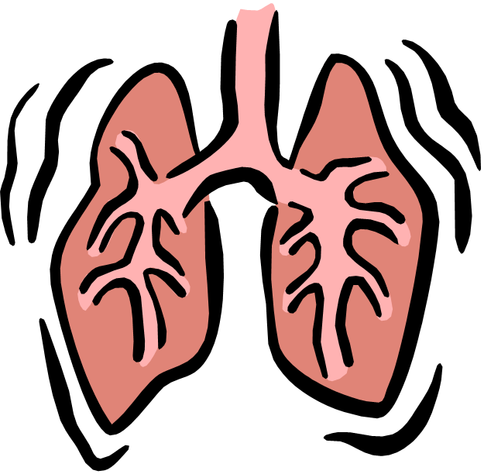
Serous Membrane
  Lines closed body cavities
  Secretes serous fluid
  Protects against friction
  Pleura, peritoneum, pericardium

Slide 33
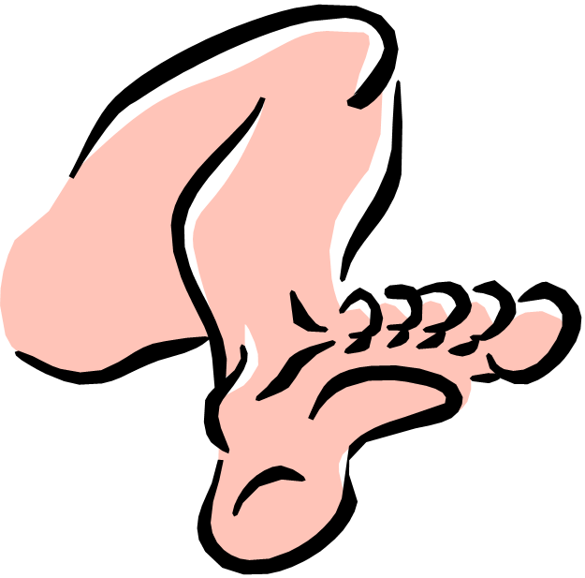
Synovial Membrane
  Fibrous tissue that lines the cavities of freely movable joints

Slide 34
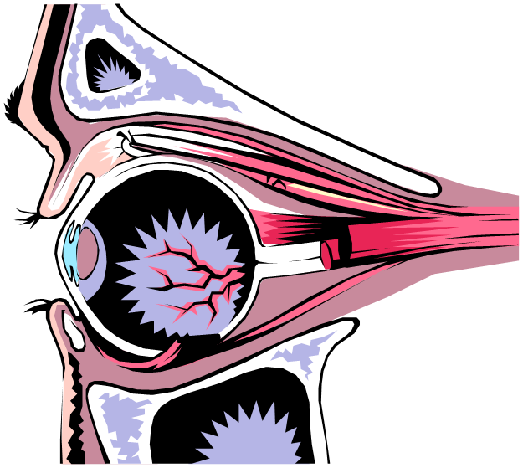
Dense Fibrous Membrane
  Tough, opaque
  Protection
  Dura mater, periosteum, sclera

Slide 35
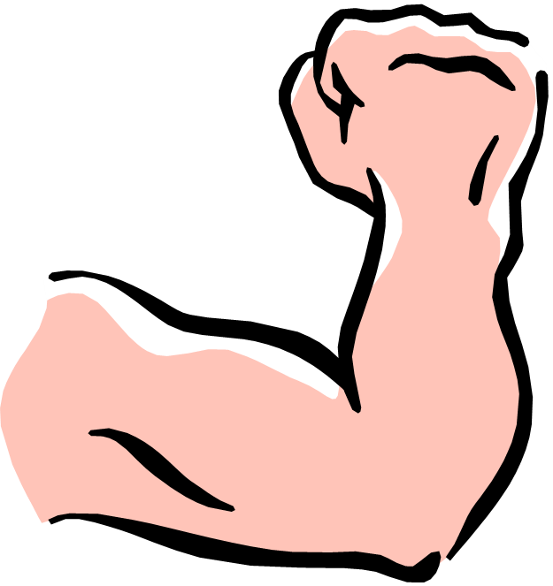
Cutaneous Membrane
  Dry” membrane
  Skin

