Slide 1
A Look at Legal Responsibilities and Child Labor Laws

Slide 3
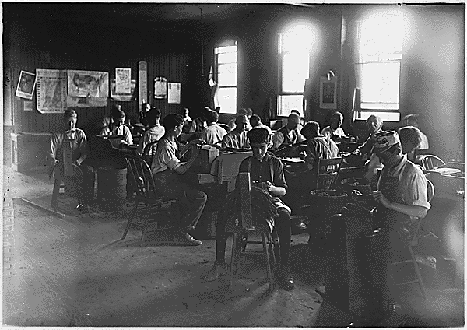
Roles and Responsibilities
  Legal Responsibilities
  Child Labor Laws
https://www.archives.gov/files/education/lessons/hine-photos/images/cigar-factory.gif
Notes:
This slide presentation is divided into two sections:
• Legal Responsibilities
• Child Labor Laws
Photo:
Boys in a Cigar Factory, Indianapolis,INAugust1908National Archives and Records AdministrationRecords of the Department of Commerce and Labor, Children's BureauRecord Group 102ARC Identifier: 523076
http://www.archives.gov/education/lessons/hine-photos/

Slide 4

Legal Responsibilities
  Family Medical Leave Act
  Texas Family Code

Slide 5
Family and Medical Leave Act
  Entitles eligible employees to take unpaid, job-protected leave
  Twelve workweeks of leave in a 12-month period
    The birth of a child and to care for the newborn child within one year of birth
    The placement with the employee of a child for adoption or foster care and to care for the newly placed child within one year of placement
    To care for the employee’s spouse, child, or parent who has a serious health condition
Notes:
According to theFamily and Medical Leave Act (FMLA): An Overview, September 28. 2012, written by Gerald Mayer, Analyst in Labor Policy, for the Congressional Research Service, the FMLA is intended to help employees balance work and family life. The act provides eligible employees with two types of job-protected leave:
• regular leave
• military family leave
For more information, see The Family and Medical Leave ActFact Sheet

Slide 6
Texas Family Code
  Rights and Duties of a Parent (Sec. 151.001)
  A parent has:
    (1) the right to have physical possession, to direct the moral and religious training, and to designate the residence of the child
    (2) the duty of care, control, protection, and reasonable discipline of the child
    (3) the duty to support the child, including providing the child with clothing, food, shelter, medical and dental care, and education
Notes:
Ask students if they were aware that Texas has a Family Code as one of Statutes in the State Constitution.
Discuss with students that parents have a right and a duty to provide for their children.
Refer to handout Texas Family Code for more information.

Slide 7
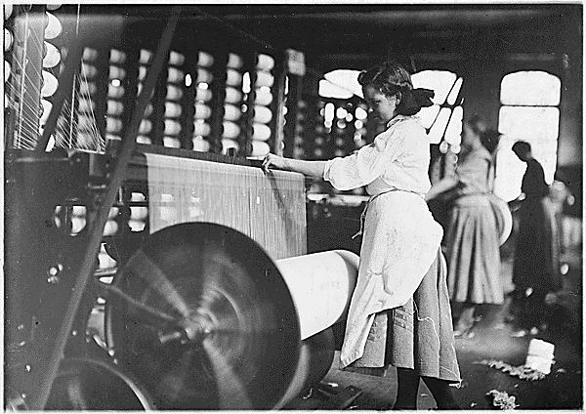
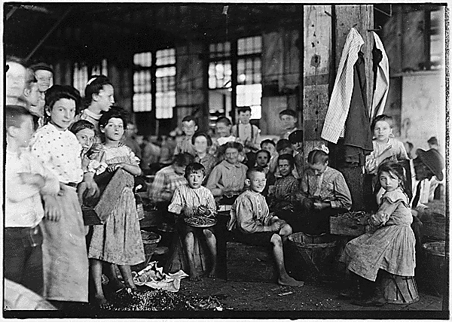
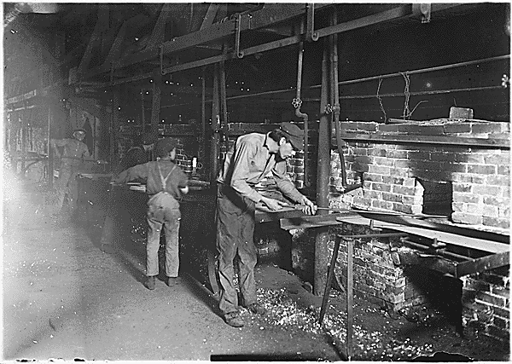
Child Labor Laws
https://www.archives.gov/files/education/lessons/hine-photos/images/girls-weaving.gif
https://www.archives.gov/files/education/lessons/hine-photos/images/stringing-beans.gif
https://www.archives.gov/files/education/lessons/hine-photos/images/bottle-factory.gif
Notes:
Photos:
Girls at Weaving Machines, Evansville,IN October1908National Archives and Records AdministrationRecords of the Department of Commerce and Labor, Children's BureauRecord Group 102ARC Identifier: 523100
http://www.archives.gov/education/lessons/hine-photos/
Workers Stringing Beans, Baltimore,MDJune7,1909National Archives and Records AdministrationRecords of the Department of Commerce and Labor, Children's BureauRecord Group 102ARC Identifier: 523215
http://www.archives.gov/education/lessons/hine-photos/
Children Working in a Bottle Factory, Indianapolis,INAugust 1908National Archives and Records AdministrationRecords of the Department of Commerce and Labor, Children's BureauRecord Group 102ARC Identifier: 523080
http://www.archives.gov/education/lessons/hine-photos/

Slide 8
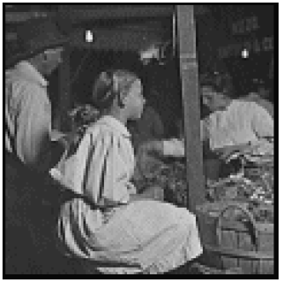
What Is Child Labor?
Source: National Archives and Records Administration
Notes:
Have students brainstorm what they think child labor is.
Photo:
Boys and Girls Selling RadishesAugust22,1908National Archives and Records AdministrationRecords of the Department of Commerce andLabor, Children's BureauRecord Group 102ARC Identifier: 523071
http://www.archives.gov/education/lessons/hine-photos/

Slide 9
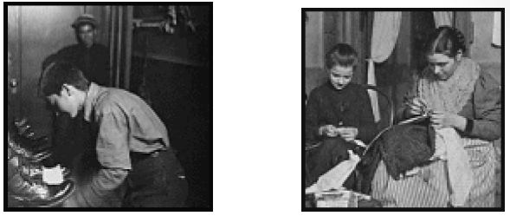
Child Labor
  Definition
  Hazardous Work
  Lewis Hine
  History of Child Labor
  Fair Labor Standards Act
  Texas Child Labor Law
Source: National Archives and Records Administration
Notes:
Child labor, under international standards, means all work performed by a person below the age of 15. It also includes all work performed by a person under the age of 18.
Photos:
Boy Working in a Shoe-Shining Parlor, Indianapolis,INAugust 1908National Archives and Records AdministrationRecords of the Department of Commerce and Labor, Children's BureauRecord Group 102ARC Identifier: 523072
http://www.archives.gov/education/lessons/hine-photos/
Garment Workers, New York,NYJanuary25,1908National Archives and Records AdministrationRecords of the Department of Commerce and Labor, Children's BureauRecord Group 102ARC Identifier: 523065
http://www.archives.gov/education/lessons/hine-photos/

Slide 10
Definition
  Violates minimum age laws
  Threatens children’s well-being
  Intolerable abuse
  Child slavery
  Child trafficking
  Debt bondage
  Forced labor
  Illicit activities
  Prevents children from going to school
  Uses children to undermine labor standards
Notes:
While exact definitions of child labor have varied over time, most organizations agree that child labor involves at least one of the following characteristics:
• violates a nation’s minimum age laws
• threatens children’s physical, mental, or emotional well-being
• involves intolerable abuse, such as child slavery, child trafficking, debt bondage, forced labor, or illicit activities
• prevents children from going to school
• uses children to undermine labor standards

Slide 11
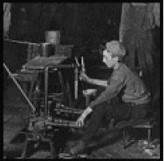
Hazardous Work
  Children labored in:
    Mines
    Factories and fields
    Wars
    Sold into prostitution
    Crippled and sickened children
    Robbed them of an education
    Trapped them from having a normal childhood
Source: National Archives and Records Administration
Notes:
Of the estimated 215 million children worldwide who toil as child laborers, more than half engage in hazardous work. These children labor in:
• Mines
• Factories and fields
• Wars
• Sold into prostitution
Child labor cripples and sickens children, robs them of an education, and traps them in the same daily struggle for survival faced by their parents and grandparents.

Slide 12
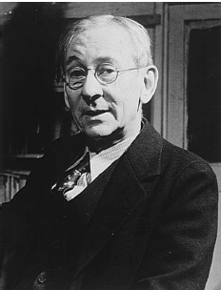
Lewis Hine
  Lewis Hine: The child labor photos that shamed America
  (click on link)
  Source: Lewis Hine: Opening
  the Eyes of America
Notes:
Lewis Hine is most famous for his photographs of the construction workers who helped build the Empire State Building in 1930.
But in the years before he celebrated the heroic labor of these men working high above Manhattan, Hine used his photographs to campaign for social reform.
In 1908 the then-sociology professor was hired by the National Child Labor Committee to document how children as young as seven were working in cotton mills and coal mines.
Over a decade he took thousands of photographs that helped convince U.S. lawmakers to introduce new industrial regulations to protect children.
Alison Nordstrom, senior curator of photographs of the George Eastman House in Rochester, New York, talked to the BBC about the new book of this historic photographer's work, entitled simply Lewis Hine.
Lewis Hine: The child labor photos that shamed America
Lewis Hine is most famous for his photographs of the construction workers who helped build the Empire State Building in 1930.
http://www.bbc.co.uk/news/magazine-17673213
Photo:
Portrait of Lewis Hine
Lewis Hine: Opening the Eyes of America
http://52454240.nhd.weebly.com/lewis-hine.html

Slide 13
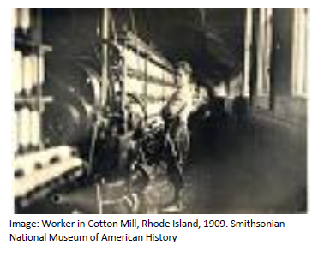
The History of Child Labor
  The Fight to End Child Labor
  (click on link)
Notes:
Best of History Websites/Progressive Era
The Fight to End Child Labor/ History.com Video
http://www.history.com/videos/the-fight-to-end-child-labor

Slide 14
The Fair Labor Standards Act (FLSA)
  Basic minimum wage and overtime pay
  Restricts hours that children can work
  Restricts work conditions
Notes:
The Fair Labor Standards Act requires employers to pay covered employees who are not otherwise exempt at least the federal minimum wage and overtime pay of one-and-one-half-times the regular rate of pay.
For nonagricultural operations, it restricts the hours that children under age 16 can work and forbids the employment of children under age 18 in certain jobs deemed too dangerous.
For agricultural operations, it prohibits the employment of children under age 16 during school hours and in certain jobs deemed too dangerous.
The Act is administered by the Employment Standards Administration's Wage and Hour Division within the U.S. Department of Labor.
The Fair Labor Standards Act (FLSA), which prescribes standards for the basic minimum wage and overtime pay, affects most private and public employment.
United States Departmentof Labor
Fair Labor Standards Act (FLSA) Minimum Wage Poster-Every employer of employees subject to the Fair Labor Standards Act's minimum wage provisions must post, and keep posted, a notice explaining the Act in a conspicuous place in all of their establishments so as to permit employees to readily read it.
http://www.dol.gov/whd/regs/compliance/posters/minwagebwp.pdf

Slide 15
Texas Child Labor Law
  Texas Child Labor Laws
  (click on link)
Notes:
Child Labor Laws cover any employee less than18 years of age. Once an individual reaches age 18, they are considered an adult under child labor laws.
The Texas Child Labor Law ensures that a child is not employed in an occupation or manner that is harmful to the child's safety, health or well-being. It is illegal to employ a child under age 14 except under specific circumstances described on this page.
State law allowsTexas Workforce Commission (TWC)to adopt rules regarding employing children. Their rules ensure that employment does not interferewith a child's education and does not pose a threat to the child's health, safety or general well-being.
TWCor its designee may inspect a place of business during work hours to collect information about the employment of children if there is good reasonto believe a child is or has been employed within the last two years. Knowingly or intentionally hindering an investigation is illegal.
All businesses are subject to state law but only those businesses covered by the Fair Labor Standards Act (FLSA) are subject to the federal law.
How do Texas Child Labor Laws compare to Federal labor laws?
Texas Child Labor Law
The Texas Child Labor Law ensures that a child is not employed in an occupation or manner that is harmful to the child's safety, health or well-being. It is illegal to employ a child under age 14 except under specific circumstances described on this website.
http://www.twc.state.tx.us/ui/lablaw/texas-child-labor-law.html

Slide 16
Questions?

Slide 17
References and Resources
  Article:
    The Family and Medical Leave Act (FMLA): An Overview
    Congressional Research Service
    Gerald Mayer, Analyst in Labor Policy, September 28, 2012
    http://www.fas.org/sgp/crs/misc/R42758.pdf
  Images:
    Microsoft Clip Art: Used with permission from Microsoft.
    National Archives and Records Administration Records of the Department of Commerce and Labor, Children's Bureau http://www.archives.gov/education/lessons/hine-photos/
    Portrait of Lewis Hine
    Lewis Hine: Opening the Eyes of America
    http://52454240.nhd.weebly.com/lewis-hine.html
  Textbook:
    Decker, C. (2011). Child development: Early stages through age 12. (5th ed.). Tinley Park: Goodheart-Willcox Company.

Slide 18
References and Resources
  Websites:
    Texas Constitution and Statutes
    Family Code
    http://www.statutes.legis.state.tx.us/Docs/FA/htm/FA.151.htm
    Texas Workforce Commission
    Texas Child Labor Law
    http://www.twc.state.tx.us/ui/lablaw/texas-child-labor-law.html
    United States Department of Labor
    The Family and Medical Leave Act (FMLA)
    http://www.dol.gov/compliance/laws/comp-fmla.htm
    United States Department of Labor
    Wage and Hour Division (WHD)
    Child Labor
    http://www.dol.gov/whd/childlabor.htm

Slide 19
References and Resources
  Websites:
    United State Department of Labor
    Wage and Hour Division (WHD); Minimum Wage Laws in the States
    http://www.dol.gov/whd/minwage/america.htm
    YouthRules!
    Preparing the 21st Century Workforce
    http://www.youthrules.dol.gov/index.htm
  Videos:
    Lewis Hine: The child labour photos that shamed America
    Lewis Hine is most famous for his photographs of the construction workers who helped build the Empire State Building in 1930.
    http://www.bbc.co.uk/news/magazine-17673213
    The Fight to End Child Labor
    Discover how unions put an end to child labor in factories during the early 1900's, along with excessive hours and pay cuts.
    http://www.history.com/videos/the-fight-to-end-child-labor#the-fight-to-end-child-labor

