Slide 1
Can You Lend A Helping Hand
Notes:
In this lesson we will discuss service learning and the many benefits it provides.

Slide 3
  How wonderful is it that no one need wait a single moment before starting to change the world.
  - Anne Frank
Notes:
Ask the following: What do you think Anne Frank meant by this quote? Who knows who Anne Frank is? Discuss the quote with the students.
The quote comes from Diary of a Young Girl, 1952.

Slide 4
We Serve
Notes:
Ask the following: What does it mean to serve?

Slide 5
Opportunity
  See A need and fill it
Notes:
To serve others means to see an opportunity and to fill it.

Slide 6

How Can We Serve Others?
  Identifying needs
  Forming and implementing plans to meet those needs
  Connecting recipients with those who can help
  Doing
Notes:
We can serve others around us in four easy steps. First, by identifying those needs around us. Second, by making a plan to meet those needs. Third by connecting resources to those who need help and last by doing something yourself to help others.

Slide 7
What is Service Learning?
  Method of teaching and learning:
    Changing lives by engaging students
    Provides relevant hands-on service for schools and communities
    Gives students the opportunity to gain and apply valuable knowledge and skills related to classroom studies
Notes:
Service learning is at the basis of all CTE courses. It is a requirement of all upper-level CTE courses because of the valuable skills and knowledge students gain from it. Service learning activities give students a real-world application of what they are learning in the classroom.

Slide 8
How Do We Get Started?
  Let’s try the FCCLA Planning Process:
    1. Identify a concern
    2. Set a goal
    3. Form a plan
    4. Act
    5. Follow-up and reflect
Notes:
This is a simple plan used in FCCLA that will help you put a service learning project into action. Future, Career, and Community Leaders of America (FCCLA) is a student organization that focuses on families, careers and communities.

Slide 9
Step 1- Identify a Concern
  Read newspapers and magazines
  Walk through the school, take photographs of concerns
  Make trips to parks, museums, hospitals, and other local areas
  Research global issues
  Listen to local, state, and national news programs
  Interview/survey other students, staff, and family members
  Reflect - think carefully about what you have done and plan to do
Notes:
Step one in the planning process is to identify a concern of your school or community. The concern should be something that reflects your personal values so that it is a meaningful service learning experience to you

Slide 10

Teenage Needs
Notes:
A service learning project can involve direct action in which students respond to a community need by interacting with and impacting the community, for example, sewing fleece blankets for the homeless. Indirect service is in response to the community need, for example, conducting a canned food drive. Research and Advocacy service is when students find, gather and report on information to raise awareness of a problem and/or advocate for change about a specific community concern, for example breast cancer awareness.
Teenagers are a large part of the community. What type of needs do they have? What are some issues teens may face?

Slide 11
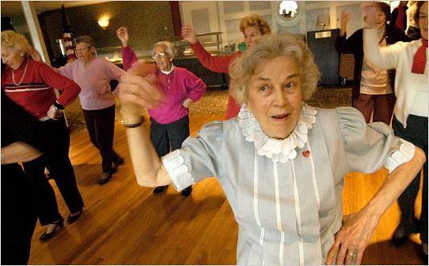
Needs of the Elderly
Notes:
Aging adults have different needs and concerns than teenagers. What issues do elderly community members have? How can you address those issues?

Slide 12
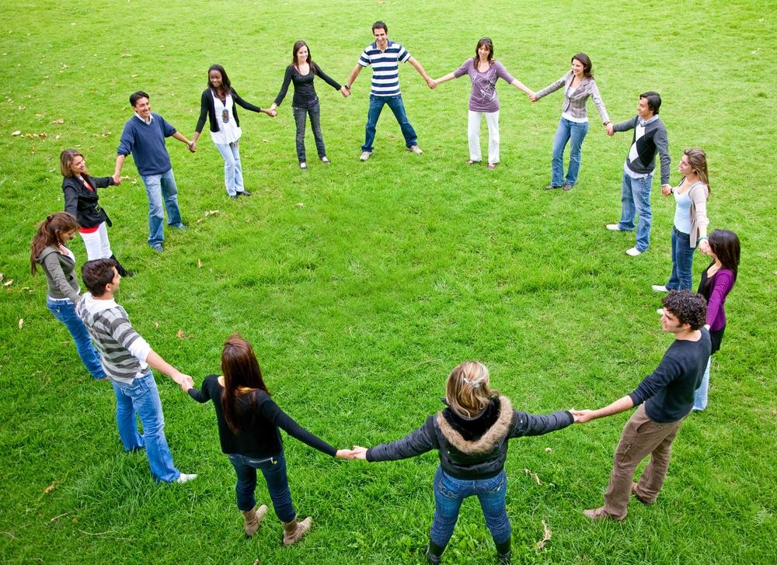
What Can We Do for Our School?
Notes:
When you look at our school as a community, you may see several pressing issues. What concerns do you have for our school? What opportunities for service learning would make a difference in our school? Brainstorm in small groups to determine what issues or concerns our small community has. Remember, it is your school, and your community.You can make a difference!

Slide 13
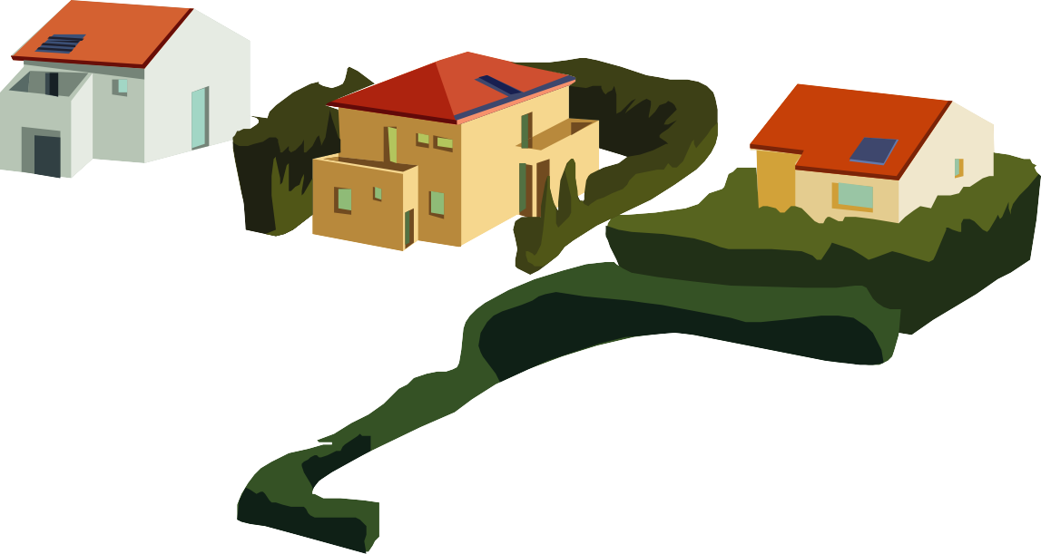
Think About Your Community Neighborhood
Notes:
Your community is anything in your surrounding area. This could mean the street where you live, your neighborhood, the neighborhood surrounding your school or even the entire town you live or go to school in. What issues or concerns can you see in your community? Brainstorm in small groups what concerns you may see.

Slide 14

Family Service Can Involve…
  Improving family life
  Meeting needs
  Providing assistance to others
  Applying skills to help others
Notes:
Family service learning opportunities are those that directly impact families. What issues do families face today? What do you think is the number one issue families encounter?

Slide 15

Who Serves Families in Our Community
  Churches
  Local Organizations
  Local/State Agencies
  Individuals
Notes:
When looking at the concerns of a group of people such as families, you need to consider who services those families on a regular basis. For example, families are regularly served by local churches through outreach programs such as festivals and back-to-school drives. It is important to consider these organizations because they can be of help to you when organizing your service learning opportunity.

Slide 16

Think about the Environment
Notes:
The environment is another possible concern you can choose to do service learning about. Ask the following: Who shares concerns about our environment? Who knows where our local recycling center is located? Who recycles at home?

Slide 17
Research the Identified Concern
  Library and internet research
  Personal, phone or Skype interviews
  Identify other groups interested in the issue
  Survey others
  Collect videos and photographs to document information
  Reflect
Notes:
It is important to examine the issues thoroughly to completely understand how the issue impacts the community. Researching the issue will also help you identify organizations that may be able to assist you in your project.

Slide 18
Discuss the Research - Share Ideas
  Brainstorm
  Discuss
  Ask questions
  Use decision-making skills
  Reflect
Notes:
It is important to focus on the issue and narrow the scope of the problem to specific needs.

Slide 19
Step 2 – Set a Goal
  Create a specific list of what you want to accomplish
  Write it down, be specific
  Make the goal measureable
Notes:
The second step in the FCCLA process is to set a goal and overall outcome for the project. It should be specific to your project and needs to be measurable.

Slide 20
Step 3 – Form a Plan
  What would be a realistic plan?
  How would this plan link to our curriculum/course TEKS?
  How could we evaluate the plan?
  Who could participate?
  Who might help or be a partner?
  What will it cost? Budget?
  Reflect
Notes:
Next, form a plan of action. How will you carry out the service project? Be as specific as possible in your planning and assign group members specific roles.

Slide 21
Step 4 – Act/Execute the Plan
  Document activities
  Work with partner
  Keep a journal
  Analyze data
  Reflect: think carefully about what you learned and what you plan to do next
Notes:
The next part of the process is to actually carry out the service project. Always keep documentation of your groups’ actions so you can later showcase examples of your work.

Slide 22
Step 5 – Follow-up and Reflect
  Collect information
  Analyze data
  Evaluate results – did you meet your goal?
  Decide to continue or make revisions
  Thank all partners and others who helped
  Reflect: think carefully about what you learned and what you plan to do next
Notes:
Now is the time to review the outcomes of your project - How did it go? Was the plan effective? Why or why not? What could be done differently? Did you meet your goal?

Slide 23
Identify – Showcase the Results
  Celebration
  Newspaper and TV Coverage
  Invite guests to share
  Make video for school webpage
  ?????
  Reflect
Notes:
At the end of the project, you should showcase your results and the impact your project made on the community.

Slide 24






Why Do It?
  Let me count the ways…
Personal
Why Volunteer?
Why Serve?
Professional
Notes:
Using either a Smart Board or dry erase board, brainstorm all of the reasons a person volunteers.

Slide 25
Service As A Career
  Case workers
  Family advocates
  Family specialist Clergy
  In Home consultants
  Therapist
  Day care teacher
  Counselor
  Financial advisor
  Child Care director
  Probation officer
  CPS officer
  Emergency Shelter Staff
  Personal home care aide
  Dietetic technician
  Social Worker
Notes:
If you are interested in service learning as a life-long career, there are several opportunities available to you.

Slide 26
  How can we expect our children to know and experience the joy of giving unless we teach them that the greater pleasure in life lies in the art of giving rather than receiving.
  - James Cash Penny
Notes:
Ask the following: What do you think James Cash Penny meant by this quote? Discuss the quote with the students.

Slide 27
Questions?

Slide 28
References And Resources
  Textbooks:
    Berger Kay, C. (2010). The complete guide to service learning. Minneapolis, MN: Free Spirit Publishing.
  Websites:
    Cathryn Berger Kaye
    Web page of international service learning consultant and author. Includes free curriculum materials and information about her books. http://www.cbkassociates.com/abcd-books/curriculum/quotable-quotes/ FCCLA
    Information about Service Learning activities and opportunities in Texas FCCLA http://texasfccla.org/Service_Learning.html
    National Service Learning Clearinghouse
    A web page with lesson plans, success stories, and information about other resources for service learning.
    http://www.servicelearning.org/
    National Service Learning Partnership
    A nationwide network for teachers and students to share their stories and resources. http://www.service-learningpartnership.org/

Slide 29
References And Resources
  Websites:
    ProTeacher
    Service Learning Project Ideas http://www.proteacher.org/c/868_Service_Leaning_Projects.html Good Character
    Character Education Resources http://www.goodcharacter.com/SERVICE/service.html GoToServiceLearning
    A site that includes lesson plans organized by topics, grade levels, and areas of study. http://www.gotoservicelearning.org/
    Do Something Good
    DoSomething.org harnesses teen energy and unleashes it on causes teens care about.
    http://www.dosomething.org/ Volunteer Match
    Find a Great Place to Volunteer http://www.volunteermatch.org/ Youth Service America
    Provides resources and funding for service learning. Students can register their projects.
    http://ysa.org/

