Slide 1
Creating an Effective Work Environment
Practicum in Human Services

Slide 3

Leadership at the Workplace

Slide 4

How can you become a good leader?

Slide 5

Steps to Becoming a Good Leader
Study the qualities of recognized good leaders
Study yourself. Determine weak and strong characteristics
Develop yourself as a good follower. Individuals who cannot obey cannot direct
Study the organization of various groups
Follow a definite plan for leadership training and improvement

Slide 6

Leadership Styles
Authoritarian
Democratic
Laissez-faire

Slide 7

Authoritarian
Characteristics:
Causes unhappy relationships to develop
Dictates group activity
Limits discussion on ideas

Slide 8

Democratic
Characteristics:
Allows group members to feel they can do tasks their own way
Is friendly and sociable
Keeps the group focused

Slide 9

Laissez-faire
Characteristics:
Allows group members to do whatever they want
Is less structured than democratic
Not very productive

Slide 10
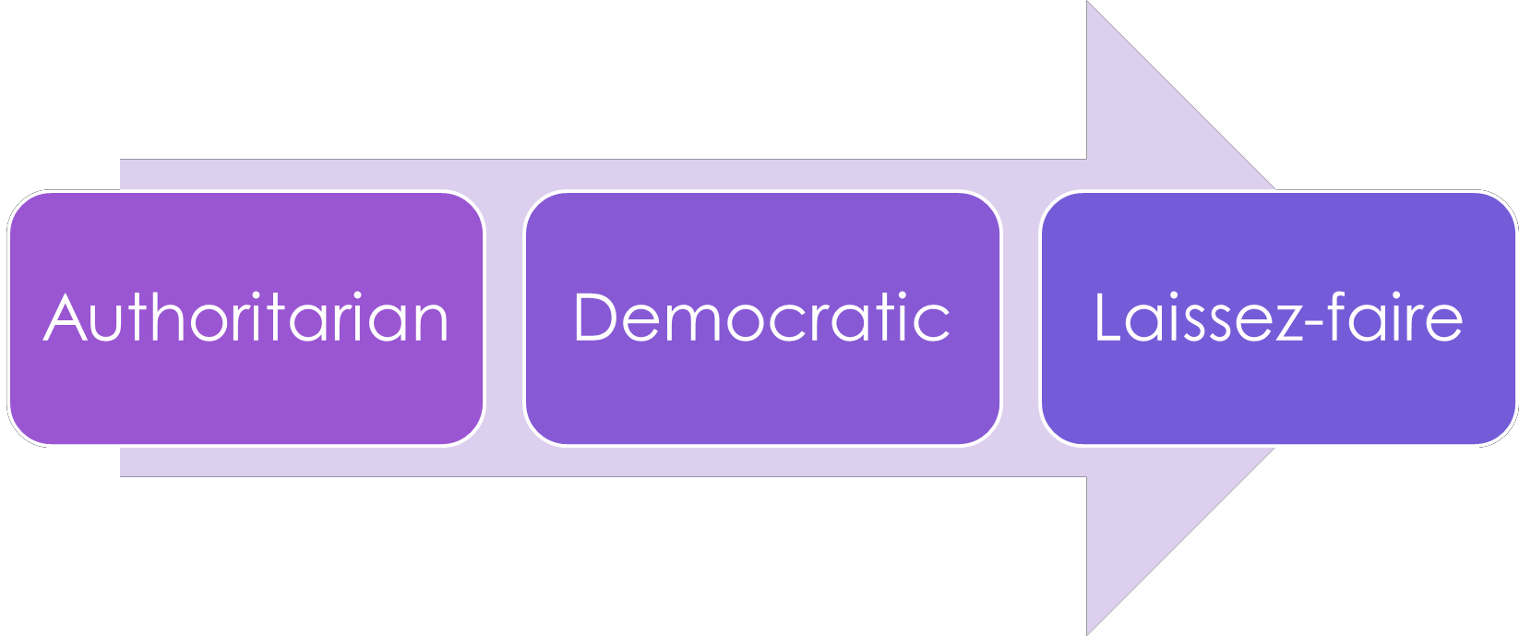
Leadership Styles

Slide 11

Teamwork

Slide 12


Roles of Members of a Group

Slide 13

Employer Expectations and Organizational Priorities

Slide 14

Hard and Soft Skills
The SCANS report presents a set of foundation skills and workplace competencies deemed essential for work world success today.

Slide 15

What are Soft Skills?

Slide 16

Soft Skills
The SCANS report presents a set of foundation skills and workplace competencies deemed essential for work world success today.

Slide 17

Communication Skills

Slide 18

Managing Your Organization’s Priorities
Clarify the organization’s mission statement
Create a prioritization process
Develop structures
Provide opportunities for collaboration

Slide 19
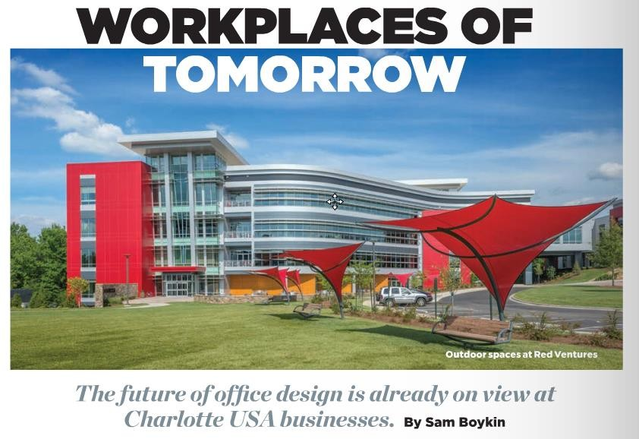
Workplaces of Tomorrow

Slide 20
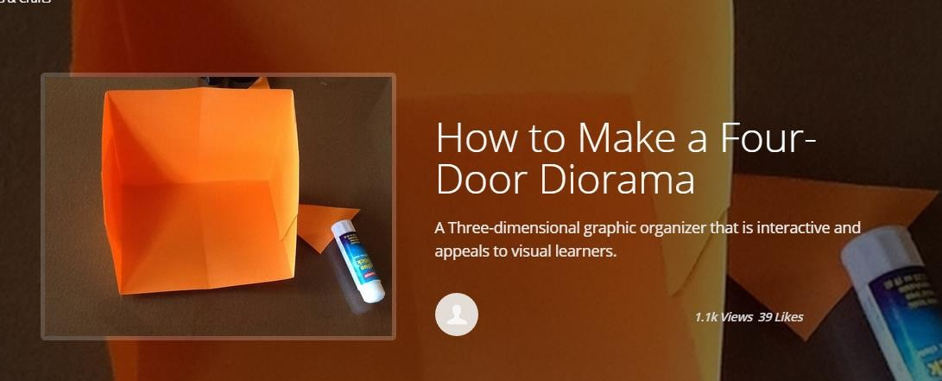
How to Make a Four-Door Diorama

Slide 21
Review
What are leadership skills?
Explain the steps to becoming a good leader.
Compare and contrast the following leadership styles:
  Authoritarian
  Democratic
  Laissez-faire
What are soft skills?
How can a business owner develop effective ways to manage the organization's priorities?

Slide 22
Questions?

Slide 23
References and Resources
Images:
Photos obtained through a license with Shutterstock.com™.
U.S. Airways – Workplaces of Tomorrow Websites:
Mind Tools - Leadership Styles – Choosing the Right Approach for the Situation http://www.mindtools.com/pages/article/newLDR_84.htm
Sam Ingersoll Management Skills - http://samingersoll.com/management-skills
Hongkiat.com - Five Characteristics of a Positive Work Environment http://www.hongkiat.com/blog/positive-working-environment

Slide 24
References and Resources
YouTube™:
How to Make a Four-Door Diorama http://snapguide.com/guides/make-a-four-door-diorama
Syntuity - What Are Soft Skills? https://youtu.be/Qjc8h6r_N8w
U.S. Department of Labor Communication Skills https://youtu.be/X0voPlW2pSs

