Slide 1
Educational Support Staff: Partners in Creating A Caring Learning Community
Educational Professional Support Services

Slide 3
Professional Support Services
  Education and Training Programs of Study
  Teaching and Training
  Administration and Administrative Support

Slide 4
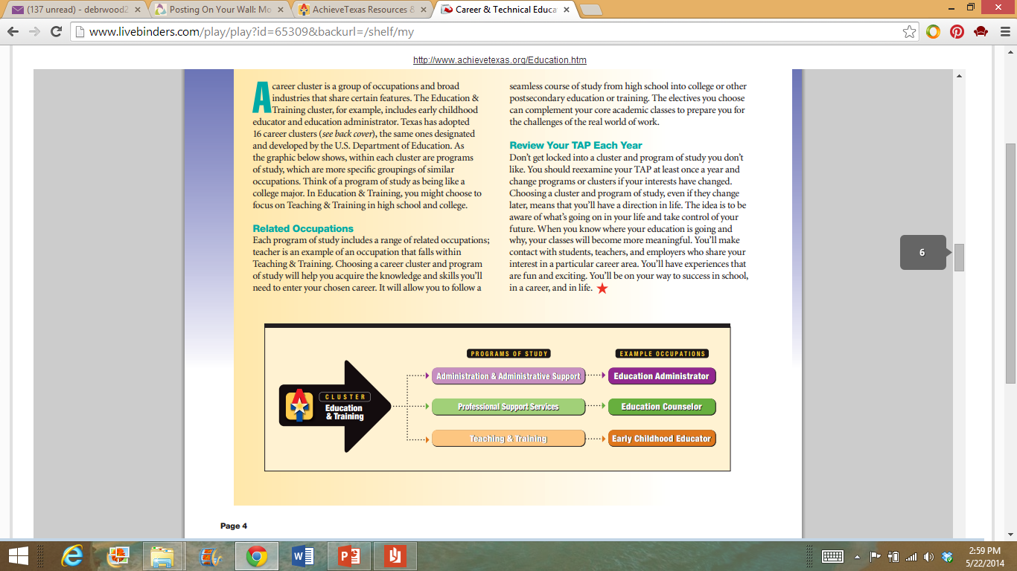
Programs of Study
Source: AchieveTexas
Notes:
Each program of study includes a range of related occupations; teacher is an example of an occupation that falls within Teaching and Training. Choosing a career cluster and program of study will help you acquire the knowledge and skills you’ll need to enter your chosen career.
What careers would fall within the professional support services?
What professional support services do we have at our campus?

Slide 5
Program Profiles
Source: AchieveTexas
Notes:
Here are the programs of study available within the Education and Training cluster in Texas high schools. The state has created programs of study for each of these areas. These documents detail high school classes you might take, extended learning opportunities, and postsecondary programs.
To download them, visit www.AchieveTexas.org/implementation.htm and click on the cluster icon for the area that interests you.
Administration and Administrative Support
In this field, professionals provide instructional leadership and manage the day-to-day activities in schools, colleges, and universities. They also manage educational programs in businesses, correctional facilities and community service organizations.
Professional Support Services
Professionals in this field assist students in schools with personal and family needs, mental health needs, educational goals and career decision-making.
Teaching and Training
In addition to being knowledgeable in the subjects they teach, professionals in this area must be able to communicate, inspire trust and confidence, motivate learners and understand their educational and emotional needs.
In this lesson, we will focus on professional support services.

Slide 6
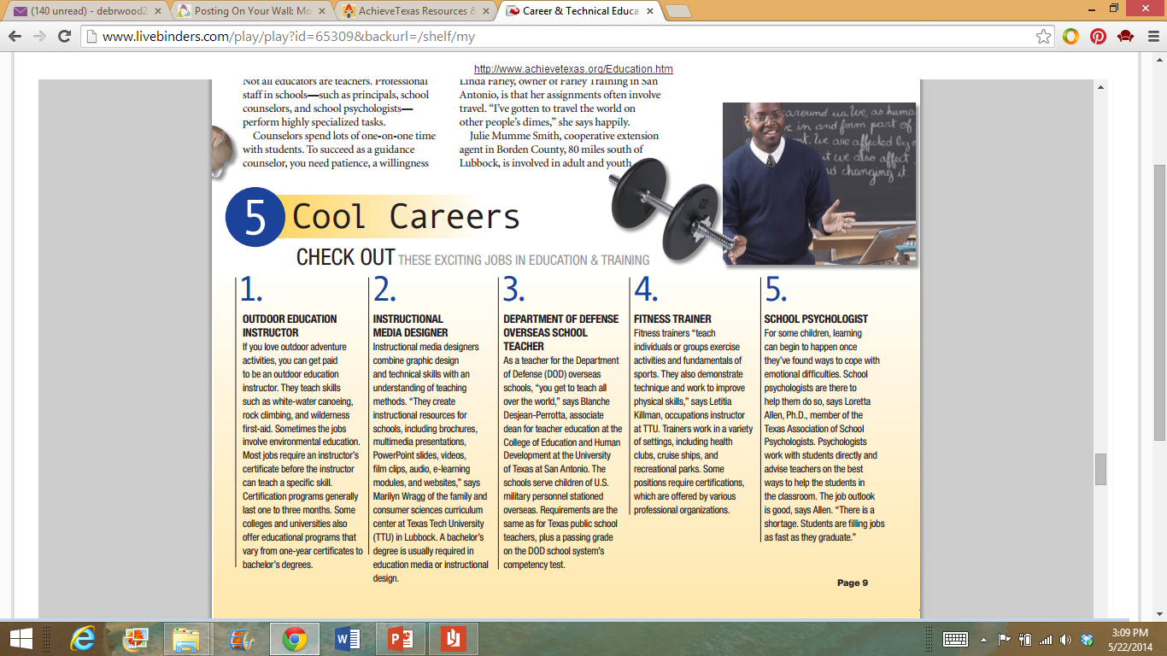
Variety of Opportunities
Source: AchieveTexas
Notes:
Other educators, including counselors, speech-language pathologists and school psychologists, choose to serve students one-on-one.
Would you like to be a speech-language pathologists? Why or why not?
Would you like to be a school psychologists? Why or why not?

Slide 7
Career and Cluster Videos
  (click on link)
Notes:
Teacher note: You may opt to show the students two Education and Training videos from this website. Click Education and Training videos.
Education and Training (Cluster video)
Clinical – Counseling – and School Psychologists
Career OneStop
These videos show the types of work people do in nearly 550 careers, organized by the 16 career clusters recognized by the U.S. Department of Education.
http://www.careeronestop.org/Videos/CareerandClusterVideos/career-and-cluster-videos.aspx

Slide 8
Professional Support Services Careers

Slide 9
Examples of Careers
  Audiologist
  Occupational Therapist
  Physical Therapist
  School Counselor
  Speech-Language Pathologist
  School Psychologist
  School Social Worker
  Vision Specialist

Slide 10
Audiologist

Slide 11
Audiologist
  Median pay: $69,720.00/year
  Number of jobs 2012: 13,000
Notes:
Audiologists make an average of $69,720.00 per year. There were an estimated 13,000 jobs in 2012.

Slide 12
Duties and Responsibilities
  Examine students who have hearing, balance or related ear problems
  Counsel students and their families
  See students regularly
Notes:
Audiologists work with students who have hearing, balance or other related ear problems. They also counsel with students regularly to meet their individual needs.

Slide 13
  Environment
    Full-time position
  Education
    Doctoral degree in audiology (Au.D.)
    Licensed by the state
    Certificate of Clinical Competence in Audiology (CCC-A)
    American Board of Audiology
Notes:
This is a full-time position that sometimes requires weekend and evenings to meet students’ needs.
Individuals wishing to become an audiologist must complete a doctoral degree in audiology and must be licensed by the state. Audiologists can opt to receive a Certificate of Clinical Competence in Audiology and can join the American Board of Audiology.

Slide 14
Occupational Therapist

Slide 15

Occupational Therapist
  Median pay: $75,400.00/year
  Number of jobs 2012: 113,200
Notes:
Occupational therapists make an average of $75,400.00 per year. There were an estimated 113,200 jobs in 2012.

Slide 16

Duties and Responsibilities
  Treat students for disabilities
  Demonstrate exercises for students
  Recommend special equipment for students
Notes:
One of the main duties of an occupational therapist (OT) is to treat students who have physical disabilities. OTs demonstrate exercises for students and help students practice exercises that will improve physical well-being. Educational OTs may also help recommend special equipment or services for students to assist them in the classroom.

Slide 17
  Environment
    12% of all OT work in the educational setting
    Full-time position
  Education
    Master’s degree
    License by the National Board of Certification in Occupational Therapy
    American Occupational Therapy Association
Notes:
Of all occupational therapists, 12 percent work in school districts or the educational setting. This is a full-time position.
A master’s degree in occupational therapy is required for a career in OT. All OTs must pass the national exam administered by the National Board of Certification in Occupational Therapy to receive their license. Also, members of the American Occupational Therapy Association can become certified in specific subjects to signify specialized knowledge in topics such as pediatrics, mental health or low vision.

Slide 18
Physical Therapist

Slide 19
Physical Therapist
  Median pay: $79,860.00/year
  Number of jobs 2012: 204,200
Notes:
Physical therapists make an average of $79,860.00 per year. There were an estimated 204,200 jobs in 2012.

Slide 20

Duties and Responsibilities
  See students and families regularly
  Arrange care plans for students
  Help students perform exercises
  Evaluate student progress
Notes:
Educational physical therapists (PT) work similarly to occupational therapists because they both work with students to improve functional problems from injuries, sprains, fractures and other conditions. They create care plans for their students and help them perform exercises. PTs must perform regular evaluations to ensure student needs are met.

Slide 21
  Environment
    Full-time position
    Evenings and weekends
  Education
    Doctoral of Physical Therapy (DPT)
    Physical Therapist Centralized Application Services
    Residency for one year
    Federation of State Board of Physical Therapy
    American Board of Physical Therapy Specialists
Notes:
Physical therapists work full-time, often long hours with their students. Because they are often helping students with exercises, they are vulnerable to injuries.
Physical therapists must earn a doctoral of physical therapy and apply to the Physical Therapist Centralized Application Services. After that, PTs must serve a one-year residency for additional training. Then, they become licensed through the Federation of State Board of Physical Therapy. Physical therapists can gain additional certifications through the American Board of Physical Therapy Specialists.

Slide 22
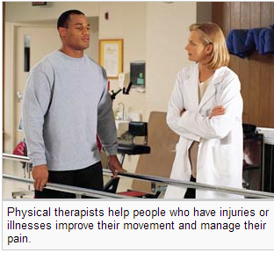
Physical Therapist Careers
  Physical Therapist
  (click on link)
Image: Bureau of Labor Statistics
Notes:
Physical Therapist Careers
Learn exactly what physical therapists do with this video from the American Physical Therapist Association.
https://www.youtube.com/watch?v=1Z2Ib4Meul4

Slide 23
School Counselor

Slide 24
School Counselor
  Median pay: $53,610.00/year
  Number of jobs 2012: 262,300
Notes:
School counselors make an average of $53,610.00 per year. There were an estimated 262,300 jobs in 2012.

Slide 25

Duties and Responsibilities
  Counsel students
  Work with teachers, staff and parents
  Classroom guidance
  Refer students and families for additional support
Notes:
Elementary, middle and high school counselors counsel students on a variety of topics such as organization, time management, study skills, goal setting and careers. They offer classroom guidance in the areas of bullying, drug abuse and college and career planning. Lastly, they refer students and families for additional services.

Slide 26
  Environment
    Full-time position
    Summers off
  Education
    Master’s degree in school counseling
    1-2 years of classroom teaching experience
    2,000-3,000 hours of clinical supervision
    National Board of Certified Counselors
Notes:
School counselors work full-time during the school year and typically have off during the summers.
School counselors usually are teachers for 1-2 years before beginning a master’s in school counseling program. They must have 2,000-3,000 hours of clinical supervision and be certified by the National Board of Certified Counselors.

Slide 27
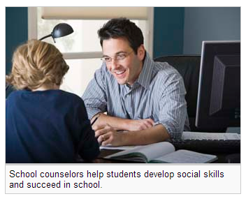
Job Shadow a school counselor
  School Counselor
  (click on link)
Image: Bureau of Labor Statistics
Notes:
Job Shadowing a School Counselor
High school students job shadow their high school counselor, Mr. Carlin.
https://www.youtube.com/watch?v=R0ChABV00cY&list=PL9w61LOHH6iScWTmbHVr5ux4bXLNKW8FW

Slide 28
Speech-language Pathologist

Slide 29
Speech-language Pathologist
  Median pay: $68,870.00/year
  Number of jobs 2012: 134,100
Notes:
Speech language pathologist make an average of $68,870.00 per year. There were an estimated 134,100 jobs in 2012.

Slide 30
Duties and Responsibilities
  Work with students with speech or communication disabilities
  Create individualized care plans
Notes:
Speech language pathologists work with students who have speech or communication disorders. They determine the level of care needed, and create individualized care plans for them.

Slide 31
  Environment
    Full-time position
    Summers off
  Education
    Masters degree
    American Speech-Language-Hearing Association
Notes:
Speech language pathologists who work in the school district usually work full-time positions and have summers off.
In order to pursue a career in speech language pathology, you must obtain a masters degree in a speech language program. Then, you must pass certifications from the American Speech-Language-Hearing Association.

Slide 32
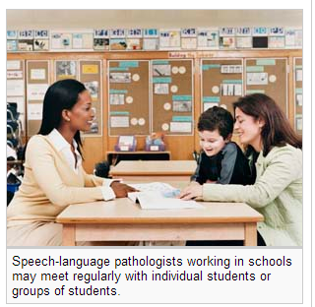
Rewards of the Profession
  Become an Audiologist and Reward Yourself with a Career that Helps Others
  (click on link)
Image: Bureau of Labor Statistics
Notes:
Become an Audiologist and Reward Yourself with a Career that Helps Others
Audiologists and speech-language pathologists (SLP) discuss rewards of the professions and the joy they receive by helping people to communicate.
http://youtu.be/_OIcPbndZMo

Slide 33
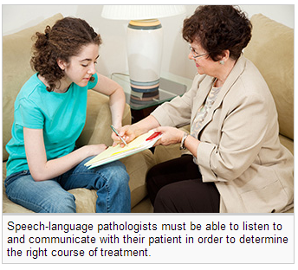
  Speech-Language Pathologist
  (click on link)
Image: Bureau of Labor Statistics
Notes:
University of Central Florida
The university highlights careers in speech-language pathology.
https://www.youtube.com/watch?v=ObhBkVWRpaM

Slide 34
School Psychologist

Slide 35
School Psychologist
  Median pay: $69,280.00/year
  Number of jobs 2012: 160,200
Notes:
School psychologists make an average of $69,280.00 per year. There were an estimated 160,200 jobs in 2012.

Slide 36
Duties and Responsibilities
  Work with students to treat:
    Mental
    Emotional
    Behavioral
Notes:
School psychologists work with students one-on-one to treat mental, emotional and behavioral disorders.

Slide 37

  Environment
    Full-time position
    Summers off
  Education
    Ph.D. in psychology or a doctoral of psychology (Psy.D.)
    State license
    Supervised program
    Internship
    Residency program
Notes:
Usually school psychologists work full-time positions and have summers off.
The process to becoming a school psychologist is a lengthy one. First you must complete a Ph.D. in psychology or a doctoral of psychology program, then apply for state licensure. Then, you must enter into a supervised program, internship and lastly, a residency program.

Slide 38
School Social Worker

Slide 39
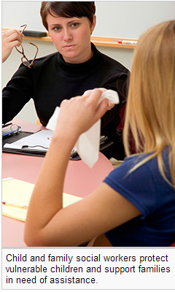
School Social Worker
  Median pay: $44,200.00/year
  Number of jobs 2012: 607,300
Image: Bureau of Labor Statistics
Notes:
School social workers make an average of $44,200.00 per year. There were an estimated 607,300 jobs in 2012.

Slide 40
Duties and Responsibilities
  Work with teachers, parents and staff to create plans to improve social development
    Aggression
    Bullying
    Absences
Notes:
School social workers work with teachers, parents and staff to create plans to improve social development throughout the campus in the areas of aggression, bullying and absences.

Slide 41
  Environment
    Full-time position
    Summers off
  Education
    Bachelors degree in social work
Notes:
Usually school psychologists work full-time positions and have summers off.
This career requires a bachelor’s degree in social work.

Slide 42
Vision Specialist

Slide 43
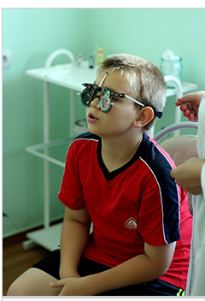
Vision Specialist
  Median pay: $55,060.00/year
  Number of jobs 2012: 442,800
Image: Bureau of Labor Statistics
Notes:
Vision specialists make an average of $55,060.00 per year. There were an estimated 442,800 jobs in 2012.

Slide 44
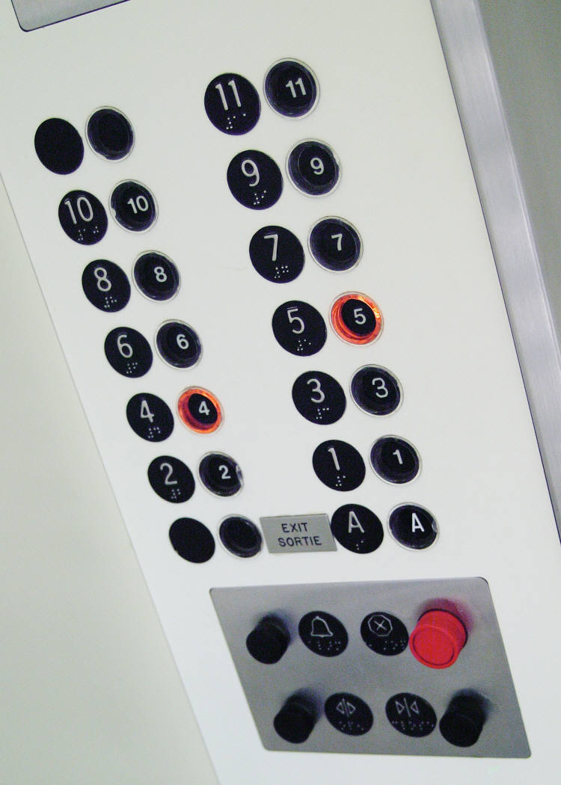
Duties and Responsibilities
  Provides Braille instruction
  Provides adaptive materials
  Works with students, families, teachers and staff
  Creates instructional plans for students
Notes:
The vision specialist works with students, families, teachers and staff to create instructional plans for students who are blind or have low vision. They provide instruction in Braille, or adaptive materials such as large print books or computer programs. The vision specialist does not test visual acuity or make any kind of medical diagnosis.

Slide 45

  Environment
    Full-time position
    Summers off
  Education
    Bachelor’s degree in education or a related field
    Teaching certificate
    Vision impairment certificate
Notes:
Usually school psychologists work full-time positions and have summers off.
A vision specialist is a certified teacher who holds an additional certificate in vision impairment.

Slide 46
Questions?

Slide 47
References and Resources
  Images:
    Bureau of Labor Statistics
    Microsoft Clip Art: Used with permission from Microsoft.
  Books:
    Early Childhood Education Today, Twelfth Edition by George S. Morrison
    This book is a great resource on early childhood education. It covers the foundation of education, programs and resources for children and families, educational needs of infants through the primary grades and the special needs of children and families.
    Introduction To Teaching: Becoming A Professional. (Fifth ed.). by Don Kauchak & Paul Eggen
    For any student going into the teaching profession, this is an excellent choice. It is an easy read for students on all levels. It covers the changing teaching profession, the foundations of education and how to become an effective teacher.

Slide 48
References and Resources
  Websites:
    AchieveTexas: AchieveTexas College and Career Initiative is an education initiative designed to prepare students for a lifetime of success. It allows students to achieve excellence by preparing them for secondary and postsecondary opportunities, career preparation and advancement, meaningful work, and active citizenship.
    http://www.achievetexas.org/
    American School Counselor Association (ASCA)
    The ASCA provides information about how to become a school counselor. It also provides current school counselors with resources such as periodicals and information related to professional development conferences.
    http://www.schoolcounselor.org/
    Bureau of Labor Statistics
    Teacher’s guide: Occupational Outlook Handbook
    http://www.bls.gov/ooh/about/teachers-guide.htm
    Texas Association of Future Educators (TAFE)
    Advisor Handbook – Competitive Events
    http://www.tafeonline.org/?page=CompetitiveEvents

Slide 49
References and Resources
  YouTube™:
    American Speech-Language-Hearing Association
    The ASLHA gives a complete overview of the audiology career.
    https://www.youtube.com/watch?v=_OIcPbndZMo
    Job Shadowing a School Counselor
    High school students job shadow their high school counselor, Mr. Carlin.
    https://www.youtube.com/watch?v=R0ChABV00cY&list=PL9w61LOHH6iScWTmbHVr5ux4bXLNKW8FW
    Physical Therapist Careers
    Learn exactly what physical therapists do with this video from the American Physical Therapist Association.
    https://www.youtube.com/watch?v=1Z2Ib4Meul4
    University of Central Florida
    The university highlights careers in speech-language pathology.
    https://www.youtube.com/watch?v=ObhBkVWRpaM

