Slide 1
Factors that Affect Housing Choices
Notes:
Housing decisions are the most important decisions consumers make. Housing expenses are usually the largest expense a consumer must pay. Housing is a basic human need and can be a source of great psychological satisfaction.

Slide 3
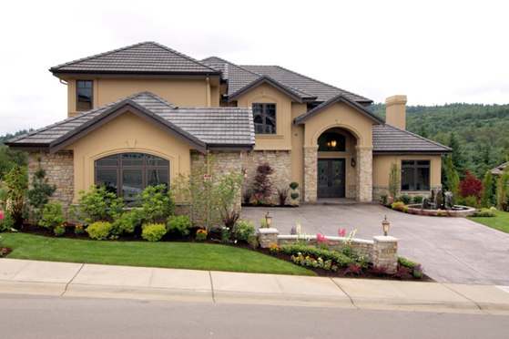
Types of Housing
  Single-Family Detached
    A home with no shared walls, designed to be used by one household
  Duplex
    A building that has two separate living spaces for two households
Notes:
Types of Housing
Single-family detached housing – a home with no shared walls, designed to be used by one household
Duplex – a building that has two separate living space for two separate households
Do you live in a single-family detached home?
Do you live in a duplex?
What are the advantages and disadvantages of living in a single-family detached house?
What are the advantages and disadvantages of living in a duplex?
Which is better?
Every consumer has a unique financial and personal situation which will impact his or her housing decisions. It’s important for the consumer to consider costs when deciding on housing.

Slide 4

Types of Housing
  Row Houses or Townhouses
    Separate dwellings for separate households that share attached walls
  Apartments
    Buildings that have multiple living spaces
Notes:
Types of Housing
Row Houses or Townhouses – separate dwellings for separate households that share attached walls
Apartments – buildings that have multiple living spaces, where each living space is designed for single households
Do you live in a row house or townhouse?
Do you live in an apartment?
What are the advantages and disadvantages of living in a row house or townhouse?
What are the advantages and disadvantages of living in an apartment?

Slide 5
Types of Housing
  Condominium
    Several units built together, but each unit is purchased as a separate home
  Manufactured Home
    Built in the controlled environment of a manufacturing plant and transported in one or more sections on a permanent chassis
Notes:
Types of Housing
Condominiums – a building with several units built together, where each unit is purchased as a separate home.
Manufactured Home (formerly known as a mobile home) – a home built to the Manufactured Home Construction and Safety Standards (HUD Code) and which displays a red certification label on the exterior of each transportable section; built in the controlled environment of a manufacturing plant and transported in one or more sections on a permanent chassis.
Do you live in a condominium?
Do you live in a manufactured home?
What are the advantages and disadvantages of living in a condominium?
What are the advantages and disadvantages of living in a manufactured home?

Slide 6
Types of Housing Options for Older Adults
  Retirement Village – 55 + Communities
  Senior Assisted Living
  Nursing Homes
Notes:
Types of Housing
As individuals age, their housing options may change. Some senior adults opt to live in retirement communities, senior assisted living facilities or nursing homes.
Have you ever been to a nursing home? What amenities do nursing homes have?
What is the difference between a senior assisted living facility and a retirement village?

Slide 7
Renting
Notes:
What does it mean to rent your home?
All housing can be either rented or owned. Both options have advantages and disadvantages. With renting, the owner of a property, called a landlord, agrees to allow a tenant to live in the property for a specified period of time. Both parties sign a legal document called a lease. The landlord retains ownership and control while the tenant pays rent for the right to live in the property. The landlord is usually responsible for most maintenance. The tenant has predictable costs and responsibilities.

Slide 8
Advantages of Renting
  Upfront costs are lower
  You are able to invest your money
  Freedom to move to another part of the city or country
  You do not have to worry about the ability to pay a mortgage
  Time to establish or improve your credit score
Notes:
What are the advantages of renting?
Upfront costs are lower than a down payment for purchasing a home.
You are able to invest your money in CD’s or other money market options rather than spend it on a home.
You have the freedom to move to another part of the city or country without being tied to a mortgage.
You do not have to worry about the ability to pay a mortgage due to an uncertainty of income resulting from pay cuts in the future.
You have time to establish or improve your credit score by creating a history of paying your rent on time.

Slide 9
Disadvantages of Renting
  Your monthly rent checks might be more than an actual mortgage payment
  You do not have the freedom to expand your living space
  Neighbors are at close proximity
  Some facilities do not allow pets
  Lack of yards, trees and plants
Notes:
What are the disadvantages of renting?
Your monthly rent checks might be more than an actual mortgage payment as rent increases from year to year.
You do not have the freedom to expand your living space.
Neighbors are at close proximity; a lack of privacy, irritations and disputes might arise.
Some facilities do not allow pets.
There may be a lack of yards, trees and plants.

Slide 10
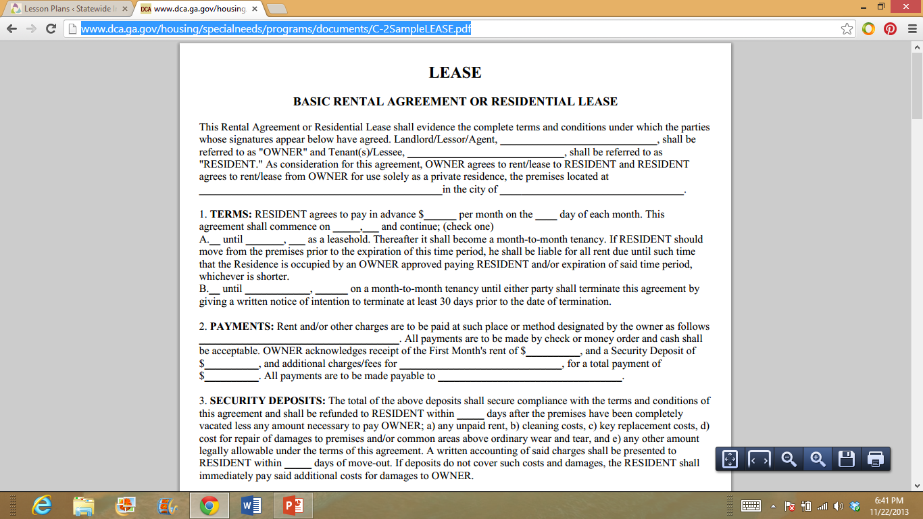
Sample of a Lease Agreement
  Sample of a Lease
(click on link)
Notes:
What elements must be included in a lease agreement?
Is a lease a legal contract?
What is a security deposit? State laws differ about how much an owner can require in deposits by type: security, first or last month's rent, or pet and damage deposits. Lease documents should be clear as to the amounts, how the money will be held and if interest is earned.
Is there a penalty for breaking a lease agreement?
Basic Rental Agreement or Residential Lease
As consideration for this agreement, OWNER agrees to rent/lease to RESIDENT.
RESIDENT agrees to rent/lease from OWNER for use solely as a private residence.
http://www.dca.ga.gov/housing/specialneeds/programs/documents/C-2SampleLEASE.pdf

Slide 11

Owning a Home
  The buyer has the value of equity in the home, which is an ownership.
Notes:
The consumer who decides to buy housing gains full control over the property. One can either pay cash (which is unusual) or obtain a mortgage (closed end, secured debt for the consumer for a fixed length of time, for specified interest).
What are the advantages of owning a home?
The buyer has the value of equity in the home, which is an ownership.
The home can be considered an investment in that the homeowner hopes the value will increase.
The owner gains a tax advantage; interest is deductible and will reduce tax liability.
What are the disadvantages of owning a home?
The owner is responsible for all maintenance costs.
If the owner has to move for any reason, decisions will have to be made about what to do with the property – either sell it to someone else or rent it to a tenant.
Buying a home requires a large amount for a down payment.
The owner must pay property taxes.

Slide 12

Financing a Home
  A mortgage — whether it’s a home purchase, a refinancing, or a home equity loan — is a product, just like a car, so the price and terms may be negotiable.
Notes:
Shopping around for a home loan or mortgage will help you get the best financing deal. A mortgage — whether it’s a home purchase, a refinancing, or a home equity loan — is a product, just like a car, so the price and terms may be negotiable. You’ll want to compare all the costs involved in obtaining a mortgage. Shopping, comparing and negotiating may save you thousands of dollars.

Slide 13
What is a Mortgage?
  Introduction to Mortgage Loans
  (click on link)
Notes:
Khan Academy
Introduction to Mortgage Loans
https://www.khanacademy.org/science/core-finance/housing/mortgages-tutorial/v/introduction-to-mortgage-loans

Slide 14

Obtain Information from Several Lenders
  Home loans are available from several types of lenders — thrift institutions, commercial banks, mortgage companies and credit unions.
  Financing options vary depending on the lender.
Notes:
Home loans are available from several types of lenders — thrift institutions, commercial banks, mortgage companies and credit unions. Different lenders may quote you different prices, so you should contact several lenders to make sure you’re getting the best price.
Each lender offers different types of financing options. Mortgages come in two basic forms: fixed rate and adjustable rate. With a fixed rate mortgage, the interest rate remains the same for the life of the loan. This means the payment will never go up or down. An adjustable rate mortgage (ARM) is one where the rate may go up or down; the monthly mortgage payment will go up or down, too. Such mortgages are also called variable rate mortgages.
Subprime mortgages are higher interest rate loans made to people with poor credit scores. How have these types of loans affected the economy? Over time people found that they could not afford to make the payments and defaulted. These widespread defaults became known as the “subprime meltdown” or “subprime crisis.” It has affected homeowners, companies that lent the money and taxpayers across the country.
Why would someone choose an ARM over a fixed rate?
What are the current interest rates for mortgages in our area?

Slide 15
Obtain All Important Cost Information
  Rates
  Points
  Fees
  Down Payments
  Private Mortgage Insurance
Notes:
As a consumer, be sure to get information about mortgages from several lenders or brokers. Know how much of a down payment you can afford, and find out all the costs involved in the loan. Knowing just the amount of the monthly payment or the interest rate is not enough.
Rates – Ask each lender and broker for a list of its current mortgage interest rates and whether the rates being quoted are the lowest for that day or week.
Points – Ask each lender about points, which are fees paid to the lender or broker for the loan and are often linked to the interest rate; usually the more points a person pays, the lower the rate.
Fees – A home loan often involves many fees, such as loan origination or underwriting fees, broker fees, and settlement (or closing costs). Every lender or broker should be able to give an estimate of its fees.
Down Payments and Private Mortgage Insurance – Some lenders require 20 percent of the home’s purchase price as a down payment. However, many lenders now offer loans that require less than 20 percent down — sometimes as little as 5 percent on conventional loans.
If a 20 percent down payment is not made, lenders usually require the home buyer to purchase private mortgage insurance (PMI) to protect the lender in case the home buyer fails to pay.
Other common expenses include:
Appraisal fees
Home inspection fees
Mortgage origination fees
Loan application fees
Filing fees
Title insurance
Points to buy down the interest rate--a point is equivalent to 1% of the loan amount.
These expenses are often referred to as closing costs which can total several thousands of dollars.

Slide 16

Obtain the Best Deal That You Can
  Shop
  Compare
  Negotiate
  Obtain a written lock-in from the lender or broker
Notes:
Once you are satisfied with the terms you have negotiated, you may want to obtain a written lock-in from the lender or broker. The lock-in should include the rate that you have agreed upon, the period the lock-in lasts and the number of points to be paid. A fee may be charged for locking in the loan rate. This fee may be refundable at closing.
Remember: Shop, Compare, Negotiate - When buying a home, remember to shop around, compare costs and terms and negotiate for the best deal. Your local newspaper and the Internet are good places to start shopping for a loan.

Slide 17
Your Rights and Responsibilities
Notes:
What are your rights and responsibilities associated with renting or buying a home?

Slide 18

Fair Housing and Equal Opportunity
  The Fair Housing Act prohibits discrimination on the basis of race, color, religion, national origin, sex, marital status, age and the source of income.
  The Equal Credit Opportunity Act prohibits lenders from discriminating against credit applicants in any aspect of a credit transaction.
Notes:
The Office of Fair Housing and Equal Opportunity (FHEO) administers and enforces federal laws and establishes policies that make sure all Americans have equal access to the housing of their choice.
The Fair Housing Act prohibits discrimination in residential real estate transactions on the basis of race, color, religion, sex, handicap, familial status or national origin.
Under these laws, a consumer may not be refused a loan based on these characteristics nor be charged more for a loan or offered less-favorable terms based on such characteristics.
The Fair Housing Act covers most housing. In some circumstances, the Act exempts owner-occupied buildings with no more than four units, single-family housing sold or rented without the use of a broker, and housing operated by organizations and private clubs that limit occupancy to members.
The Equal Credit Opportunity Act prohibits lenders from discriminating against credit applicants in any aspect of a credit transaction. It prohibits discrimination on the basis of race, color, religion, national origin, sex, marital status, age, whether all or part of the applicant’s income comes from a public assistance program, or whether the applicant has in good faith exercised a right under the Consumer Credit Protection Act.

Slide 19
What is Prohibited?
  Sale and Rental of Housing
    Refuse to rent or sell housing
    Refuse to negotiate for housing
    Make housing unavailable
    Deny a dwelling
  Mortgage Lending
    Refuse to make a mortgage loan
    Refuse to provide information regarding loans
    Impose different terms or conditions on a loan, such as different interest rates, points or fees
Notes:
What Is Prohibited?
In the sale and rental of housing, no one may take any of the following actions based on race, color, national origin, religion, sex, familial status or handicap:
Refuse to rent or sell housing
Refuse to negotiate for housing
Make housing unavailable
Deny a dwelling
Set different terms, conditions or privileges for sale or rental of a dwelling
Provide different housing services or facilities
Falsely deny that housing is available for inspection, sale or rental
For profit, persuade owners to sell or rent (blockbusting)
Deny anyone access to or membership in a facility or service (such as a multiple listing service) related to the sale or rental of housing
In mortgage lending, no one may take any of the following actions based on race, color, national origin, religion, sex, familial status or handicap (disability):
Refuse to make a mortgage loan
Refuse to provide information regarding loans
Impose different terms or conditions on a loan, such as different interest rates, points or fees
Discriminate in appraising property
Refuse to purchase a loan
Set different terms or conditions for purchasing a loan
In addition, it is illegal for anyone to:
Threaten, coerce, intimidate or interfere with anyone exercising a fair housing right or assisting others who exercise that right
Advertise or make any statement that indicates a limitation or preference based on race, color, national origin, religion, sex, familial status or handicap. This prohibition against discriminatory advertising applies to single-family and owner-occupied housing that is otherwise exempt from the Fair Housing Act.
Additional protection can be provided if you or someone associated with you:
Have a physical or mental disability (including hearing, mobility and visual impairments, chronic alcoholism, chronic mental illness, AIDS, AIDS-related complex and mental retardation) that substantially limits one or more major life activities
Have a record of such a disability
Are regarded as having such a disability

Slide 20
Housing Costs and Skills
  Adjust your money habits
  Aim to save a deposit of 20% or more of the purchase price of your home to avoid paying lenders mortgage insurance (LMI)
  Move in with a family member while saving for a home
  Make the most of your savings
  Savings Calculator
  (click on link)
Notes:
The biggest single purchase you will make in your life will be a home. You will need to financially plan for this purchase.
What is lenders mortgage insurance (LMI)? Lenders mortgage insurance, also known as private mortgage insurance in the United States, is insurance payable to a lender or trustee for a pool of securities that may be required when taking out a mortgage loan.
Be prepared to scrutinize past choices and, if necessary, to adjust your money habits. Cut back on the extras. What things could be considered extras? Decisions you make today will influence your future options.
While it may not seem that appealing, many young people choose to move back into the family home while they are saving for their first house. Rent is likely to be one of your biggest expenses, so if you can avoid paying this, you could increase your savings very quickly.
Make the most of what you save. Once you have worked out how much you can save, make your money work for you. If you leave it in your everyday transaction account, you might be tempted to use the cash. You will also earn less interest than you would with other accounts or options. Use the savings calculator to determine how much you would have to save monthly to save $20,000 in two years. You have $5000.00 as a starting balance and the interest rate is 7%. The answer is $551.70 monthly.

Slide 21

Key Steps
  Organize
  Be aware of spending and savings
  Negotiate
  Evaluate your credit score
  Read and be knowledgeable about the fine print
Notes:
The key steps include:
Organize – Set a personal goal to save a certain amount each month and stick to it. Be disciplined in your savings practices, and plan financially to achieve your goals.
Be aware of spending and savings – Prioritize your family’s spending to enable you to save the maximum amount each month.
Negotiate – Talk to your creditors to help you develop a new payment plan. Many creditors will work with consumers to aid them in paying off their debts sooner.
Evaluate your credit score – Know your credit score and what it means to banks and credit card companies and your future. Good credit is essential to your finances. Banks and credit card companies select whether to lend you money and what interest rates you will pay based on your credit score.
Read and be knowledgeable about the fine print. Determine which option is the best for you and your family. Know your rights. Be well-informed before you sign on the dotted line.

Slide 22

Questions?

Slide 23
References and Resources
  Images
    Microsoft Clip Art: Used with permission from Microsoft.
  Textbooks:
    Parnell Frances Baynor. (2001). Skills for personal and family living. (pp. 195-206). Tinley Park: The Goodheart-Willcox Publishing Company.
    Ross Lowe, 2006. Consumer education & economics, Student Edition. 6 Edition. Glencoe/McGraw-Hill.
    Sasse Connie. (2004). Families today. (4th ed., pp. 285-304). New York: McGraw Hill Glencoe.
  Websites:
    Federal Trade Commission
    Homes and Mortgages
    http://www.consumer.ftc.gov/topics/homes-mortgages
    New York Times
    Renting versus purchasing calculator.
    http://www.nytimes.com/interactive/business/buy-rent-calculator.html

Slide 24
References and Resources
  Websites:
    Realty Times
    10 Tips Every Tenant Needs to Know.
    http://realtytimes.com/rtpages/19980701_10tips.htm
    U.S. Department of Housing and Urban Development
    Buying a home.
    http://portal.hud.gov/hudportal/HUD?src=/topics/buying_a_home
    Yahoo! Homes
    Pros and cons of renting versus buying a home article.
    http://homes.yahoo.com/news/pros-and-cons-of-renting-vs—buying-a-home-20120531.html;_ylt=AoWVPAIKU.PUSkKVdJN3tKCavYl4
  YouTube™:
    Khan Academy
    Introduction to Mortgage Loans
    https://www.khanacademy.org/science/core-finance/housing/mortgages-tutorial/v/introduction-to-mortgage-loans

