Slide 1
Foundations of Safe food
Purchasing, receiving and storage

Slide 3
Purchasing
Safe practices
Notes:
Purchasing involves buying products for the foodservice operation.

Slide 4
Foodservice purchasing steps
Notes:
Purchasing includes the steps and procedures necessary to procure food products needed to create and prepare food items in the foodservice setting.
It also includes:
establishing product specifications
writing purchase orders
working with vendors to place orders

Slide 5
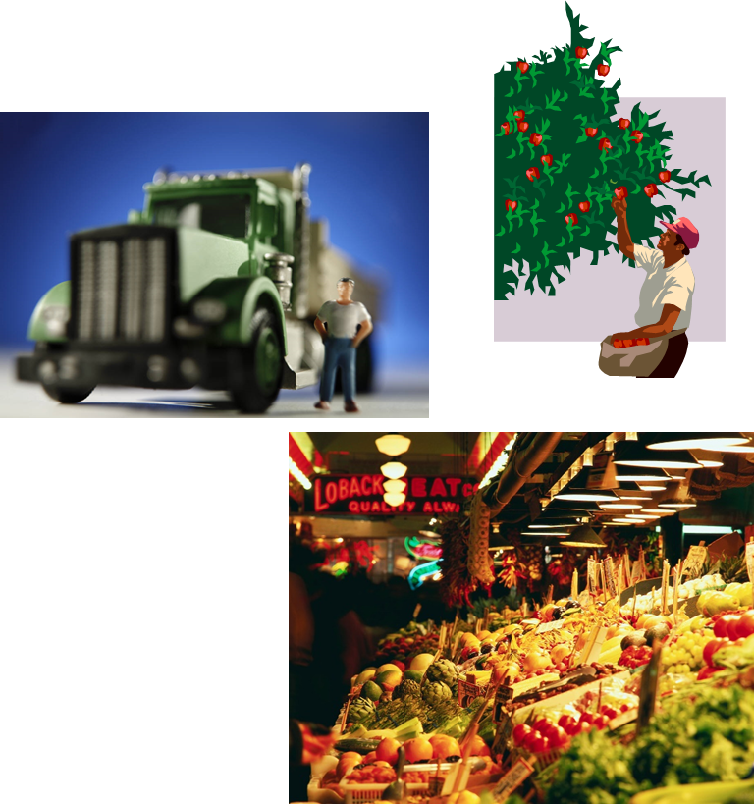
Safe purchasing practices
Purchase from an approved, reputable supplier
Suppliers should be:
Inspected
Meet local, state and federal laws
Suppliers include:
Distributors
Growers
Local markets
Manufacturers
Packers
Shippers
Notes:
Always purchase from approved, reputable suppliers. These vendors should show unwavering commitment to providing safe food for the operation. Get to know the vendors and their safety practices. In order for food to be safe, it has to start safe.
Arrange deliveries so they arrive one at a time and during off-peak hours.

Slide 6
Products purchased
Perishable food
Fresh fruits
Meat
Poultry
Seafood
Vegetables
Semi-perishable foods
Pickled vegetables
Processed meats
Smoked fish
Nonperishable foods
Canned goods
Flour
Nonedible foods
Cleaning materials
Paper goods
Notes:
Perishable foods have a short shelf life, spoil quickly and should be used immediately.
Semi-perishable foods contain a substance that slows down the chemical breakdown of the food.
Nonperishable foods have a long shelf life.
Nonedible foods are nonfood products.

Slide 7
Receiving
Safe practices
Notes:
Receiving involves taking steps necessary to ensure food products are delivered following food safety guidelines.

Slide 8
Safe Receiving practices
Trained staff should:
Be available to inspect all deliveries
Be authorized to accept, reject and sign for deliveries
Verify order
Inspect all products
Check each package for:
Freshness
Quality
Signs of damage
Notes:
Specific staff should be trained to receive and inspect all deliveries.
Supplier should deliver food when staff has enough time to do inspections.

Slide 9
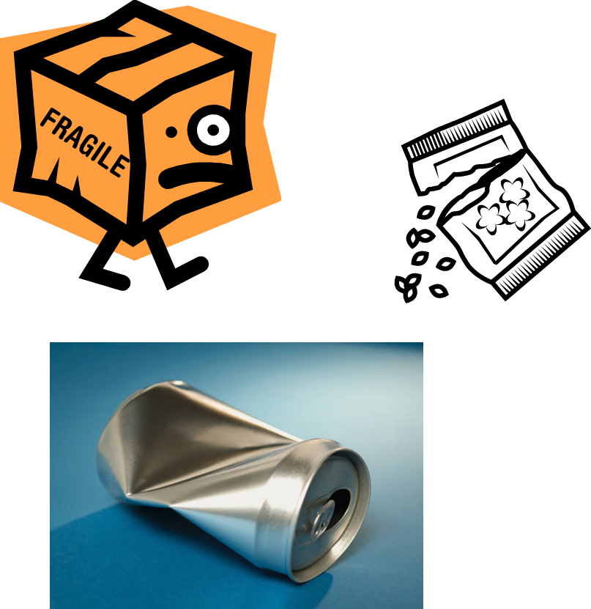
Packaging
Reject items with:
Dents or leaks on cans
Expired dates
Signs of pest presence
Strange odors
Tears and holes in the packaging
Water spots and leaks
Notes:
If items are rejected, set them aside and make a note on the invoice.
Credit for the items should be given.

Slide 10
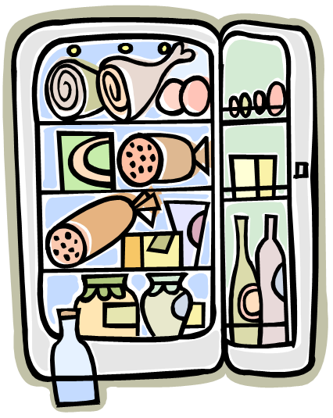
Storage
Safe practices
Notes:
Storage involves taking steps to store food and nonfood items immediately.

Slide 11
Safe Storage practices
Store perishable and semi- perishable foods immediately
Label and date products
Practice FIFO (first in, first out)
Place older items in front
Use older items first
Notes:
Be sure to label foods and date foods to preserve their quality.
Store items away from the walls and six inches off the floor.

Slide 12
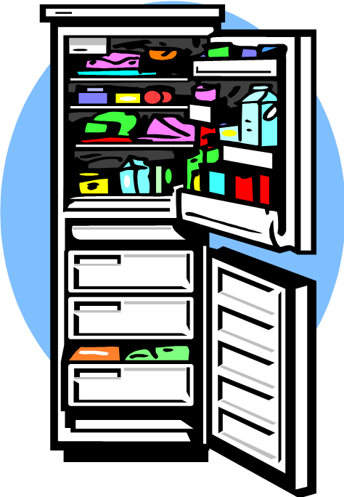
Storage Temperatures
Monitor storage temperatures regularly
Dry storage:
50°F to 70°F
Refrigeration:
41°F or lower
Freezer
32°F or lower
Notes:
Pathogens can grow if food is not stored at the correct temperature.

Slide 13
Refrigerator Storage
To prevent cross-contamination:
Arrange food items in the following order (top to bottom):
Ready-to-eat food
Seafood
Whole cuts of meat
Ground meat/ground fish
Whole poultry/ground poultry
For proper airflow:
Do NOT overload
Limit opening refrigerator
Use open shelving
Notes:
Storing food in the refrigerator with the ready-to-eat food on top and the poultry on the bottom will prevent juices from the raw foods from dripping on the ready-to-eat foods.
Storing too much food in a refrigeration unit makes units work harder to stay cold and could lead to outages.
Opening the refrigerator often raises the temperature inside.
Never line shelves as this limits airflow.

Slide 14
Sysco Quality Assurance
Insuring food safety is one of the most critical challenges facing the food industry today.
Notes:
Click on image to view YouTube™ video:
Sysco Quality Assurance
Insuring food safety is one of the most critical challenges facing the food industry today.
http://www.youtube.com/watch?v=XXlUfaz7sQI

Slide 15
Questions?

Slide 16
References and Resources
Images:
Microsoft Office Clip Art: Used with permission from Microsoft.
Textbooks:
Culinary essentials. (2010). Woodland Hills, CA: Glencoe/McGraw Hill.
ServSafe manager: Updated with the 2013 FDA Food Code. (2014). Chicago, IL: National Restaurant Association.
YouTube™:
Sysco Quality Assurance
Insuring food safety is one of the most critical challenges facing the food industry today.
http://www.youtube.com/watch?v=XXlUfaz7sQI

