Slide 1
Needs, Wants, Values, and Goals
Making the Right Decisions

Slide 3
Making Decisions (Needs vs. Wants)
  Needs
    Food
    Clothing
    Shelter
  Wants
    Sports car
    Fine jewelry
    Fine houses
Notes:
Needs are those things essential to survival, such as food, clothing, and shelter.
Wants are things that you desire, even though they aren’t essential.
Below is the link Needs vs. Wants from TeachMeAboutMoney.org
Needs vs. Wants
Learn about understanding Needs vs. Wants!
http://youtu.be/el40d2gyWaI

Slide 4

FCCLA Planning Process
  Identify Concerns
  Set a Goal
  Form a Plan
  Act
  Follow Up
Notes:
The Planning Process is a decision-making tool that supports the organization’s overall philosophy about youth-centered leadership and personal growth. It can be used to determine group action in a chapter or class or to plan individual projects.
IDENTIFY CONCERNS■ Brainstorm to generate ideas, or state the activity or problem you want to address if alreadydetermined.■ Evaluate your list and narrow it down to a workable idea or project that interests and concerns the majority or all of your members.
SET A GOAL■ Get a clear mental picture of what you want to accomplish, and write your ideas down as your goal.■ Make sure your goal is one that can be achieved and evaluated.■ Consider resources available to you.
FORM A PLAN■ Decide what needs to be done to reach your goal.■ Figure out the who, what, where, when, and how.■ List the abilities, skills, and knowledge required on your part.■ List other available resources, such as people, places, publications, and funds.■ Make a workable timetable to keep track of your progress.■ List possible barriers you might face, and develop plans if necessary.■ Decide ways to recognize your accomplishments along the way.
ACT■ Carry out your group or individual plan.■ Use family and community members, advisers, committees, task forces, and advisory groups when needed.
FOLLOW UP■ Determine if your goal was met.■ List ways you would improve your project or plan for future reference.■ Share and publicize your efforts with others, including the media if appropriate.■ Recognize members and thank people involved with your project.

Slide 5
Influences
  Family
  Culture
  Friends
  Values
  Needs
  Wants
  Resources
  Demographics
  Society
Notes:
Family – parents can make decisions for you if you are not ready or able to make a decision alone.
Culture – a family’s beliefs and customs directly affect your decisions.
Friends – may help you in making decisions both positive and negative.
Values – your decisions express your values and what is important to you.
Needs – a strong influence since these are basic physical needs.
Wants – decisions may be based on desires rather than needs.
Resources – Time, energy, knowledge, skills, available technology, and money will affect your decisions.
Demographics – changes in characteristics of population will affect everyone.
Society – refers to a group you belong to, such as your school, community, or country.

Slide 6



Goals
  Something you plan to do in the future
  Willing to work for
  Give you direction
  Keep you focused
  Help you gain success
Notes:
Ask students to share some of their goals with the class.

Slide 7
Personal Goals
  Short Term
    Can be accomplished in the near future
    Easier to achieve
    May serve as a stepping stone
  Long Term
    Far-reaching and take longer to achieve
    More time consuming
Notes:
Examples of short term goals may be:• reading a book• cleaning their room• completing a project
Examples of long term goals may be:• graduating from high school/college• starting a business• getting married• raising a family

Slide 8
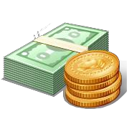
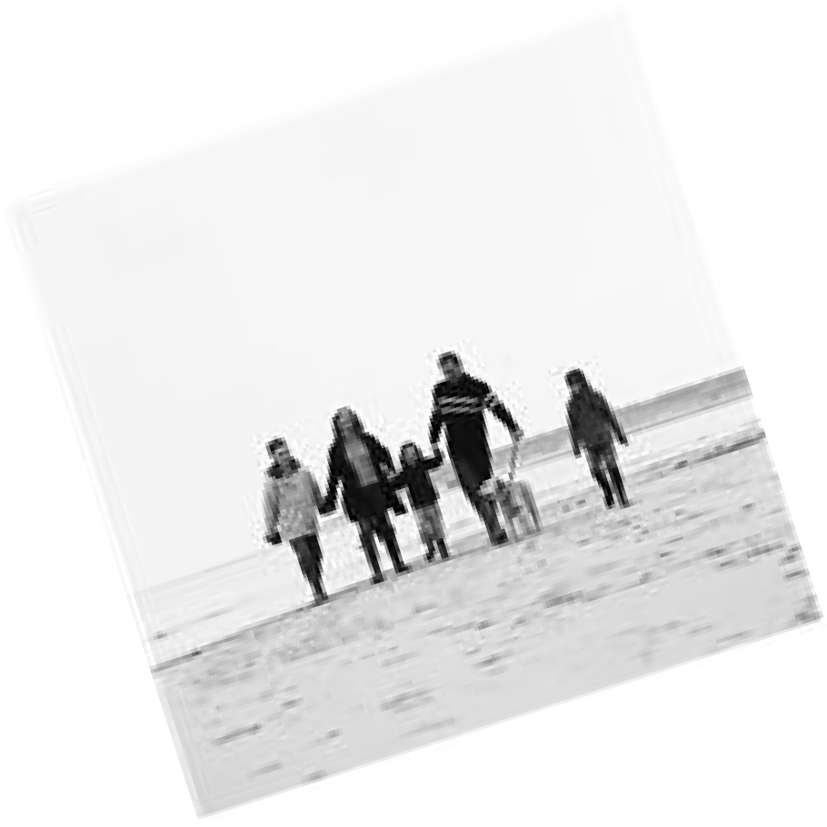


Values
  Concepts, beliefs, attitudes, activities, and feelings that are most important to you.
  May include:
    Love
    Knowledge
    Religion
    Power
    Health
    Friendship
Notes:
Your values become a part of your personality and they affect your behavior.

Slide 9





Universal Values
  Courage
  Fairness
  Freedom
  Honesty
  Respect
  Responsibility
  Trustworthiness
Notes:
Values that are generally accepted and shared worldwide are called Universal Values. They are the glue that makes positive and peaceful interaction among people.

Slide 10
Personal Management Skills
  Use available resources:
    Information
    Time
    Materials
    Skills
    People
Notes:
Our personal management skills include how we manage time and energy. Effective use of our time and energy can help us stay balanced in our lives and work more effectively in order to achieve our goals.

Slide 11
Time Saving Techniques
  Use a calendar
  Avoid time wasters
  Be flexible
  Set goals
  Make a To do list
  Avoid procrastination
  Prevent interruptions
  Use small amounts of time
  Stay organized
  Take a break
  Do it right the first time
  Practice work simplification
Notes:
Take advantage of these tips to make time work for you.

Slide 12

Managing Your Energy
  Amount changes daily
  Identify your peak period
  Levels vary with age
  Increase levels by:
    Getting plenty of rest
    Eating healthy food
    Exercising regularly
Notes:
Understanding when we perform our best and what affects our energy can help us with our work.

Slide 13
References/Resources
  Images:
    Microsoft Office Clip Art: Used with permission from Microsoft.
    Family, Career, and Community Leaders of America (FCCLA)
    http://texasfccla.org/
  Textbooks:
    Jackson, L., (2003). Careers In Focus. Tinley Park, IL: Goodheart-Wilcox Company.
    Kelly-Plate, J., & Eubanks, E., (2004). Today’s Teen. New York, NY:
    Glencoe/McGraw-Hill.
    Ryder/ Harder. (2004). Contemporary Living. Tinley Park, IL: Goodheart- Wilcox Company.
    Wehlage/Larson-Kennedy. (2001). Goals for Living. Tinley Park, IL: Goodheart-Wilcox Company.
  YouTube™
    Needs vs Wants
    Learn about understanding Needs vs. Wants!
    http://youtu.be/el40d2gyWaI

