Slide 1
Nutrition Over the Life Span
Principles of Human Services

Slide 3
Do our nutritional needs change as we get older? How?
Notes:
Ask the students how their nutritional needs changed from the time they were babies to today.

Slide 4

Dietary Needs at Different Stages
  Pregnancy
  Infants
  Children
  Teenagers
  Adults
  Seniors and older adults
Notes:
Nutritional needs change throughout the life cycle. Each life stage brings its own growth and nutritional needs and challenges. Meeting these demands promotes good health at each stage of the life cycle and builds a solid foundation for the future. Nutritional needs change throughout the life cycle. Each stage brings its own growth and nutrition needs and challenges.
Pregnancy
Infants
Children
Teenagers
Adults
Seniors and older adults

Slide 5

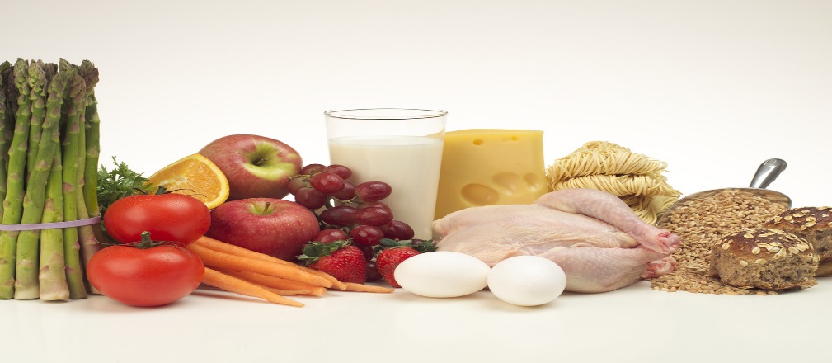
Pregnant Mothers
  Maintaining good nutrition and health habits and getting proper medical care are the most important responsibilities of the pregnant mother.
Notes:
Nutrition is most important responsibility
Baby’s growth and development depends on nutrients from mother
Poor eating habits by the mother place the baby at risk
The fetus depends on the mother for its nourishment
The fetus depends on the mother for its nourishment. Maintaining good nutrition and health habits and getting proper medical care, are the most important responsibilities of the pregnant mother.

Slide 6
Nutritional Needs During Pregnancy
  Folate, folic acid
  More foods from:
    Dairy Group
    Protein Foods Group
    Fruit Group
    Vegetable Group
    Grains Group
  Should add 300 calories a day to diet
  Average weight gain –25 to 35 pounds
  Pre-natal vitamin and mineral supplement
  No alcohol
Notes:
Folate or folic acid help the body make new cells and may prevent birth defects.
Foods from the Dairy group provide calcium, potassium, vitamin D and protein.
Foods from the Protein group provide iron as well as protein.
Fruits, vegetables, dry beans and grains are essential for folate and other nutrients such as fiber, vitamins, and minerals.
Three hundred calories per day should be added to diet from nutrient rich foods.
Pre-natal vitamins and mineral supplements may be prescribed by obstetrician.
Refrain from drinking any alcoholic beverages during pregnancy.

Slide 7

Infants
  A baby needs the right nourishment which may be mother’s milk or infant formula.
Notes:
Grow and develop quickly in their first year of life
Triple in weight
Brain and organs continue to develop
A baby may grow 50 percent longer and triple in weight in the first year.

Slide 8
Nutritional Needs for Infants-Matching Game
  Age of Infant
    Birth to six months
    Four to six months
    Six to eight months
    Seven to ten months
    Eight to Twelve months
    One to two years
  Food Options
    Soft or cooked table foods
    Breast milk or infant formula
    Cut foods into smaller, ¼-inch squares
    Pureed or mashed fruits and vegetables
    Finger foods
    Introduce iron-fortified infant cereal like rice and barley or pureed meats
Notes:
Have students match the appropriate food options to the age of the infant. See answers below.
Birth to 6 Months: Babies get all the nutrients they need from breast milk for the first six months. Infant formula is an acceptable alternative when mothers decide to decrease or discontinue breast feeding. You should not give your baby cow’s milk until after age 1.
By 4 to 6 Months: While most babies are ready to eat solid foods now, they will continue to get most of their calories, protein, vitamins and minerals from breast milk or infant formula. Introduce iron-fortified infant cereal like rice and barley or pureed meats to help replenish iron reserves.
By 6 to 8 Months: This is an appropriate time to begin pureed or mashed fruits and vegetables. Gradually introduce single-item foods one at a time. Watch your child carefully for any reactions such as diarrhea, vomiting or unusual rashes.
By 7 to 10 Months: Babies are usually ready to begin feeding themselves with finger foods, such as dry cereal or teething biscuits. They also can begin to use a cup for water.
By 8 to 12 Months: At this stage, most infants are ready for soft or cooked table foods.
From 1 to 2 Years: Babies continue developing eating skills. They feed themselves and enjoy the same foods as the rest of the family. Choking on firm, round foods is a risk, so cut these foods into smaller, ¼-inch squares.

Slide 9

Children
  Need a regular meal schedule
  Stomachs are small, energy levels high
  Snacks to satisfy food needs
  Active, growing children need a regular meal schedule
Notes:
Their stomachs are small and their energy levels are high so they need healthy snacks in between meals.
Most 2- to 3-year-old children need to consume about 1,000 calories per day. Here’s how to distribute those calories in a healthy eating plan:
Grain Group: About 3 ounces of grains per day, preferably half of them whole grains. That is about three regular slices of bread or one slice of bread plus 1/3 cup cold cereal and ¼ cup cooked rice or pasta.
Vegetable Group: 1 cup raw and/or cooked vegetables per day. Like adults, young kids need variety: mashed sweet potatoes, broccoli with low-fat dip or tomato sauce for pasta.
Fruit Group: 1 cup fresh, frozen, canned, dried and/or 100 percent juice per day. Emphasize whole fruits rather than juice. Children love melon balls, Mandarin oranges (fresh or canned in juice) and frozen berries.
Milk Group: 2 cups per day. Whole milk is recommended for children younger than 2. Older children can have lower-fat, calcium-rich choices such as fat-free or low-fat milk, yogurt and cheese.
Meat and Beans Group: 2 ounces total per day. Options include one ounce of lean meat or chicken plus one egg or 1 ounce of fish plus ¼ cup of cooked beans (black, pinto, or other varieties).
Oils: 3 teaspoons or less per day of liquid oil or margarine.

Slide 10

Teenagers
  Most rapid growth period
  Dramatic physical changes
  Fit healthy eating into busy schedules
  Eat foods for nutrition when eating with friends
Notes:
Physical changes occur rapidly and nutritional needs increase. Iron and calcium are especially important for building muscle and bones. Teens may need more of some foods for a healthy, physically active lifestyle. Eat a small amount of high-fat foods and choose plenty of nutrient-dense foods.

Slide 11
Nutrition for Teens
  Importance of Nutrition for Teens
  (click on link)
Notes:
Importance of Nutrition for Teens
Susan Adams, Registered Dietitian discusses why healthy eating habits and nutrition are important for teens to learn about and adapt into their daily routines.
http://youtu.be/zJNmu0tpdZU

Slide 12
Adults
  Exercise
  Weight control
  Healthy diet
  Regular visits to the doctor
  Active lifestyle
Notes:
In a national survey in 2010, more than one-third of U.S. adults (35.7%) are obese. They also are prone to have other ailments such as hypertension (high blood pressure), diabetes, and digestive disorders. Midlife is the time when high blood pressure and high cholesterol can run havoc on a person’s life. Exercise, weight control, and a diet rich in fiber, fruits, vegetables, and whole grain can help alleviate many cardiovascular problems. According to _Life-Span Development_ by John W. Santrock, due to advances in drug medication to lower blood pressure and cholesterol, diet, and exercise in high-risk individuals, the deaths due to cardiovascular disease have decreased in the United States.

Slide 13

Seniors and Older Adults
  Want to remain independent
  May need assistance in shopping and cooking
  Can purchase convenience foods
  Community may provide meal assistance
Notes:
Older adults want to stay independent for as long as possible but may need a little help. Adult bodies have stopped growing so energy needs are lower. Different adults have different food needs. Some may have health problems that require a special diet and limit foods they can eat. Older adults can become dehydrated easily and should, therefore, drink plenty of water.
Physical changes, such as losing the sense of taste and smell, can affect an elderly person's intake of food and cause them to lose weight. This is why having a good nutritional status can improve an older adults quality of life.
What is osteoporosis? It is a condition in which bones lose their minerals and become porous, making them weak and fragile. Can you prevent osteoporosis? According to WebMD, a lot of physical activity during the preteen and teen years increases bone mass and greatly reduces the risk of osteoporosis in adulthood. If you eat a diet adequate in calcium and vitamin D and exercise regularly early in life and then continue with these healthy habits, you may be able to delay or avoid osteoporosis. Older adults should participate in physical activity or exercise.
http://www.webmd.com/osteoporosis/tc/osteoporosis-prevention
Lack of transportation does affect the nutritional status of older adults. The Elderly Nutrition Program provides grant money and commodities for meals served to older citizens. Is there one in our community?

Slide 14

Factors that Affect Food Choices
  Appearance
  Fitness
  Weight
  Protection from illness
Notes:
Good nutrition affects:
Appearance – helps give you shiny hair, bright eyes, healthy nails and teeth, and smooth clear skin
Fitness – helps you stay energetic and alert throughout the day
Weight – helps you reach and maintain a healthy weight
Protection from Illness – helps your body defend against disease

Slide 15

Factors that Food Choices Affect
  Healing
  Emotional strength
  Future Health
Notes:
Good nutrition affects:
Healing – helps the body build new cells, repair breaks and sprains, and heal after illness or surgery
Emotional Strength – helps your body and mind deal with stress
Future Health – helps you stay healthy as you grow older

Slide 16
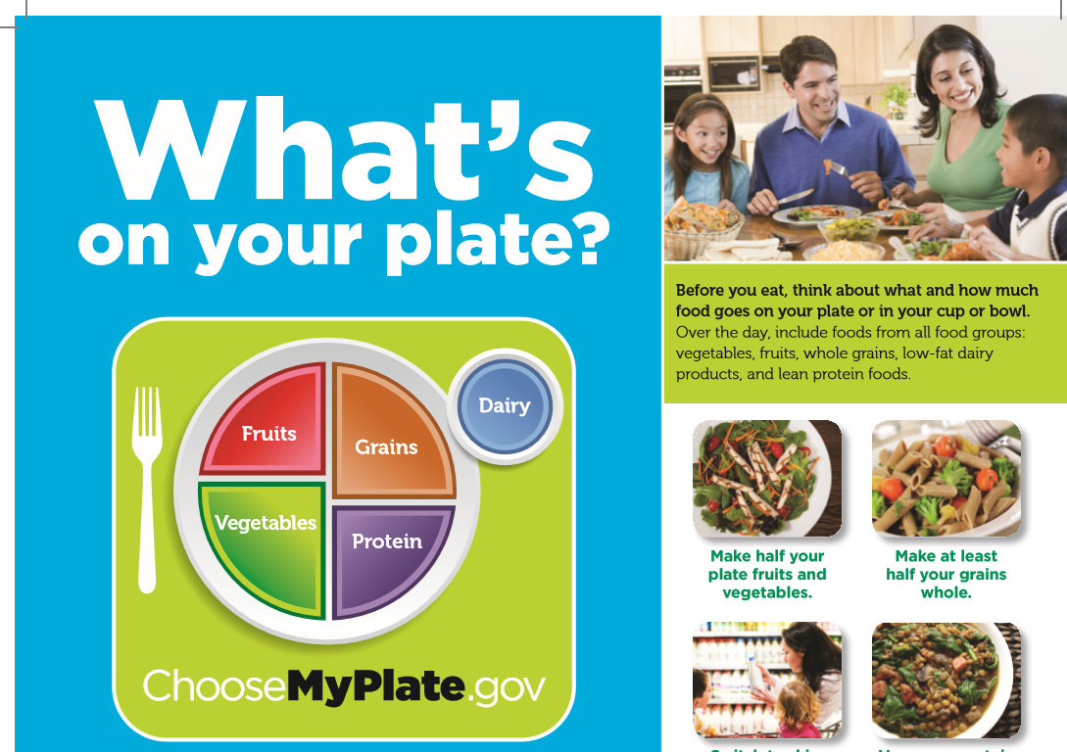
ChooseMyPlate
  The different plate shape is to help grab consumers’ attention with a new visual cue that is a familiar mealtime symbol.
Notes:
In June 2011, the United States Department of Agriculture introduced the new food guide – MyPlate, based on the 2010 Dietary Guidelines for Americans.

Slide 17
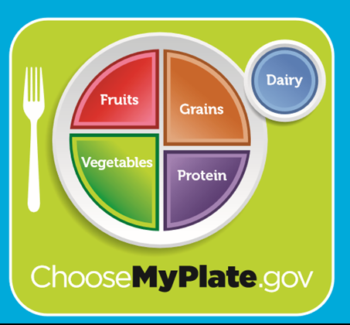
ChooseMyPlate
(click on picture)
Notes:
Introducing the New Food Icon: MyPlate
The Department of Agriculture introduces the new food icon, MyPlate, to replace the MyPyramid image as the government's primary food group symbol. An easy-to-understand visual cue to help consumers adopt healthy eating habits, MyPlate is consistent with the 2010 Dietary Guidelines for Americans.
http://youtu.be/SEFmSk08LIE

Slide 18
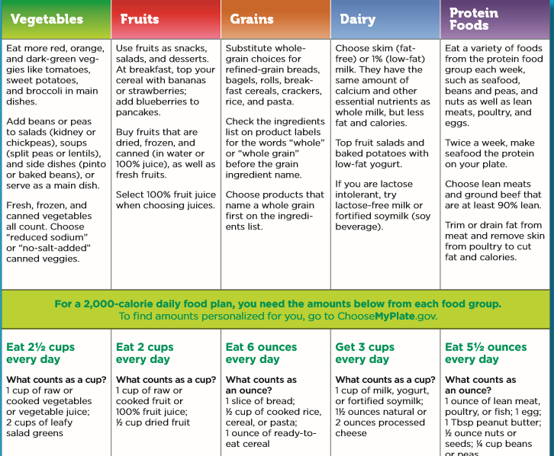
ChooseMyPlate
  Educating yourself on the food groups, healthy fats and what vitamins and minerals your body needs are just a few steps in the right direction.
Notes:
Discuss the requirements and the benefits of the food choices. What counts as a serving from each group?

Slide 19
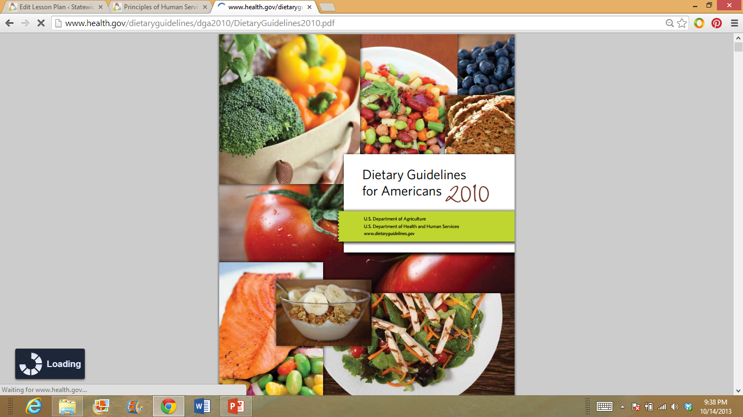
Recommended Dietary Guidelines 2010
  Build a healthy plate
  Cut back on foods high in solid fats, added sugars, and salt
  Eat the right amount of calories for you
  Be physically active your way
(click on picture)
Notes:
The guidelines provide information and advice for choosing a healthy eating pattern—namely, one that focuses on nutrient-dense foods and beverages, and that contributes to achieving and maintaining a healthy weight. Such a healthy eating pattern also embodies food safety principles to avoid foodborne illness.
The Dietary Guidelines for Americans, 2010 are the best science-based advice on how to eat for health. The guidelines encourage all Americans to eat a healthy diet and be physically active. Because more than one-third of children and more than two-thirds of adults in the United States are overweight or obese, the 7th edition of Dietary Guidelines for Americans places stronger emphasis on reducing calorie consumption and increasing physical activity.
The complete 112 page report is available at http://www.cnpp.usda.gov/Publications/DietaryGuidelines/2010/PolicyDoc/PolicyDoc.pdf
The shorter consumer brochure is available at http://www.cnpp.usda.gov/Publications/DietaryGuidelines/2010/DG2010Brochure.pdf

Slide 20
Relation to Health, Wellness, and Disease
  Your food and physical activity choices each day affect your health – how you feel today, tomorrow, and in the future.
Notes:
Food has a powerful impact on health. Healthy food choices promote wellness. When you practice wellness, active steps are taken to stay in good health. It is important to do this throughout your life span.

Slide 21
Wellness
  Good health
  Positive well-being
  Includes physical, mental, and emotional health
  Reflected in attitude and behavior
Notes:
What does wellness mean to you?

Slide 22
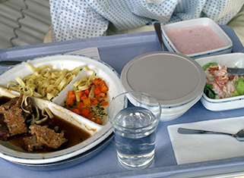
Careers in Family and Community Services
  What Dietitians and Nutritionists Do
  (click on link)
Image: http://www.bls.gov/es/ooh/
Notes:
Dietitians and nutritionists typically do the following:
Explain nutrition issues
Assess patients’ and clients’ health needs and diet
Develop meal plans, taking both cost and clients’ preferences into account
Evaluate the effects of meal plans and change the plans as needed
Promote better nutrition by giving talks to groups about diet, nutrition, and the relationship between good eating habits and preventing or managing specific diseases
Keep up with the latest nutritional science research
Bureau of Labor Statistics, U.S. Department of Labor, Occupational Outlook Handbook, 2012-13 Edition, Dietitians and Nutritionists,
on the Internet at http://www.bls.gov/ooh/healthcare/dietitians-and-nutritionists.htm (visited October 15, 2013).

Slide 23
Questions?

Slide 24
References and Resources
  Images:
    Microsoft Clip Art: Used with permission from Microsoft.
  Textbooks:
    Brisbane, H. (2010). The developing child. Columbus, OH: Glencoe/McGraw-Hill.
    Duyff, R. L. (2010). Food, nutrition & wellness. Columbus, OH: Glencoe/McGraw-Hill.
    Kowtaluk, H. (2010) Food for today. Columbus, OH: Glencoe/McGraw-Hill.
    Weixel, S., & Wempen, F. (2010). Food & nutrition and you. Upper Saddle River, NJ: Pearson/Prentice Hall.
  YouTube™:
    Importance of Nutrition for Teens
    Susan Adams, Registered Dietitian discusses why healthy eating habits and nutrition are
    important for teens to learn about and adapt into their daily routines.
  http://youtu.be/zJNmu0tpdZU

Slide 25
References and Resources
  YouTube™:
    U.S. Department of Agriculture.
    ChooseMyPlate.gov Website. Washington, DC.
    http://www.choosemyplate.gov/
  Websites:
    Academy of Nutrition and Dietetics
    The world’s largest organization of food and nutrition professionals
    http://eatright.org
    Best Teen Diets
    It encourages positive food decisions supportive of good health whether your goal is to
    lose weight, gain weight or stay within your healthy weight range.
    http://bestteendiets.org/index.html

Slide 26
References and Resources
  Websites:
    Nutrition Education of Texas
    Teaching Nutrition: Background information about nutrition, nutrients, and healthy eating
    habits. Topics include nutrients, food safety, selecting a balanced diet, nutritional needs
    during the lifecycle, nutrition and health. For additional information, visit:
    http://netx.squaremeals.org/teaching_nutrition.html
    Tips for a Safe and Healthy Life
    U.S. Department of Health and Human Services
    Centers for Disease Control and Prevention
    http://www.cdc.gov/family/tips
    U.S. Department of Agriculture.
    ChooseMyPlate.gov Website. Washington, DC.
    http://www.choosemyplate.gov/
    Accessed February, 2013.

