Slide 1
Parenting Skills and Relationships

Slide 3

Relationship Skills
  Appropriate communication skills
  Marriage preparation
  Money management
Notes:
Relationship Skills
The Parenting Skills and Relationships lesson will focus on the importance the roles and responsibilities of parenting. The areas of money management, appropriate communication skills and marriage preparation are vital conducive to a successful relationship. Relationships have significantly changed over the last several decades and lasting bonds are harder to develop. All too often, couples fall in love, get married, and start a family based on emotional feelings without establishing a working plan for their future resulting in marriage failure. To avoid these mistakes relationships must be approached in a manner that incorporates structure and organization in addition to the emotional bonds.

Slide 4

Communication Skills
  Binds relationships
  Forms connections
Notes:
Relationship Skills
Communication skills are the glue that binds the couple together. Both parties have different background experiences that shape their ideas of a relationship. Open communication allows for the couple to connect their past and join their future. Couples that have surface communication skills are much like a childhood art project glued together with a glue stick. Sometimes they stay together but more often than not they come apart with time. On the other hand, couples that have a strong communication base are bound together with industrial strength glue that cannotbe separated.

Slide 5

Good Communication
  What are the four ingredients to successful communication?
Notes:
What are the four ingredients to successful communication?

Slide 6
Good Communication
  Four Ingredients to Successful Communication:
    Empathy
    Keeping in touch
    Sharing your ups and downs
    Listening
Notes:
Good Communication Four Ingredients to Successful Communication
Empathy: Allows you to understand how your significant other feels without sharing the same feelings at the moment
Keeping in touch: Talking about thoughts or feelings to keep up to date if your partner’s view has changed and recount your day with each other
Sharing your ups and downs: Sharing support and guidance
Listening: Poor listening blocks effective communication. Talk honestly and listen carefully
What are some other tips for good communication between couples?

Slide 7
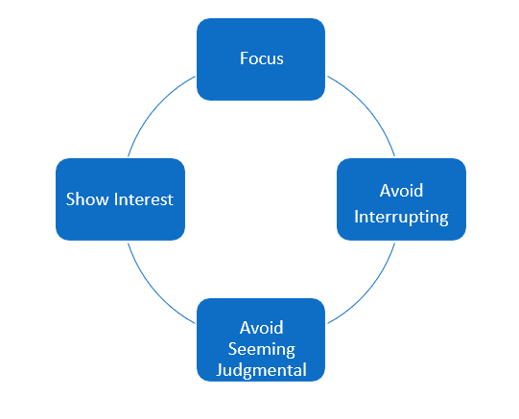
Tips for Effective Listening
Notes:
Tips for effective listening
If your goal is to fully understand and connect with the other person, listening effectively will often come naturally. If it doesn’t, you can remember the following tips. The more you practice them, the more satisfying and rewarding your interactions with others will become.
Focus fully on the speaker, his or her body language, and other nonverbal cues. If you’re daydreaming, checking text messages, or doodling, you’re almost certain to miss nonverbal cues in the conversation. If you find it hard to concentrate on some speakers, try repeating their words over in your head—it’ll reinforce their message and help you stay focused.
Avoid interrupting or trying to redirect the conversation to your concerns, by saying something like, “If you think that’s bad, let me tell you what happened to me.” Listening is not the same as waiting for your turn to talk. You can’t concentrate on what someone’s saying if you’re forming what you’re going to say next. Often, the speaker can read your facial expressions and know that your mind’s elsewhere.
Avoid seeming judgmental. In order to communicate effectively with someone, you don’t have to like them or agree with their ideas, values, or opinions. However, you do need to set aside your judgment and withhold blame and criticism in order to fully understand a person. The most difficult communication, when successfully executed, can lead to the most unlikely and profound connection with someone.
Show your interest in what’s being said. Nod occasionally, smile at the person, and make sure your posture is open and inviting. Encourage the speaker to continue with small verbal comments like “yes” or “uh huh.”

Slide 8
Marriage Preparation
  How can you strengthen a relationship?
Notes:
What kind of marriage partner would you want to have? Make a list of your perfect marriage partner. Why are these important to you?

Slide 9

Marriage Preparation
  Marriage preparation is the preparation for married life
Notes:
Relationship Skills
Marriage preparation is the preparation for married life. It is not the marriage ceremony. As the couple plans for marriage, they will need to create a life plan that includes strong communication skills, commitment, trust, caring, devotion, faithfulness, and money management.

Slide 10

Marriage Preparation
  Involvement
  Getting through conflict
  Keeping outside relationships
  and interests alive
  Communicating
  Intimacy
  Have fun
  Be open to change
Notes:
Everyone’s relationship is unique, and people come together for many different reasons. But there are some things that good relationships have in common. Knowing the basic principles of healthy relationships helps keep them meaningful, fulfilling and exciting in both happy times and sad:
What makes ahealthy love relationship?
Staying involved with each other. Some relationships get stuck in peaceful coexistence, but without truly relating to each other and working together. While it may seem stable on the surface, lack of involvement and communication increases distance. When you need to talk about something important, the connection and understanding may no longer be there.
Getting through conflict. Some couples talk things out quietly, while others may raise their voices and passionately disagree.The key in a strong relationship, though, is not to be fearful of conflict. You need to be safe to express things that bother you without fear of retaliation, and be able to resolve conflict without humiliation, degradation or insisting on being right.
Keeping outside relationships and interests alive. No one person can meet all of our needs, and expecting too much from someone can put a lot of unhealthy pressure on a relationship. Having friends and outside interests not only strengthens your social network, but brings new insights and stimulation to the relationship.
Communicating. Honest, direct communication is a key part of any relationship. When both people feel comfortable expressing their needs, fears, and desires, trust and bonds are strengthened. Nonverbal cues—body language like eye contact, leaning forward or away, or touching someone’s arm—are critical to communication.
Touch is a fundamental part of human existence. Studies on infants have shown the importance of regular, loving touch and holding on brain development.
These benefits do not end in childhood. Life without physical contact with others is a lonely life indeed.
Focus on having fun together
Think about playful ways to surprise your partner, like bringing flowers or a favorite movie home unexpectedly.
Be open to change. Change is inevitable in life, and it will happen whether you go with it or fight it. Flexibility is essential to adapt to the change that is always taking place in any relationship, and it allows you to grow together through both the good times and the bad.

Slide 11

What Does Money Management Look Like?

Slide 12

Money Management
  Manage resources
  Financial plan
Notes:
Relationship Skills
Money management is a key part of a successful lasting relationship. Texas is a community propertystate, which essentially means that all earned income and purchased property during the marriage is owned jointly by both parties. It is the couples’ joint responsibility to manage their resources. All couples need a financial plan to guide their lifestyle and protect their future.

Slide 13
Take Charge America
  Food Budget Obesity
  (click on link)
Notes:
Take Charge America-Budget Doctor
The TCA Budget Doctor discusses food budgeting and why it is important to monitor your spending.
http://youtu.be/zN4I67BWnHk

Slide 14

Financial Responsibilities
  Financial and career stability should be considered before deciding to have children.
  Housing
  Food
  Transportation
  Clothing
  Medical care
  Education
Notes:
Financial and career stability should be considered before deciding to have children. Children are expensive. Just as one must assess his or her financial condition before purchasing a car or home, individuals must seriouslyevaluate their ability to financially support a dependent child. The United States Department of Agriculture (USDA) estimates the cost of rearing a child to age eighteen in 2012 is more than $234,900. It does not include prenatal and birthing costs or anyeducation beyond high school. This figure includes the costs of housing, food at and away from home, transportation, clothing, medical care, education through grade twelve, and other miscellaneous expenses.
Adequate child care is expensive. In many families, it is by far the largest household expense. In some of the more expensive states, the cost of child care for infants equals about half of the median income for single moms.

Slide 15
S.M.A.R.T. Goals
  Goals should describe accomplishments, not activities.
  S = Specific
  M= Measurable
  A = Achievable
  R = Relevant
  T = Time-Bound

Slide 16
What is a S.M.A.R.T. Goal?
  S.M.A.R.T. Goals
  (click on link)
Notes:
S.M.A.R.T. Goals
Ever had a goal you couldn't complete? Chances are it wasn't a SMART Goal! We'll show you what a SMART Goal is, how you can use them to improve both yours and your staff's productivity, and how to set them up.
http://youtu.be/Uy6qGhki-K4

Slide 17

Goals
  S = Specific
  Who
  What
  When
  Where
  Why
Notes:
Specific: Goal objectives should address the five Ws… who, what, when, where, and why. Make sure the goal specifies what needs to be done with a timeframe for completion. Use actionverbs… create, design, develop, implement, and produce. Example: resolve accounting discrepancies within 48 hours.

Slide 18

Goals
  M = Measurable
Notes:
Measurable: Goal objectives should include numeric or descriptive measures that define quantity, quality, and cost. How will you and your family member know when the goal has been successfully met? Focus on elements such as observable actions, quantity, quality, cycle time, efficiency, and/or flexibility to measure outcomes, not activities. Example: save ten dollars by the end of each week.

Slide 19

Goals
  A = Achievable
Notes:
Achievable: Goal objectives should be within the family member’s control and influence; a goal may be a “stretch” but still feasible. Is the goal achievable with the available resources? Is the goal achievable within the timeframe originally outlined? Consider authority or control, influence, resources, and work environment support to meet the goal. Example: obtain the XYZ professional certification within two years.

Slide 20

Goals
  R = Relevant
Notes:
Relevant: Goals should be instrumental to the mission of the family.
Why is the goal important?
How will the goal help the family achieve its objectives?
Develop goals that relate to the family member’s key accountabilities or link with family goals that align with the family agenda. Example: develop and implement a financial plan that increases the savings account by ten percent.

Slide 21

Goals
  T = Time-bound
Notes:
Time-bound: Goal objectives should identify a definite target date for completion and/or frequencies for specific action steps that are important for achieving the goal.
How often should the family members work on this task?
By when should this goal be accomplished?
Incorporate specific dates, calendar milestones, or timeframes that are relative to the achievement ofanother result. Example: check the balances of all outstanding accounts every six months.

Slide 22
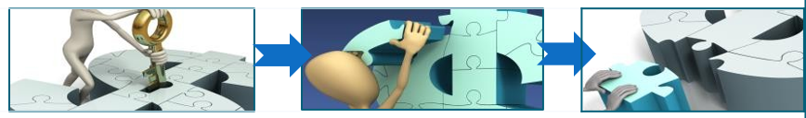
How to Successfully Manage Your Money
  How to Organize Tasks and Responsibilities
  Determine your needs and wants
  Establish your priorities
  Use a systematic process
  A decision-making process that can help you make the best financial approach
  Become your own personal accountant
  Keep accurate and current records of your money
Notes:
Organizing tasks and responsibilities can help you manage your individual and family resources such as finances, food,clothing, shelter, health care, recreation, transportation, time, and human capital.

Slide 23
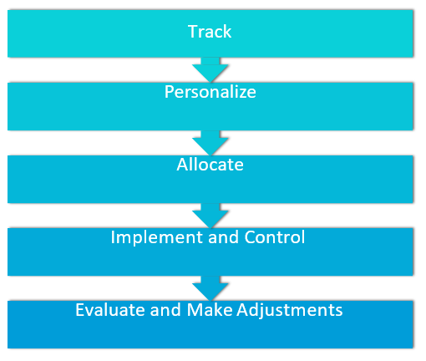
A Spending Plan
Notes:
Imagine that you are creating a spending plan. Using the five steps of the spending plan development process, describe in detail what you would do to create your spending plan from beginning to end.
1. Track Current Income and Expenses
Make sure to indicate how you would track your income and expenses and justify your choice by describing how it would fit your lifestyle.
2. Personalize Your Spending Plan
3. Allocate Money to Each Category
Make sure to indicate how you would determine which changes to make to spending.
4. Implement and Control
Make sure to indicate which control system you would use and justify your choice by describing how it would fit your lifestyle.
5. Evaluate and Make Adjustments
Why is tracking income and expenses an important part of creating a spending plan?
What are three things to consider when determining how much money to allocate to each category? Explain.
What do you do if you have a net gain?
What do you do if you have a net loss?
How do you ensure there is enough money to pay bills and meet expenses throughout the month in your household?

Slide 24
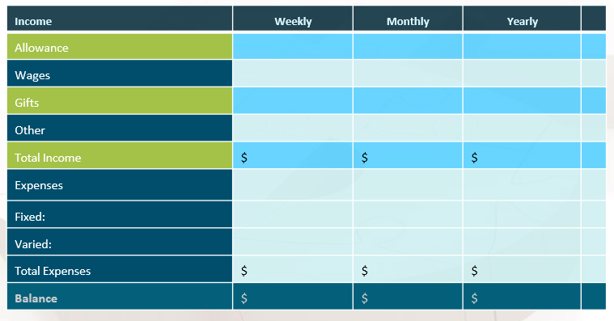
Money Management Plan
Notes:
Your money management plan consists of determining all your income from various sources and compiling a list of all your expenses. After you total all your income and expenses, subtract total expenses from total income to determine the balance amount.
Once your plan is put into action, evaluate your budget periodically.
• Is your plan working?
• Are you able to attain your goals with your plan?
• Is this plan helping you control your spending?
How can a money management plan help you manage your money now and in the future?
What are the differences between variable, fixed and discretionary expenses? Give examples of each.
What are some contributing factors of a negative balance-when you have more expenses than income?
What are some steps to avoid a negativebalance?

Slide 25

Tips to get Started
  Envelope System
  Cut-up credit cards
  Written budget
  Emergency fund
Notes:
Tips to get started:
Devise a cash envelope system for yourself. Include envelopes for categories such as: groceries, clothing, miscellaneous, medicine, giving, and haircuts. Put money in each envelope and live within that amount of money each pay period.
Cut up credit cards. If you don’t have the guts to do that, put them in a gallon freezer bag, fill the bag with water and freeze it. If you really feel the need to buy something with the credit cards, set the bag out to thaw. Use the time it is thawing to really evaluate if what you are considering buying is a “need” or a “want”. Look at other options of buying this. Ask yourself: If I delay buying this until I have the cash, how will I feel in the long run?
Use a written budget each month to track your spending, savings and giving.
Have money set aside in an emergency fund and DEFINE what an emergency would be in your household.

Slide 26
Parenting Skills and Responsibilities

Slide 27
What are some parenting skills and responsibilities?
Notes:
How are parenting skills and responsibilities related to successful families?
How would you summarize what parenting skills and responsibilities are?

Slide 28

Parenting Skills and Responsibilities
  Some important responsibilities that affect health and happiness of parents and children include the following:
    child guidance
    legal and moral responsibilities
    financial responsibilities
    health and safety responsibilities
    social and emotional development
    cognitive development
Notes:
The lesson focus is to determine parenting readiness and to understand parental responsibilities. A responsibility is a condition for which a person assumes the duties, obligations, and accountability for something. The responsibilities of parenting are endless. Some important responsibilities that affect health and happiness of parents and children include the following:
• child guidance
• legal and moral responsibilities
• financial responsibilities
• health and safety responsibilities
• social and emotional development
• cognitive development
How do these parenting skills and responsibilities relate to you as a caregiver?

Slide 29

Child Guidance
  The guidance parents use should be appropriate for the child’s
    age
    abilities
    situation
Notes:
All children need guidance. Guidance includes all of an adult’s actions and words that are used to influence a child’s behavior. Children need guidance for a variety of reasons. Some of these reasons include the following:
• to teach children what actions are acceptable and what actions are not
• to teach children how to interact with others
• to promote children’s healthy attitudes about themselves
• to establish a positive self-concept and high self-esteem
• to ensure children’s safety
• to encourage self-discipline
• to teach children self-control
The guidance parents use should be appropriate for the child. It should be appropriate for the child’s age and abilities and for the situation.
As a caregiver, how are going to provide guidance to the children in your care?

Slide 30

Legal and Moral Responsibilities
  Seat restraints
  Economic security
  Education
  Respect of others
  Understanding rules
  Decision-making skills
Notes:
Legal responsibilities of parenting include those things that are required because of a law. One example of a legal responsibility is protecting children by placing them in appropriate seat restraints while traveling in a motor vehicle. Divorced parents have a legal responsibility to provide economic security for their children by making child support payments.
What are some other legal responsibilities of parenting?
Moral responsibility involves rearing children to be responsible and contributing members of society. A child’s moral development involves his or her respect of others, understanding of rules, and ability to make good value decisions about what is right and what is wrong. The development of morals and a conscience relates closely to social, emotional, and cognitive development.
Why is moral responsibility an important component of parenting? Why is moral responsibility an important component as a caregiver?

Slide 31

Social and Emotional Development
  Affection
  Nurturing
  Positive self-esteem
  Self-concept
  Self-image
Notes:
Children need affection. The affection of parents and other family members is important for the social and emotional development of children. The nurturing provided by a parent plays an important role in the development of a positive self-esteem and in the development of a child’s relationships. For a young child, these relationships might include positive interactions with other children through play. As a teenager, positive and healthy interactions might be exhibited through dating. Regardless of age, all children need to know that they are loved and accepted by their parents and family members.
A child’s self-concept is developed primarily as a result of interaction with the family. Self-concept is how a person sees his or her own identify, abilities, and worth. Children are born not knowing who they are. As they grow, they learn about who they are by what they can do and what they are told about themselves by the people around them. Self-image and self-concept are molded by the attitudes reflected in the faces, voices, and words of those who are important to them.
As a caregiver, how are you going to help develop and nourish a child’s self-concept?

Slide 32

Health and Safety Responsibilities
  Food
  Water
  Clothing
  Shelter
  Safety
  Protection
  Medical checkups
Notes:
Every child must have basic needs met to ensure healthy development. A need is a condition in which something is required for physical or mental well-being. Food, water, clothing, and shelter are examples of basic needs. Parents want their children to be safe and protected. Safety begins with medical checkups, inoculations, and safe physical and emotional surroundings. To provide and maintain a safe environment, parents should be aware of safety practices to implement and to teach it.
What are some safety and health practices to instill at a child care center?

Slide 33
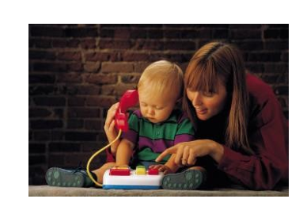
Cognitive Development
  Intelligence and mental ability
  Provide educational opportunities
  Thinking skills
  Learning activities
Notes:
Cognitive development is how children gain the ability to think and know about things. Some of this mental development is gained through learning. Intelligence and mental ability can be defined in many ways. The family influences how a child’s mind develops through what they teach the child and how they support the child. The family environment should provide opportunities for children to exercise thinking skills. A child who is involved in learning activities at an early age may find it easier to learn in school. However, too much pressure from parents to do well can frustrate and turn them off to learning.
The promotion of strong stable families is the key message to present to students in this unit. The impact of adult relationships affects the child during their upbringing and serves as a model for their future relationships. Parenting is the entire process of raising a child to be a successful productive member of society upon achieving adulthood. Not everyone should be a parent. Parenting requires special aptitudes and competencies that all individuals do not want or have. The lifestyle of a family must change to meet the demands of a new infant.
Individuals should be socially and emotionally mature enough to handle the responsibilities of being a parent before making a decision to become a parent.
As a child guidance provider, name and describe five ways to provide cognitive opportunities with children.

Slide 34

Questions?

Slide 35
References and Resources
  Microsoft Clip Art: Used with permission from Microsoft.
  Textbook:
    Decker, C. (2011). _Child development: Early stages through age 12_. (5th ed.). Tinley Park: Goodheart-Willcox Company.
  Websites:
    Calculators - Yes, You Can
    Free Electronic Spending Plans
    http://www.yesyoucanonline.info/Resources/Calculators
    Mint.com
    Free Electronic Control Systems
    https://www.mint.com/
    Parenting and Money
    Financial tips that worked for couples.
    http://www.parentingandmoney.com/2012/03/07/parenting-and-money/

Slide 36
References and Resources
  Websites:
    Sense and Dollars
    Spending Money- Budget Basics
    http://senseanddollars.thinkport.org/games/checkitout/home.html
  YouTube:
    S.M.A.R.T. Goals
    Ever had a goal you couldn't complete? Chances are it wasn't a SMART Goal! We'll show you what a SMART Goal is, how you can use them to improve both yours and your staff's productivity, and how to set them up.
    http://youtu.be/Uy6qGhki-K4
    Take Charge America-Budget Doctor
    The TCA Budget Doctor discusses food budgeting and why it is important to monitor your spending.
    http://youtu.be/zN4I67BWnHk

