Slide 1
Selection and Care of Clothing: Part ll

Slide 3

Items of Clothing = MONEY

Slide 4
Evaluate Your Wardrobe
Think about your current wardrobe. Do you have:
Buttons that are loose or missing?
Hems which need to be repaired?
Tears or loose threads on a shirt, pants or dress?
Clothing items not in use = loss of MONEY
What skills do you need to repair and maintain your wardrobe?

Slide 5
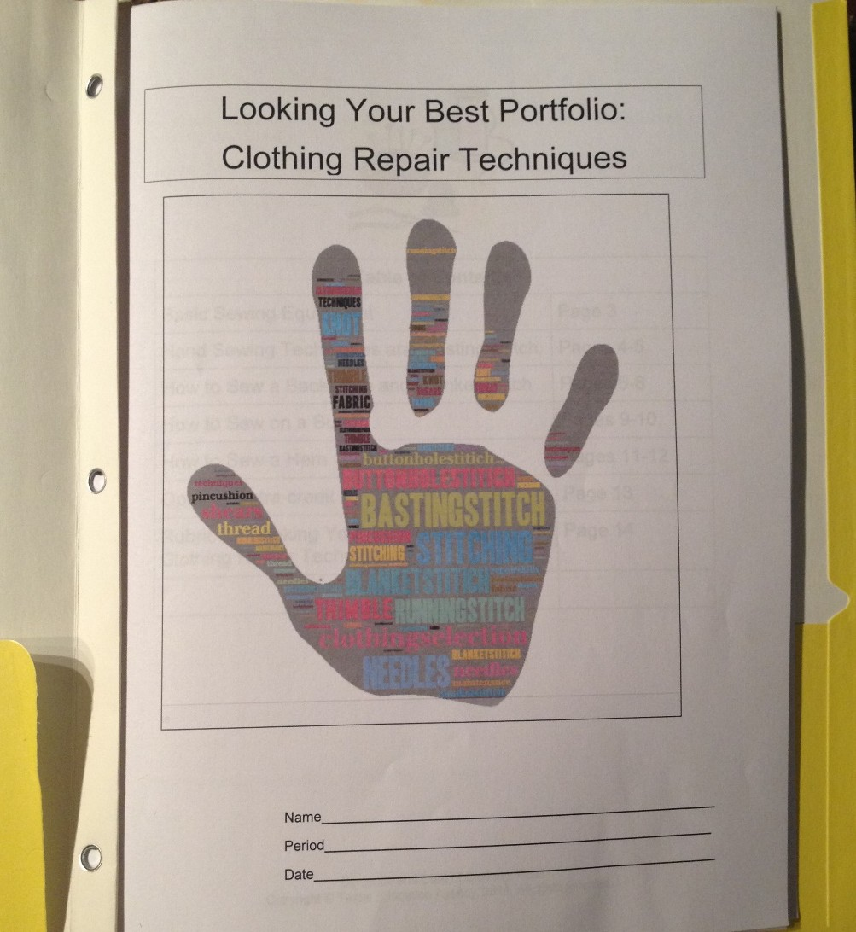
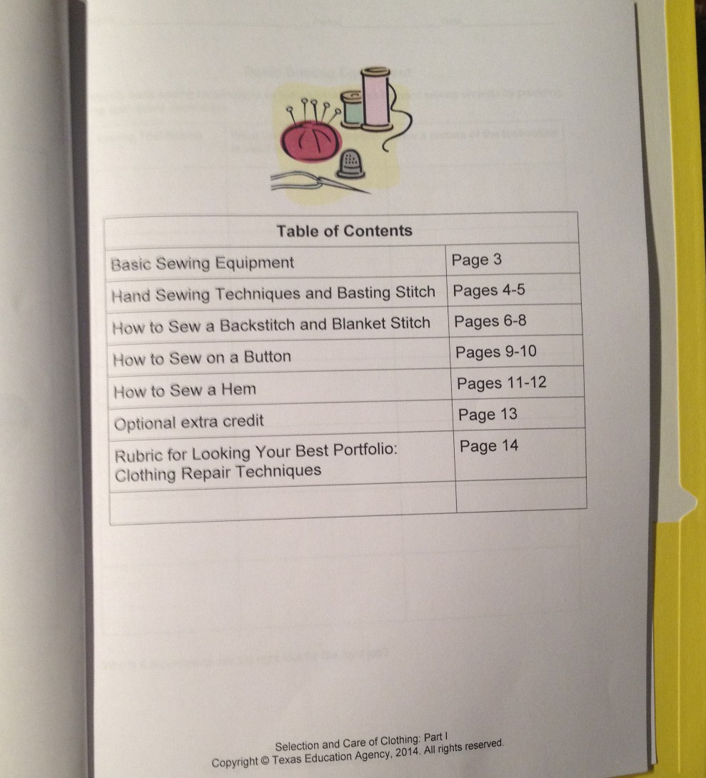
Looking Your Best Portfolio: Clothing Repair Techniques

Slide 6
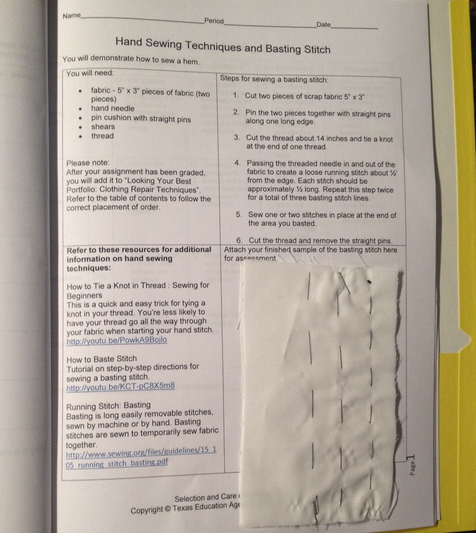
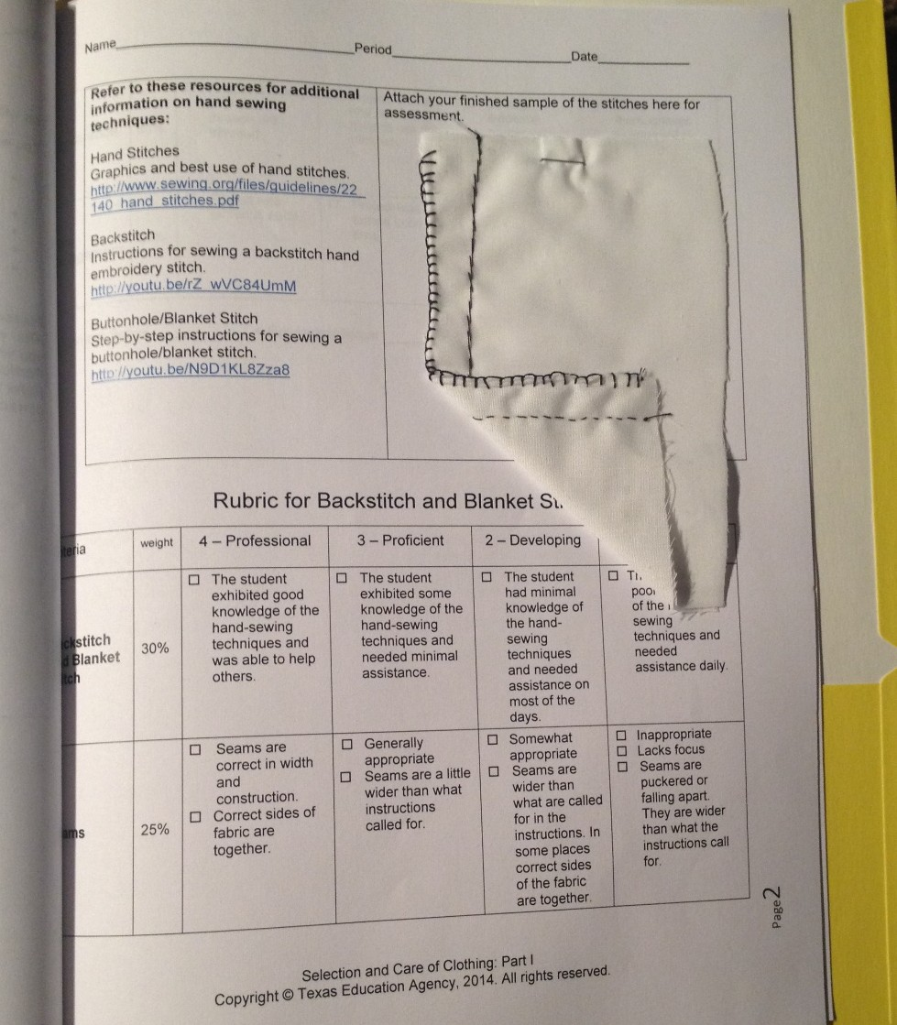
Looking Your Best Portfolio: Clothing Repair Techniques

Slide 7
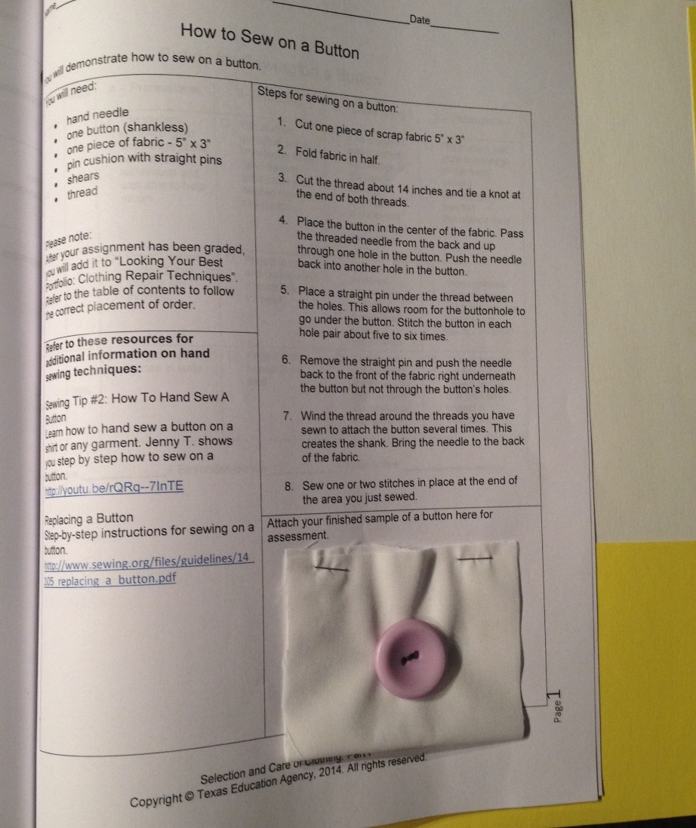
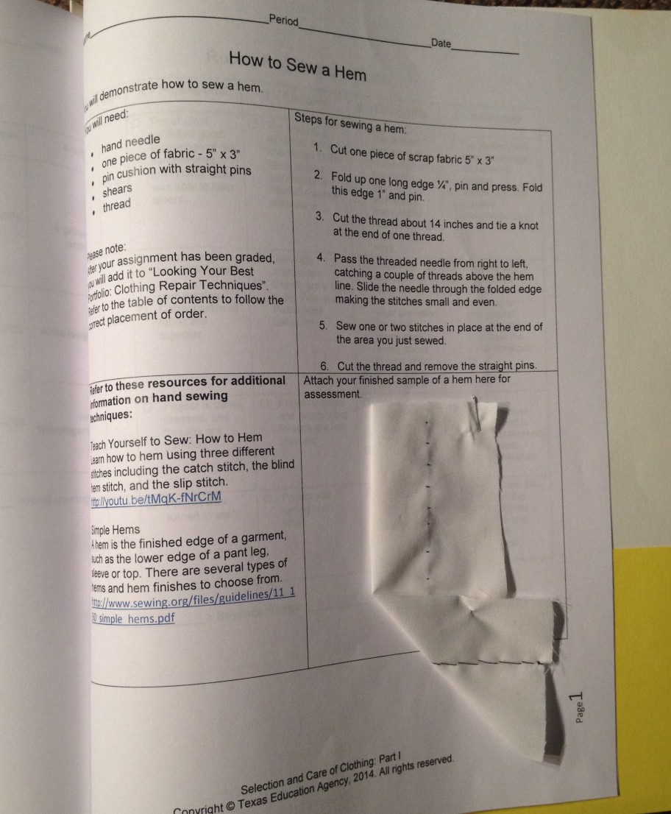
Looking Your Best Portfolio: Clothing Repair Techniques

Slide 8

Guidelines for Use of Sewing Tools and Notions
Notions are all the things you need to complete a sewing project other than fabric.
Keep your tools and notions neat and organized.
Using sewing tools correctly will make the job easier.
Keep straight pins and needles out of your mouth.
Allow ample time to clean up your work area before the end of the class.

Slide 9
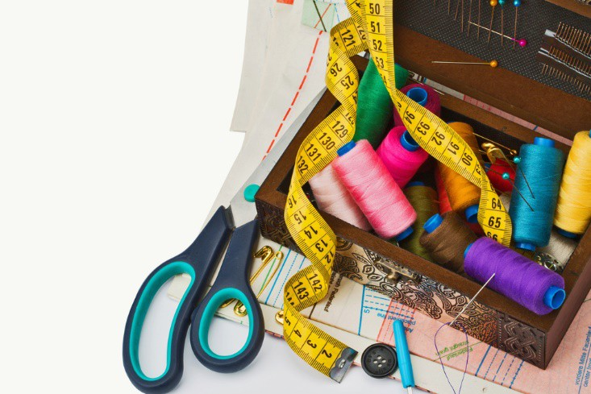
How to Sew a Basting Stitch
Steps for the basting stitch:
Cut two pieces of scrap fabric 5” x 3”.
Pin the two pieces together with straight pins along one long edge.
Cut the thread about 14 inches and tie a knot at the end of one thread.
Pass the threaded needle in and out of the fabric to create a loose running stitch about ½” from the edge. Each stitch should be approximately ½” long. Repeat this step twice for a total of three basting stitch lines.
Sew one or two stitches in place at the end of the area you basted.

Slide 10
How to Sew a Backstitch
Cut two pieces of scrap fabric 5”x3”4
Pin the to pieces together with straight pins along one long edge
Cut the thread about 18-24 inches in length. Bring both ends of the thread together and tie a know
For the backstitch, push the threaded needle through the fabric, and make a small forward stitch about .5” from the edge. Go back to the middle the previous stitch and push the needle through again. Repeat, overlapping each stitch.
Ser one or two stitches in place at the end of the area you just sewed

Slide 11
How to Sew a Buttonhole/Blanket Stitch
Cut the thread about 18-24 inches in length. Bring both ends of the thread together and tie a knot.
Sew the blanket stitch along the same edge as the backstitch. For the blanket stitch, pass the threaded needle from the back, bringing the point of the needle out at the end of the fabric. Loop the thread behind the point of the needle. Pull the threaded needle through the fabric, allowing the edge thread to loop on the end of the fabric.
Sew one or two stitches in place at the end of the area you just sewed.
Cut the thread, and remove the straight pins.

Slide 12
Steps for Sewing on a Button
Cut the thread about 14 inches in length and tie a knot at the end of both threads.
Place the button in the center of the fabric. Pass the threaded needle from the back and up through one hole in the button. Push the needle back into another hole in the button.
Place a straight pin under the thread between the holes. This allows room for the buttonhole to go under the button. Stitch the button in each hole pair about five to six times.
Remove the straight pin, and push the needle back to the front of the fabric right underneath the button but not through the button’s holes.
Wind the thread around the threads you have sewn to attach the button several times. This creates the shank. Bring the needle to the back of the fabric.
Sew one or two stitches in place at the end of the area you just sewed.

Slide 13
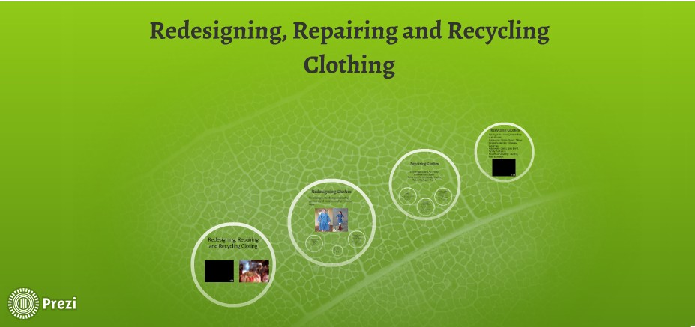
Redesign, Repair and Recycle

Slide 14


Slide 15
References and Resources
Images:
Microsoft Clip Art: Used with permission from Microsoft™. (Slides 5, 12 and 19 )
Photos obtained through a license with Shutterstock.com.™. (Slides 1, 6, 7, 11, 13, 14, 15, 16, 17 and 21)
Textbook:
Johnson, L. (2004). Strengthening family & self. Tinley Park, IL: Goodheart-Wilcox.
Websites:
How to Manage Your Time Effectively
It’s important that you develop effective strategies for managing your time to balance the conflicting demands of time for study, leisure, earning money
and job hunting. http://www.kent.ac.uk/careers/sk/time.htm Redesign, Repair and Recycle
Meigan Rhodes created a Prezi on redesigning clothes. http://prezi.com/d0f_jfjjwl1n/redesign-repair-and-recycle/
Sewing.org
Free sewing and craft projects, learn to sew, guidelines articles, charitable projects, bridal, children and more. http://www.sewing.org
Sew Trendy
Teens sewing with style.
http://www.sewtrendy.com/ Statisticbrain.com
Teenage consumer spending.
http://www.statisticbrain.com/teenage-consumer-spending-statistics/

Slide 16
References and Resources
YouTube™: Backstitch
Instructions for sewing a backstitch hand embroidery stitch. http://youtu.be/rZ_wVC84UmM
Buttonhole/Blanket Stitch
Step-by-step instructions for sewing a buttonhole/blanket stitch. http://youtu.be/N9D1KL8Zza8
How to Baste Stitch
Tutorial with step-by-step directions for sewing a basting stitch. http://youtu.be/KCT-pC8X5m8
How to Sew a Torn Seam
Have you ever wanted to get good at sewing? Well look no further than this informative video on How to Sew a Torn Seam. http://youtu.be/mUE_ATvXIdA
How to Tie a Knot in Thread : Sewing for Beginners
This is a quick and easy trick for tying a knot in your thread. You’re less likely to have your thread go all the way through your fabric when starting your hand stitch. http://youtu.be/PowkA9Bojlo

