Slide 1
Service Learning with a Smile

Slide 3
What is Service Learning?
  Service-Learning is a method of teaching and learning:
    changes lives by engaging students
    provides relevant hands-on service for schools and communities
    gives students the opportunity to gain and apply valuable knowledge and skills related to classroom studies
Notes:
After students read this definition, ask them to individually write the definition in their own words. Next, have them work with a partner to write a definition. Keep revising until the class has created a definition they all understand.

Slide 4
How do you get started?
  Try the FCCLA Planning Process
    1. Identify a concern
    2. Set a goal
    3. Form a plan
    4. Act
    5. Follow up and reflect
Notes:
After students read this definition, ask them to individually write the definition in their own words. Next, have them work with a partner to write a definition. Keep revising until the class has created a definition they all understand.

Slide 5
Step 1: Identify a concern
  Read newspapers and magazines
  Walk through the school, take photographs of concerns
  Make trips to parks, museums, hospitals, and other local areas
  Research global issues
  Listen to local, state, and national news programs
  Interview/survey other students, staff, and family members
  Reflect - think carefully about what you have done and plan to do
Notes:
The first step of Service Learning is to identify a concern by looking and listening. There are many ways to identify meaningful community needs. (Give students opportunities to do some of these activities and list the needs they see or hear about. They can work independently or in small groups.
After they have had opportunities to look and listen, use one of their concerns or discuss the example provided throughout this presentation.)
An example is students might observe bullying at the high school and among younger students where they work with primary students.

Slide 6
Teenage Needs
Notes:
Service learning projects can involve direct action in which students respond to a community need by interacting with and impacting the service recipient or site (for example, by sewing fleece blankets for the homeless). Indirect service buiids an infrastructure or capacity to respond to the community need (for example, conduct a canned food drive and pack Thanksgiving baskets for people in need. Research and Advocacy service is when students find, gather and report on information to raise awareness of a problem and/or advocate for change in the condition of the underlying community need (for example, breast cancer awareness).
Teens in our community are special.
What type of needs do they have? What are some things they might not want to openly discuss, but are real needs in their lives?

Slide 7
Elderly
Notes:
Service learning projects can be fun and beneficial to the community. There are specific steps in accomplishing the service learning project. Investigation: What we know already and what we will need to learn to meet the community needs. Preparation/Planning: Our learning goals and what we will study to reach them. Action: How I applied new knowledge and skills. Reflection: How I changed because of what I learned. Reflection is important because students will tie the service with learning. Demonstration/Celebration: How we showed and shared what we learned.
The elderly have different needs all together. What sort of needs do they have that we as a class might be able to reach? Please discuss in your groups and we will share your ideas with the class.

Slide 8
Your School
Notes:
What needs does our school have? What opportunities for service learning can make a difference right in our high school? Brainstorm in groups of three and determine what types of service learning you can start working on. You can make a difference!!

Slide 9
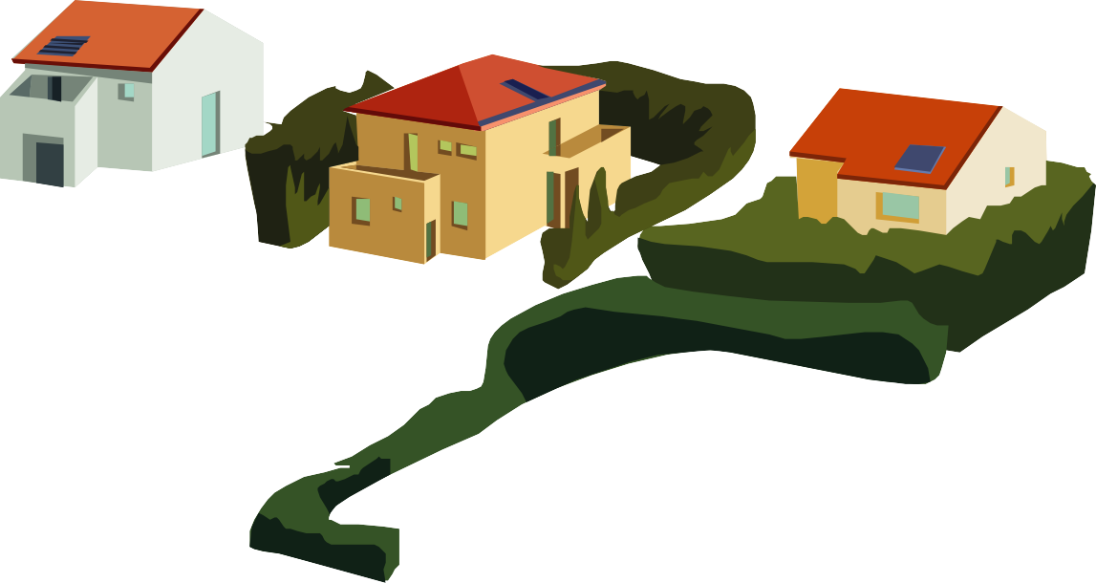
Your Neighborhood

Slide 10
The Environment
Notes:
Remember …regardless of the need you choose to address, you must be able to directly connect it to one of the TEKS for our class…this is why it is called service learning instead of community service.

Slide 11
Research the Concern
  Library and Internet Research
  Personal, phone or Skype interviews
  Identify other groups interested in the issue who could be partners
  Survey others
  Collect videos or photographs to document information
  Reflect
Notes:
It is important to examine the issues. Discuss the needs you discovered and choose one to examine with the techniques on this slide.
Give students time to try some of these research techniques on their problem or the example of bullying.

Slide 12
Discuss the Research, Share Ideas
  Brainstorm
  Discuss
  Ask questions
  Use decision-making skills
  Reflect
Notes:
Now it is time to agree to take action. Use these skills to agree on a specific issue. It is important to focus on the issue and narrow the scope of the problem to specific needs.

Slide 13
Sample Plan
  Example for bullying issue:
    1. Survey 50 fifth grade students about their bullying experiences
    2. Compile a list of strategies to help from research/experience
    3. Create videos to teach effective strategies to use with bullies
    4. Develop pocket reference cards
    5. Mentor fifth grade students at lunch and recess
    6. Survey again after 3 months
Notes:
The first step of the FCCLA Planning Process is to look and listen. There are many ways to identify meaningful community needs. (Give students opportunities to do some of these activities and list the needs they see or hear about. They can work independently or in small groups.
After they have had opportunities to look and listen, use one of their concerns or discuss the example provided throughout this presentation.)
Example: students might observe bullying at the high school campus and among younger students at an elementary or middle school.

Slide 14
Step 2: Set a Goal
  Create a specific list of what you want to accomplish
  Write it down, be specific
  For example:
    By the end of this project, all 87 of the fifth grade students will be able to define 3 types of bullying, discuss and practice prevention strategies with a high school mentor, and use the strategy alone
  Make the goal measureable
Notes:
It is always important to set goals. They need to be specific and include ways to measure the results. The goal will guide the project and let you know if you accomplished what you wanted to improve or change.

Slide 15
Step 3: Form a Plan
  1. What would be a realistic plan?
  2. How would this plan relate to our curriculum/TEKS?
  3. How could we evaluate the plan?
  4. Who could participate?
  5. Who might help or be a partner?
  6. What will it cost? Budget?
  Reflect
Notes:
The next step is to form a plan. Discuss the issue in small groups and devise a plan. Give each group one of the questions to consider.
List and record their responses as groups report to the class. Ask students to reflect about the answers. Are their other questions we should consider?

Slide 16
Step 4: Execute the Plan
  Document activities
  Work with partners
  Keep a journal
  Take pictures and videos
  Analyze data
  Reflect
Notes:
The next part of the process is the Act step. If we decide to complete the project, this is where we go into action. We would complete these things as we work on the project.

Slide 17
Step 5: Follow up and Reflect – Review the Outcome
  Collect information
  Analyze data
  Evaluate results – did you meet your goal?
  Decide to continue or make revisions
  Thank all partners and others who helped
  Reflect: Think carefully about what you have done, what you learned, and what you plan to do next
Notes:
We are almost finished with the process. Now we review the outcomes…how did it go? Was the plan effective? Why or why not? What could be done differently? Did you meet your goal?

Slide 18
Showcase the results
  Celebration
  Newspaper and TV coverage
  Invite guests to share
  Make video for school webpage
  ???
  Reflect
Notes:
This is also the time to assess how well the high school students met their educational objectives. Do they have the skill or knowledge that was identified at the beginning of the plan?
Let’s get started…

Slide 19

  How wonderful is it that no one need wait a single moment before starting to change the world. - Anne Frank

Slide 20
Resource and References
  Books:
    The Complete Guide to Service Learning by Cathryn Berger Kaye, free spirit Publishing, 2010.
  Websites
    Cathryn Berger Kaye
    Web page of international service learning consultant and author. Includes free curriculum materials and information about her books. http://www.abcdbooks.org/curriculum/quotes.html
    FCCLA
    http: //texasfccla.org/Service Learning.html
    Information about Service Learning activities and opportunities in Texas FCCLA
    National Service Learning Clearinghouse
    A web page with lesson plans, success stories, and information about other resources for service learning.
    http://servicelearning.org

Slide 21
Resource and References
  Websites
    National Service Learning Partnership
    A nationwide network for teachers and students to share their stories and resources. http://www.service-learningpartnership.org
    ProTeacher
    Service Learning Project Ideas http://www.proteacher.org/c/868_Service_Leaning_Projects.html
    Good Character
    Character Education Resources
    http://www.goodcharacter.com/SERVICE/service.html
    GoToServiceLearning
    A site that includes lesson plans organized by topics, grade levels, and areas of study. http://www.gotoservicelearning.org/

Slide 22
Resource and References
  Websites
    Do Something Good
    DoSomething.org harnesses teen energy and unleashes it on causes teens care about. http://www.dosomething.org/
    Volunteer Match
    Find a Great Place to Volunteer
    http://www.volunteermatch.org/
    Youth Service America
    Provides resources and funding for service learning. Students can register their projects. http://ysa.org/

