Slide 1
Setting Tables with Service and Style

Slide 3
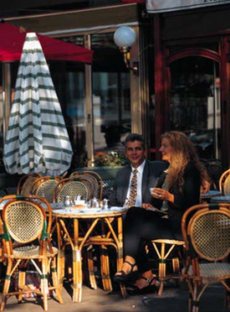
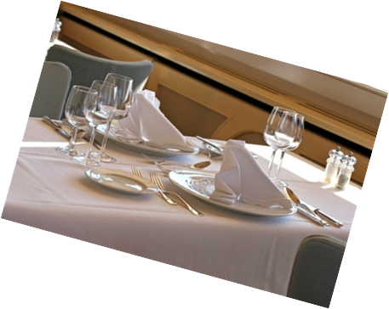
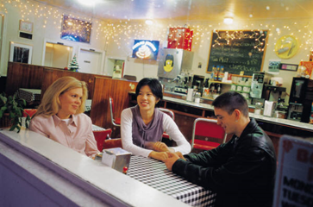
Types of Dining
  Fine-Dining
  Theme
  Casual Dining
    Family-style restaurants
    Neighborhood establishments
    Grills and buffets
    Vending machines
Notes:
Different types of dining appeal to different customers and situations.
Fine-dining restaurants provide an environment featuring excellent food, elegant décor and superior service. Customers are willing to pay top prices.
In our community/city, which restaurant is considered fine-dining?
Theme restaurants often try to recreate another place or time. Customers enjoy seeing sports memorabilia or an indoor waterfall in the middle of a simulated rain forest.
Do we have a theme restaurant in our community/city?
Casual-dining establishments attract people who like to eat out, but are not interested in a formal atmosphere or high prices.
In our community/city, what establishments are considered casual dining?

Slide 4
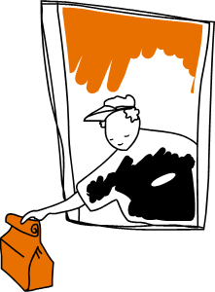
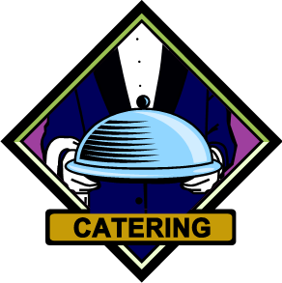
  Quick-Service Restaurants
    Fast food
  Catering Services
    Contract foodservice
    Airline meals
    Hotel and motel restaurants
    Cruise ship dining
Notes:
Fast food or quick-service restaurants are the largest section of the food service industry. They offer limited menus, low prices and speedy service.
Name the fast food eating places in our community/city.
Catering services are a growing segment of the foodservice industry. It often involves purchasing, receiving, storing, preparing, cooking, delivering and serving food to a client in another location.
Have any of you used a catering business before?

Slide 5
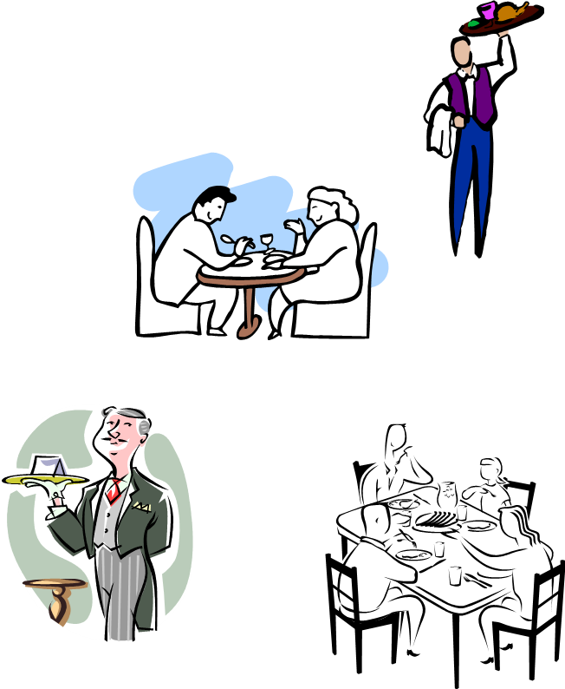
Types of Meal Service
  Modern American Plated Service
  Booth Service
  Banquette Service
  Family-Style Service
  Classical French Service
  Russian Service
  Butler Service
  Buffet service
Notes:
Modern American plated service is the most popular because it requires fewer and less extensively-trained staff. The food is completely prepared, portioned, plated and garnished in the kitchen.
In booth service, the table rests against, or is attached to, a wall. All customers are served from a single focal point.
Banquette is a type of seating arrangement in which customers are seated facing the server, with their backs against a wall.
Family-style service is used in a casual-dining atmosphere. Customers serve themselves and pass the food around the table just like home.
Classical French service is the most elegant and elaborate style. Some foods are fully or partially prepared tableside in full view of the customer.
Russian service is another elegant, formal service that is used internationally. Each course is completely prepared, cooked, portioned and garnished in the kitchen and then placed on a service plate or platters.
In butler service, the server carries the prepared food on a silver tray to standing or seated customers. Customers serve themselves from the trays.
Buffet service is where all the food is attractively displayed on a table for customers to see. Customers go to the buffet, choose what they want, and serve themselves.
Have students give you some examples of each of these with restaurants in your area or places they have visited.

Slide 6

Culinary Tip
  Using the Correct Hand
    Right hand
      Beverages and soups
      Clear dishes
    Left hand
      Solid foods
Restaurant Business: How to Wait Tables
Notes:
Notice that whenever a server performs a function from the guest’s left, the left hand is used. When working from the customer’s right, the right hand is used. This is true regardless of the type of table being served or the type of service being performed.
Click on hyperlink to view video:
Restaurant Business: How to Wait Tables
Waiting tables is a multi-tasking endeavor, as a waiter must greet the customers, take drink orders, seat other tables, serve the food properly and maintain an effortless attitude. Understand the job of a professional waiter with information from an executive chef in this free video on the restaurant business.
http://youtu.be/TbFVPYD-Kfs

Slide 7
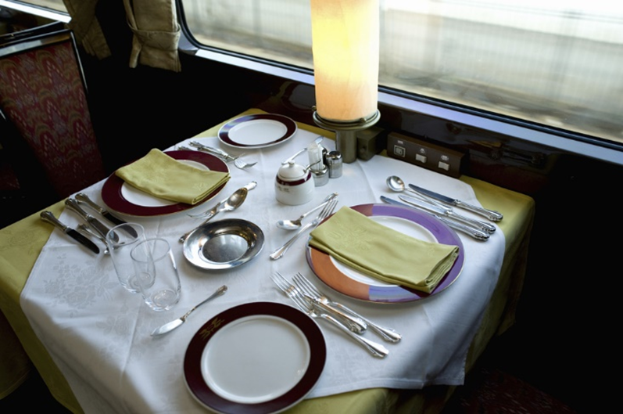
Setting the Table
  Begin with clean linens
  Add
    Centerpieces
    Napkins
    Flatware
    Tableware
    Glassware
Notes:
Linen napkins and tablecloths can dramatically enhance a room’s appearance but you can use place mats and tablecloths as well.
Centerpieces are decorative objects placed on tables to add beauty and interest. There are four types: lighting, floral, edible and sculpted.
Napkins are placed to the left of the dinner plate or folded in a design and placed on top of the plate or in the glass.
Flatware refers to dining utensils such as spoons, forks and knives.
Tableware are the dishes, soup bowls and coffee cups.
Glassware is for beverages such as juice, water and iced tea.

Slide 8
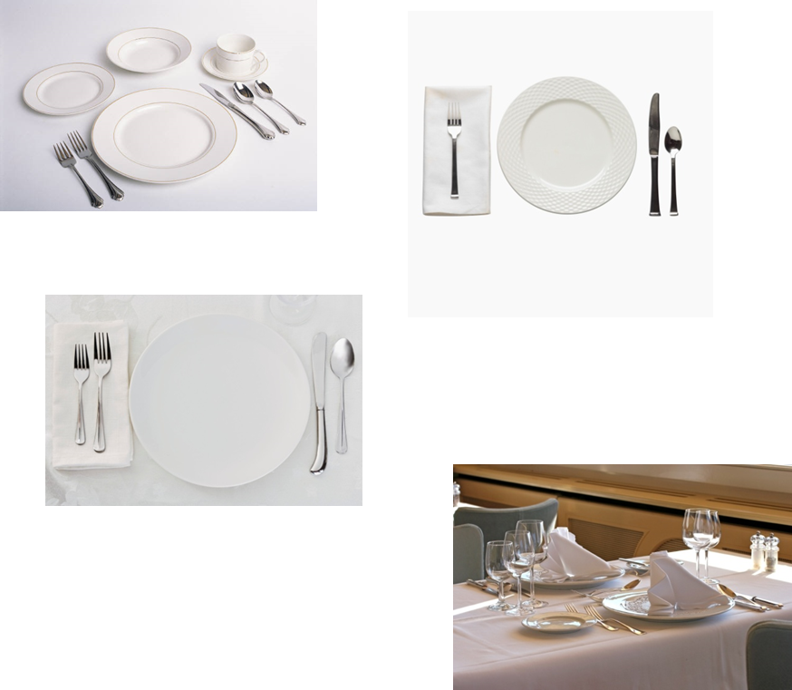
Place Settings
  Breakfast
  Lunch
  Dinner
  Formal Dinner
Notes:
To center each place setting, first place the napkin. Set fork on the left side of the plate and the knives and spoons on the right side.
Always set knives with the cutting edge toward the center of the place setting.
Place flatware one inch from the edge of the placemat or table.
Place all flatware form the outside in, following the order of use.
Place the bread-and-butter plate on the left, above the fork(s).
Place the water glass above the tip of the dinner knife.
Preset coffee cups to the right of the knives and spoons, with handles at the 4 o’clock position.

Slide 9

Setting a Formal Table Setting
How To Set a Dinner Table
Notes:
Click on hyperlinks to view videos:
Setting a Formal Table Setting
The basics to setting a formal table
http://youtu.be/qKSHmmNk_5Y
How to Set a Dinner Table
Figuring out which fork to use for which course can be confusing enough, but having to actually set those forks—and everything else on the table?
A recipe for disaster... or a chance to strut your etiquette stuff
http://youtu.be/PcTR1B06e-g

Slide 10

Napkin Folding
  Creative napkin folding can transform an ordinary occasion into a celebration
Fancy Napkin Folding
Lotus Napkin Fold
Notes:
The restaurant owner or manager decides how napkins are to be folded. Beautiful napkin folds add to the place setting and impresses guests.
These are two short video from reliable sources on napkin folding but there are many more to choose from. Preview ones that you would like your students to create. The Lotus is one of the most difficult napkin folds so challenge the students to assemble it for extra credit.
Click on hyperlinks to view videos:
Fancy Napkin Folding
Looking for that extra something to fancy up your dinner table for guests?
Try these easy napkin folding techniques for flair that's sure to impress.
http://video.about.com/interiordec/Fancy-Napkin-Folding.htm
Lotus Napkin Fold
Don't panic! In this easy video, we'll show you how to shape a napkin into a lotus fold.
http://youtu.be/0sMr8h6ygs8

Slide 11

Questions?

Slide 12
References and Resources
  Images:
    Microsoft Office Clip Art: Used with permission from Microsoft.
    Shutterstock™ images. Photos obtained with subscription. (slide 7)
  Textbook:
    Culinary essentials. (2010). Woodland Hills, CA: Glencoe/McGraw Hill.
  Video:
    Fancy Napkin Folding with Jonathon Stewart
    Easy napkin folding techniques for flair that's sure to impress
    http://video.about.com/interiordec/Fancy-Napkin-Folding.htm
  YouTube™:
    How to Set a Dinner Table
    Figuring out which fork to use for which course can be confusing enough, but having to actually set those forks—and everything else on the table? A recipe for disaster... or a chance to strut your etiquette stuff.

Slide 13
References and Resources
    http://youtu.be/PcTR1B06e-g
    Lotus Napkin Fold
    How to shape a napkin into a lotus fold
    http://youtu.be/0sMr8h6ygs8
    Restaurant Business: How to Wait Tables
    Waiting tables is a multi-tasking endeavor, as a waiter must greet the customers, take drink orders, seat other tables, serve the food properly and maintain an effortless attitude. Understand the job of a professional waiter with information from an executive chef in this free video on the restaurant business.
    http://youtu.be/TbFVPYD-Kfs
  Setting a Formal Table Setting
  The Basics of Setting a Formal Table
  http://youtu.be/qKSHmmNk_5Y

