Slide 1
The Importance of Client Satisfaction

Slide 3
“You never get a second chance to make a good first impression.” -Will Rogers
Notes:
Script: How does this apply to the importance of client satisfaction?
Allow time for classroom discussion.
Teacher note: Throughout the slide presentation, there are several statistics on the importance of client satisfaction. Please allow time for a class discussion pertaining to the statistics.

Slide 4
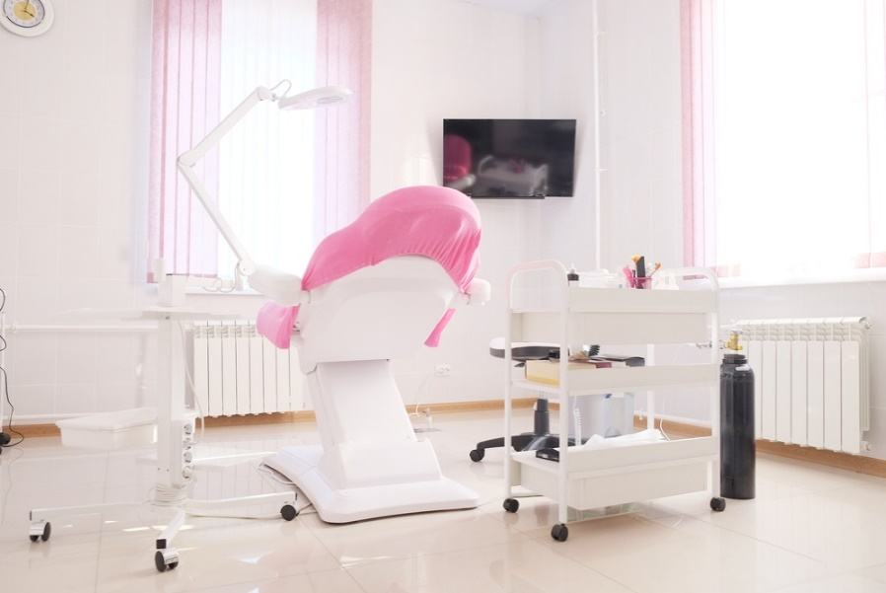
Human Services Career Pathways
Notes:
Practicum in Human Services provides occupational specific training and focuses on the development of:
Consumer Services
Early Childhood Development and Services
Counseling and Mental Health Services
Family and Community Services
Personal Care Services
The importance of client satisfaction can be applied to all Human Services career pathways.

Slide 5
Employer Expectations
An employer searches for an employee who will save them time and money over the other applicants.
Notes:
All people have expectations of one another, whether spoken or held as private thoughts. This is also true of employers. Once you secure a job, it is vital to the success of an employee to discover what the spoken and unspoken expectations are on the job. The expectations may change over time and may differ from employer to employer and from position to position. An employer searches for an employee who will save them time and money over the other applicants.
Career success is often determined by soft skills. A United States government study agrees that soft skills are essential to job success. What are soft skills? In the early 1990’s, the Secretary of Labor asked a blue-ribbon panel to determine what it takes to be successful in the modern employment world. This panel published a report called the Secretary’s Commission on Achieving Necessary Skills (SCANS). The SCANS report presents a set of foundation skills and workplace competencies deemed essential for work world success today.
The SCANS report identifies the following soft skills as necessary for work and career success:
believing in one’s own self worth
communicating effectively
exhibiting self-control
giving strong efforts
having empathy
knowing how to learn
managing time
making effective decisions
persevering
prioritizing tasks
setting goals
taking responsibility
working well in teams
How do soft skills relate to client satisfaction? How do the soft skills relate to the career pathways in Human Services?

Slide 6
Professional Ethics at the Workplace
Ethics set the stage for all future interactions with each client. Ethical qualities can include:
Accountability
Commitment to excellence
Concern and respect for others
Fairness
Honesty
Integrity
Loyalty
Trustworthiness
Notes:
Ethics can be defined as a system of moral values that help people decide right from wrong. A business will thrive if professional ethics are practiced. Ethics set the stage for all future interactions with each client.
Ethical behavior is doing the right thing, even under pressure to do the wrong thing. Unethical behavior is doing the wrong thing.
Ethical qualities include:
accountability – be responsible for your actions
commitment to excellence – always do your best
concern and respect for others – care about fellow employees and clients
fairness – treat everyone equally
honesty – tell the truth, even if you may have done something incorrectly
integrity – do not let peer pressure change your mind about what you know is right
loyalty – keep confidential information confidential
trustworthiness – be reliable; be the type of person who can be trusted
How do these ethical qualities relate to client service and satisfaction? Allow time for class discussion.

Slide 7
What does good client service look like?
Notes:
What does good client service look like? Allow time for class discussion. You may opt to assign a scribe to write the answers on the board. Possible answers may include:
Courtesy is shown to clients
Employee is kind and competent to clients
Employee sincerely cares for the needs of the clients
Good attitude by employee – practices the Golden Rule
Good communication between employee and clients
Have you personally experienced good client service? When? Where? What happened?

Slide 8
What does poor client service look like?
Notes:
What does poor client service look like? Allow time for class discussion. You may opt to assign a scribe to write the answers on the board. Possible answers may include:
Employees are rude to the clients
Employees displaying an uncaring attitude toward clients
Employee is unknowledgeable about products or services offered
Employee using foul language with the client
Telling a client “There is nothing I can do for you.”
Have you personally experienced poor client service? When? Where? What happened?
How can this affect a business? Your job?

Slide 9
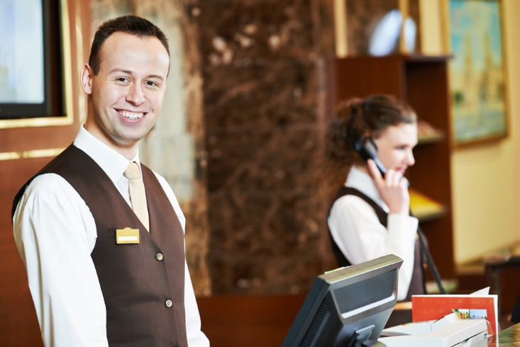
Customer Service Statistics
55% of consumers would pay more for a better customer experience.
Notes:
Forbes.com
44 Facts Defining the Future of Customer Engagement
http://www.forbes.com/sites/sap/2014/10/06/44-facts-defining-the-future-of-customer-engagement
Have you ever paid more due to a better customer experience?

Slide 10
Short-term Goals to Providing Good Client Service
Always remind the clients that you value them and their business
Be aware of your verbal and non-verbal communication skills
Communicate clearly and concisely with all clients
Practice the 30 second rule
Training employees on providing good client service
Notes:
Several short-term goals to providing good client service may include:
Always remind the clients that you value them and their business
Be aware of your verbal and non-verbal communication skills
Communicate clearly and concisely with all clients
Practice the 30 second rule – make verbal contact with the client within 30 seconds of walking into the business and make eye contact
Training employees on providing good client service. Training starts on day one on the job!

Slide 11
Long-term Goals and Advantages of Providing Good Client Service
Being considerate of all client’s needs
Building genuine caring relationships with clients
Making all clients feel valued
The business earns a good reputation for providing good client service

Slide 12
Customer Service Statistics
A 2% increase in customer retention has the same effect as decreasing costs by 10%.
Notes:
Forbes Magazine
44 Facts Defining the Future of Customer Engagement
http://www.forbes.com/sites/sap/2014/10/06/44-facts-defining-the-future-of-customer-engagement
What could these percentages mean to a business?

Slide 13
Customer Service
(click on image)
Notes:
Customer Service
Six Common Customer Expectations-- Created using PowToon.
https://youtu.be/RyrjeDWQ0Vw

Slide 14
Customer Service Statistics
70% of buying experiences are based on how the customer feels they are being treated
Notes:
Forbes Magazine
44 Facts Defining the Future of Customer Engagement
http://www.forbes.com/sites/sap/2014/10/06/44-facts-defining-the-future-of-customer-engagement
Are you more apt to purchase more if the client service is exceptional? Could the opposite be true also? Allow time for class discussion.

Slide 15
How to Greet Customers
(click on image)
Notes:
How to Greet Customers Improve the customer experience by greeting them right! Consultant Dick Marks discussed the “I Care” method of greeting customers at a business. https://youtu.be/kkxMFUk648o

Slide 16
Customer Service Statistics
86% of buyers will pay more for a better customer experience
Notes:
Forbes Magazine
44 Facts Defining the Future of Customer Engagement
http://www.forbes.com/sites/sap/2014/10/06/44-facts-defining-the-future-of-customer-engagement
Would you pay more for a service if it meant you got treated better/right?

Slide 17
Communication With Employer
Keep the lines of communication open between yourself and the supervisor/employer
Ask questions
Repeat the instructions and follow them
Notes:
It is important to practice good communication skills when consulting with a supervisor/employer. It is especially vital when you need to expedite solutions to client problems. Your supervisor/employer should provide adequate training on methods and strategies of handling client problems. If you are required to perform a duty that you are unfamiliar with, ask your supervisor/employer questions. It is more important to be knowledgeable at the workplace then to do something wrong and that in turn, could affect the clients.

Slide 18
Client Recommendations
Survey – online, text or a card
What are important questions to ask on a survey?
A good survey produces high quality data, which gives a business actionable insight into the client satisfaction levels.
Notes:
Client feedback and suggestions are an invaluable tool for any business. Possible questions to ask on a survey may include:
"What specific items or actions pleased you the most?“
"What would you like to see us add to our inventory or layout?“
"How could we make your experience easier?“
"Who serves you best here?“
“What can we do to improve our business?”
"Have we been able to provide everything you need?“
How can a survey help a business grow and improve? A survey shows a client you care enough to ask what they like and dislike about the company/business. Paying attention to how clients answer the survey, may help you have a high repeat business rate. How? When you listen to client’s comments, this tells them that they're more than just a revenue stream to your company/business.
Have you ever completed a survey? What kind of questions were asked on the survey? Was there an incentive attached to participating in the survey?

Slide 19
Steps to Resolving Client Complaints
Apologize
Be available
Defuse the tension
Solve the problem
Follow-up
Notes:
Steps to Resolving Client Complaints may include:
The first thing you need to do is apologize to the client. It is not your fault, so you should not take it personally.
Be available in body and mind. Avoid distractions around you and maintain eye contact with the client. Do not answer your phone or text during work hours and especially when an irate client is standing in front of you!
Defuse the tension by allowing the client to express what the complaint is. Don’t interrupt and don’t offer excuses.
Solve the problem by offering a replacement or a refund. You may offer a discount or freebies (consult with supervisor/employee first)
Follow up with the customer. You may either call, text or e-mail. This will make the client feel like you really do care for him or her and in turn, he or she will more likely be your most valued patron.

Slide 20
How Clients Respond to Poor Service
May provide a negative review on social media
They may decide to take their business elsewhere
A poor experience is shared with at least 20 friends/family/colleagues. On the web, the numbers could multiply very quickly
Notes:
According to Brand Reputation CEO Graeme Crossley “A customer that has a good experience will typically tell 3 to 5 people, but a customer who has a poor experience will tell more than 20. When this trend occurs via the web, these numbers can rapidly multiply and could spell disaster for brands that don’t have strategies in place to combat online negative chatter.“
Have you ever been influenced by a bad review you read on social media? How did it influence you?
Econsultancy.com
The impact of negative consumer reviews is growing.
https://econsultancy.com/blog/4866-the-impact-of-negative-consumer-reviews-is-growing

Slide 21
Review
Identify three examples of soft skills.
What does good client service look like?
Describe two short-term goals to providing good client service.
List and explain three questions to ask on client survey.
Why is it important to keep the lines of communication open with your supervisor/employer?
Notes:
Have students answer independently in short paragraphs on paper or allow for classroom discussion.

Slide 22
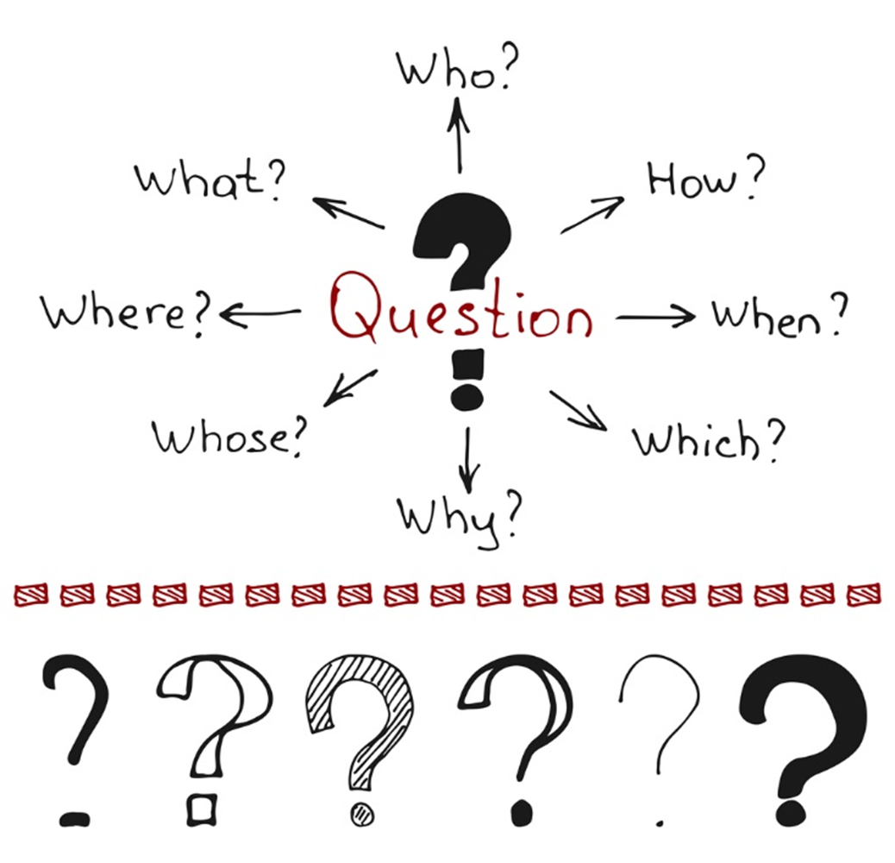

Slide 23
References and Resources
Images:
All photos obtained through a license with Shutterstock.com™.
Websites:
Econsultancy.com
The impact of negative consumer reviews is growing.
https://econsultancy.com/blog/4866-the-impact-of-negative-consumer-reviews-is-growing
Forbes Magazine
44 Facts Defining the Future of Customer Engagement
http://www.forbes.com/sites/sap/2014/10/06/44-facts-defining-the-future-of-customer-engagement
YouTube™:
Customer Service
Six Common Customer Expectations— Created using PowToon.
https://youtu.be/RyrjeDWQ0Vw
How to Greet Customers
Improve the customer experience by greeting them right! Consultant Dick Marks discussed the “I Care” method of greeting customers at a business.
https://youtu.be/kkxMFUk648o

