Slide 1

The Business of travel and tourism
Travel and Tourism Management

Slide 2
Copyright
Copyright © Texas Education Agency, 2015. These Materials are copyrighted © and trademarked ™ as the property of the Texas Education Agency (TEA) and may not be reproduced without the express written permission of TEA, except under the following conditions:
1) Texas public school districts, charter schools, and Education Service Centers may reproduce and use copies of the Materials and Related Materials for the districts’ and schools’ educational use without obtaining permission from TEA.
2) Residents of the state of Texas may reproduce and use copies of the Materials and Related Materials for individual personal use only, without obtaining written permission of TEA.
3) Any portion reproduced must be reproduced in its entirety and remain unedited, unaltered and unchanged in any way.
4) No monetary charge can be made for the reproduced materials or any document containing them; however, a reasonable charge to cover only the cost of reproduction and distribution may be charged.
Private entities or persons located in Texas that are not Texas public school districts, Texas Education Service Centers, or Texas charter schools or any entity, whether public or private, educational or non-educational, located outside the state of Texas MUST obtain written approval from TEA and will be required to enter into a license agreement that may involve the payment of a licensing fee or a royalty.
For information contact: Office of Copyrights, Trademarks, License Agreements, and Royalties, Texas Education Agency, 1701 N. Congress Ave., Austin, TX 78701-1494; phone 512-463-7004; email: copyrights@tea.state.tx.us.
2
Copyright © Texas Education Agency, 2015. All rights reserved.

Slide 3
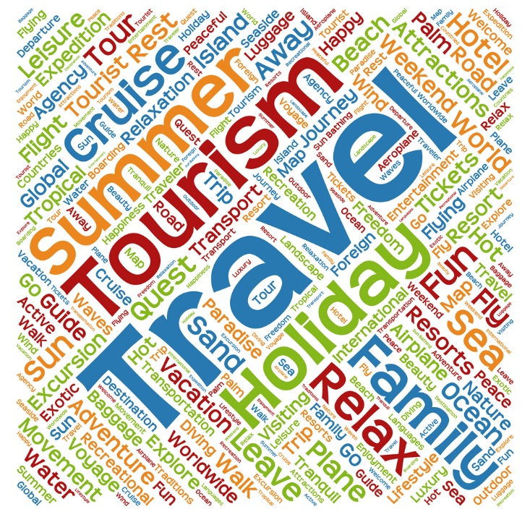
Travel and Tourism
3
Copyright © Texas Education Agency, 2015. All rights reserved.
Notes:
The travel and tourism industry is divided into two parts:
Travel – involves businesses that physically move people from one place to another
Tourism – involves businesses that organize and promote travel and vacations

Slide 4
Travel businesses
Airlines
Cruise Lines
Car Rentals
Taxi and Ferry Services
Train and Bus Services
4
Copyright © Texas Education Agency, 2015. All rights reserved.
Notes:
Travel businesses include:
Airlines - a company that owns and operates many airplanes which are used for carrying passengers and goods to different places.
Car rentals - automobiles that rented for short periods of time, generally ranging from a few hours to a few weeks.
Cruise lines - a passenger ship used for pleasure voyages, where the voyage itself and the ship's amenities are a part of the experience, as well as the different destinations along the way.
Taxi and ferry services:
Taxi - a car that carries passengers to a place for an amount of money that is based on the distance traveled.
Ferry - to carry or move (someone or something) on a vehicle (such as a boat or a car) usually for a short distance between two places.
Train and bus services:
Train - a connected line of railroad cars with or without a locomotive.
Bus- a large motor vehicle carrying passengers by road, especially one serving the public on a fixed route and for a fare.

Slide 5
Tourism businesses
Tour Operators
Travel Agencies
Travel and Tourism Offices
Cruise Companies
Meeting and Convention Planners
Convention and Visitors Bureau
5
Copyright © Texas Education Agency, 2015. All rights reserved.
Notes:
Tourism businesses include:
Convention and visitors bureau – a nonprofit organization that promotes tourism and provides services to travelers.
Cruise companies – a company that owns and operates cruise ships for pleasure voyages.
Meeting and convention planners – coordinate all aspects of professional meetings and events.
Tour operators - a person whose job duties include organizing tours, whether they be for holidays or historic places.
Travel agencies - businesses that help to make arrangements for people who want to travel.
Travel and tourism offices - an office where visitors to a place can get information about what to see and do, especially while on holiday, or an official organization that runs these offices.

Slide 6

Travel and Tourism Interactions
Guests use businesses from both sectors when traveling
Employees must work together to meet customer needs
Goal is to make travel fun, safe and exciting
6
Notes:
Employees from both the travel and tourism industries must interact so people on business or vacation have successful trips.

Slide 7

Business Departments
7
Copyright © Texas Education Agency, 2015. All rights reserved.
Notes:
Each travel business is unique and may perform most of the functions in the departments within a travel and tourism business.
In a small business, one person may perform several of these functions.
In a large business, each function will have a separate department with many people for each function.

Slide 8
Department Functions
Reservations and Bookings
Management
Marketing and Sales
Technology
Customer Service
Accounting
Engineering
Human Resources
Purchasing and Receiving
Safety
8
Copyright © Texas Education Agency, 2015. All rights reserved.
Notes:
Departments and their functions include:
Accounting - keeps track of all the money that flows into and out of the business.
Customer service or guest services - handles all activities involved with complaints, concierge services and customer inquiries.
Engineering - makes sure that all the equipment, plumbing, electricity and building facilities are working properly.
Human resources - manages all employee issues including benefits, firing and hiring, pay and training.
Management – oversees all functions of the business including making sure the business is operating profitably.
Marketing and sales – promotes the business, develops marketing plans and sells the products and services.
Purchasing and receiving – keeps track of purchases and inventory for the business.
Reservations and bookings - handles all activities involved with customers reserving rooms, seats, tours and more.
Safety – secures property for the safety of the guests and employees and oversees emergency procedures.
Technology – maintains computer software and data storage; may also oversee business website.

Slide 9
Department interactions
Communication is vital
Linked with software programs
Technology connected
9
Copyright © Texas Education Agency, 2015. All rights reserved.
Notes:
All of the business departments must work together.
Each of these main departments are necessary for the day-to-day operations for businesses.
Communication between departments is critical.
Many of the departments are linked through industry related software.
Technology departments in today’s business is often the connecting media. The company network and intercompany communication (email, instant messaging) is critical in today’s environment.
These are just a few examples of how departments work together. For businesses to succeed in today’s environment, communication and departmental interaction must work together like well-designed interlocking gears.

Slide 10
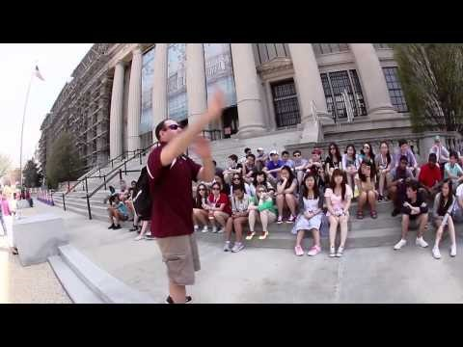
Travel Effect: The Movement
(click on link)
(image from video)
10
Copyright © Texas Education Agency, 2015. All rights reserved.
Notes:
Click on the hyperlink to view video:
Travel Effect: The Movement
It's a great impact the travel has on our lives, on our organizations and our way on our way of life. Whether it comes as business productivity, family relationships, education, memories, long-term, this is a huge opportunity well beyond just the value of the individual trip.
https://youtu.be/A4BA2L44plk

Slide 11

11
Copyright © Texas Education Agency, 2015. All rights reserved.
Notes:
What does this quote mean to you?

Slide 12
Let’s Review!
What does travel involve?
What does tourism involve?
What are some travel businesses?
What are some tourism businesses?
How do travel and tourism businesses interact?
Name four business departments and their functions.
How do business departments interact?
12
Copyright © Texas Education Agency, 2015. All rights reserved.
Notes:
Answers to the questions are found within the slide presentation or may vary with class discussion.

Slide 13

13
Copyright © Texas Education Agency, 2015. All rights reserved.
Notes:
Questions?

Slide 14
References and Resources
Images:
Shutterstock™ images. Photos obtained with subscription. (Slides 1, 3, 6, 7, 11, 13)
Textbooks:
Mancini, M. (2013). Access: Introduction to travel and tourism. Clifton Park, NY. Cengage Learning.
Reynolds, J. S. & Chase, D. M. (2010). Hospitality services. Tinley-Park, Illinois: The Goodheart-Willcox Company.
YouTube™:
Travel Effect: The Movement
It's a great impact the travel has on our lives, on our organizations and our way on our way of life. Whether it comes as business productivity, family relationships, education, memories, long-term, this is a huge opportunity well beyond just the value of the individual trip.
https://youtu.be/A4BA2L44plk
14
Copyright © Texas Education Agency, 2015. All rights reserved.

