Slide 1
Today’s Families

Slide 3
What is a family?
Notes:
Ask this question, and assign a scribe to write the responses on the board.

Slide 4
Family
  People living in the same household who are related by blood, marriage or adoption
Notes:
What do family members do for each other? They support each other, learn from each other, love each other and grow together.

Slide 5

Families
  Also include other people who do not live within the same household
  Can be formed by:
    Origin
    Procreation
Notes:
Discuss that a family of origin consists of your parents, step-parents, sibling and step- siblings. Your family of procreation is the one that you create.
Family can be formed by:
Origin - family from which you are born into
Procreation - family in which you will have children

Slide 6

Types of Families
  Adoptive
  Blended/Step
  Couple/Childless (no children)
  Extended
  Foster
  Nuclear
  Single Adult
  Single Parent

Slide 7

Adoptive Family
  Children NOT biologically linked to parents
    Parents have gone through a legal process to make children part of their family
Notes:
What are some pros and cons of an adoptive family?
Problems: Parents have challenges when child arrives, great adjustment for older child because of past memories, current fears and insecurities
Strengths: Offers love and stability to family-less child, brings love and satisfaction to childless family

Slide 8

Blended/ Step Family
  Husband, wife and at least one child from previous relationship
    Creates new family roles
Notes:
This family structure has the most hurdles to overcome. With the blending of two families and many different personalities, the transition to normalcy may be difficult.
What are some pros and cons of a blended/step family?
Problems: Many adjustments, extra effort to blend different personalities, takes time to develop relationships
Strengths: Learn how to relate to different personalities, solve problems, advantage of two-parent family, more resources

Slide 9
Couples without children
  Married adults who have no children because:
    they are unable to conceive
    they simply do not want children
    Husband and wife can be extremely career-minded
Notes:
What are the pros and cons of couples not having children?

Slide 10

Extended Family
  Includes relatives other than nuclear
  Several generations of one family live together
  More common in other countries
  Could be a temporary arrangement
Notes:
Modified extended family – Relatives live NEAR each other and interact frequently.
What are the pros and cons of an extended family?
Problems: too many irons in the fire
Strengths: extended family members are an important resource, family members learn respect, strong family ties, elders have a respected position in the family hierarchy

Slide 11

Foster Family
  Parents care for children on a temporary basis (children waiting for adoption or needing a place to stay while problems/issues are being resolved)
  Foster parents are licensed by the state, screened by social services, receive training and a small amount of money
Notes:
Fostering a child is a huge consideration for the foster parents.
What are some pros and cons of a foster family?
Problems: Parents could get difficult kids, parents and kids form attachments that have to be broken
Strengths: Offers love and stability to a child in transition

Slide 12

Nuclear Family
  Two parents and biological or adopted children
  Shared responsibilities
  Most accepted family structure in our society
Notes:
You may want to use this opportunity to give an example of a nuclear family. Think of a popular television show that the students can relate to.
What are the pros and cons of a nuclear family?
Problems: Parents taking sides, picking favorites, family members not getting enough attention
Strengths: Rewards of parenting, strong bonds, another adult to share good and bad times, children learn about both parental roles

Slide 13

Single Adult Family
  Household consisting of one adult
  Adult family status is single, meaning he or she has no partner or children
Notes:
What are the pros and cons of this type of family?

Slide 14

Single Parent Family
  Rapidly growing structure in our society
  One parent and child(ren)
Notes:
This family structure is growing because of the divorce rate in our country.
What are the pros and cons of a single parent family?
Problems: Less time to devote, less income, all responsibilities on one parent, parent feels overwhelmed, fewer resources for children
Strengths: Rewards of parenting, extended family can help, children learn responsibility and independence at a younger age

Slide 15

Family Structures
  Family Life and Structure
  (click on link)
Notes:
Family Life and Structure
Description of types of families.
http://youtu.be/inafIc2M90o

Slide 16
Functions of a Family
  To meet physical needs
  To raise autonomous children who eventually leave home
Notes:
Discuss with your students what physical needs are, such as food, shelter and clothing. There could possibly be more physical needs if you have a family member with special needs, such as one who is wheelchair bound.

Slide 17

Functions of a Family
  To adapt to change and provide family experiences of bonding
  To maintain the sanity of the adults while promoting growth in children
Notes:
Making memories is one way to support emotional needs. Another is simply being supportive during life trials.

Slide 18
Roles And Responsibilities Of Family Members
  Individuals within the family provide the following:
    Basic needs (such as food, clothing, and shelter)
    Economic support
    Education
    Love and affection
    Nurturance
    Opportunities to have fun
    Protection
    Religious background
Notes:
Families take on many forms and shapes, and yet they perform some of the same basic functions from culture to culture. Individuals within the family provide the following:
Basic needs (such as food, clothing, and shelter)
Economic support
Education
Love and affection
Nurturance
Opportunities to have fun
Protection
Religious background
Each individual in the family has certain roles. Your role as a son, daughter, sister, brother, niece, nephew, aunt or uncle is a given role that you acquired when you were born into the family. When you marry, you will assume a chosen role as husband or wife. Roles are defined by age and responsibilities. Parents are usually responsible for providing food and shelter. As children get older and enter the workforce, these responsibilities might fall partly on their shoulders. In relationships, it is important to communicate the roles you will be sharing or expected to fulfill to meet the needs of the family.

Slide 19
Factors That Influence Family Responsibilities
  Each of Haley’s six stages involves different emotional and physical processes and in turn influence family responsibilities.
    Leaving home
    Getting married or committing to a couple relationship
    Parenting the first child
    Living with an adolescent
    Launching the children
    Retirement and older adulthood
Notes:
Jean Piaget, Lawrence Kohlberg, and even William Shakespeare have written about the developmental stages individuals pass through as their lives move from birth to death. In 1973, Jay Haley identified a model of similar stages for families. Each of Haley’s six stages involves different emotional and physical processes and in turn influence family responsibilities.
The stages of the Family Life Cycle can be described as:
Leaving home
Getting married or committing to a couple relationship
Parenting the first child
Living with an adolescent
Launching the children
Retirement and older adulthood
The stages do not occur in exactly the same way in all families. Some families can be in two stages at one time. For example, the same family could be living with an adolescent and launching an older child. Remember the family life stages are fluid, without rigid boundaries, and that they can encompass the emotional, intellectual, physical and spiritual aspects of life.

Slide 20
Influences on Family Dynamics
  Crisis in the family
  Dynamics of previous generations
  Family values
  Level and type of influence from extended family or others
  Nature of attachments
  Nature of the household “mix”
  Special needs or chronically sick child and/or adult
Notes:
Conduct a discussion about how each item listed can influence the dynamics of a family.
Crisis events which affect family members:
abuse
alcohol or other drug use
an affair
death
divorce
family violence
homelessness
mental health difficulties
poverty
trauma
unemployment
How do family values, beliefs, culture and ethnicity influence the family dynamics?
How does the nature of attachments in a family, such as being secure or insecure, influence the overall family dynamics?
How do the dynamics of previous generations (parents’ and grandparents’ families) influence the family dynamics?

Slide 21
Compare Different Families
  Families are Different and Alike
  (click on link)
Notes:
Families of All Kinds
Compare how families are different and alike.
http://youtu.be/POofYM4ZiKg

Slide 22
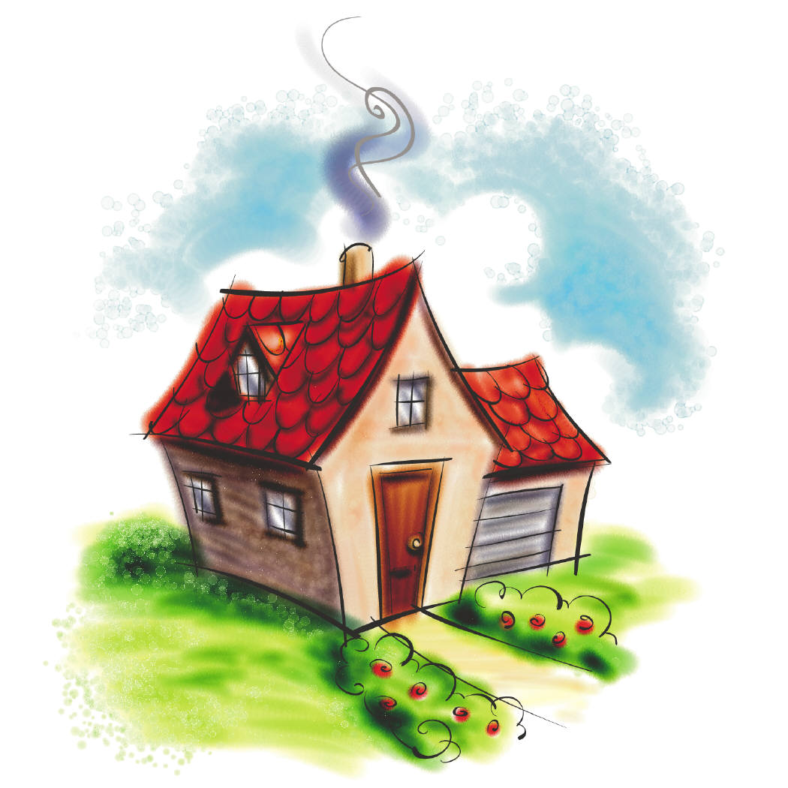
Benefits of a Family
  Maslow’s Hierarchy of Needs
    Provides for physical needs (food, shelter, clothing, protection and security)
    Satisfies one’s emotional needs (encouragement, support, belonging, companionship, love, self-esteem and self-actualization)
Notes:
Maslow’s Hierarchy of Needs – Abram Maslow, a scientist, created a pyramid diagram to show the way in which human needs are met.

Slide 23
Meeting Needs
  Financially
    Do chores without allowance
    Restrain from asking for extra things
    Take a part-time job
  Physically
    Complete chores
    Cook
    Help around the house
  Other
    Pick up the responsibilities wherever needed
Notes:
These lists involve doing things for others to help alleviate stress.

Slide 24



Managing Your Money
  Determine your needs and wants
  Establish your priorities
  Become your own personal “accountant”
  Keep accurate and current records of money
  Use a systematic process
  Use a decision-making process to help you take the best financial approach
Notes:
Organizing tasks and responsibilities can help you manage your individual and family resources such as finances, food, clothing, shelter, health care, recreation, transportation, time and human capital.

Slide 25

Effective Methods For Managing Family Roles
  Be supportive and accepting of all family members
  Have a positive attitude
  Learn to compromise and practice conflict resolution
  Practice good communication skills
  Forgive one another
Notes:
Why would families who hold weekly family meetings demonstrate stronger communication skills in stressful situations?

Slide 26
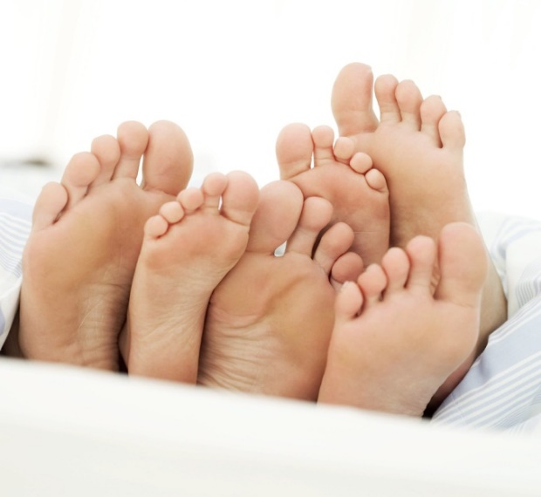
Family Ties
  Families are strengthened …
    by spending time together
    by showing respect to each other
    by sharing innermost thoughts and feelings
    by trusting each other
    with traditions
Notes:
Ask: What are some ways that families spend time together? Examples include family dinners, watching football or playing games.

Slide 27
Traditions
  Family traditions allow us to find our purpose and fulfill our goals by:
    Anticipating
    Participating
    Reflecting

Slide 28
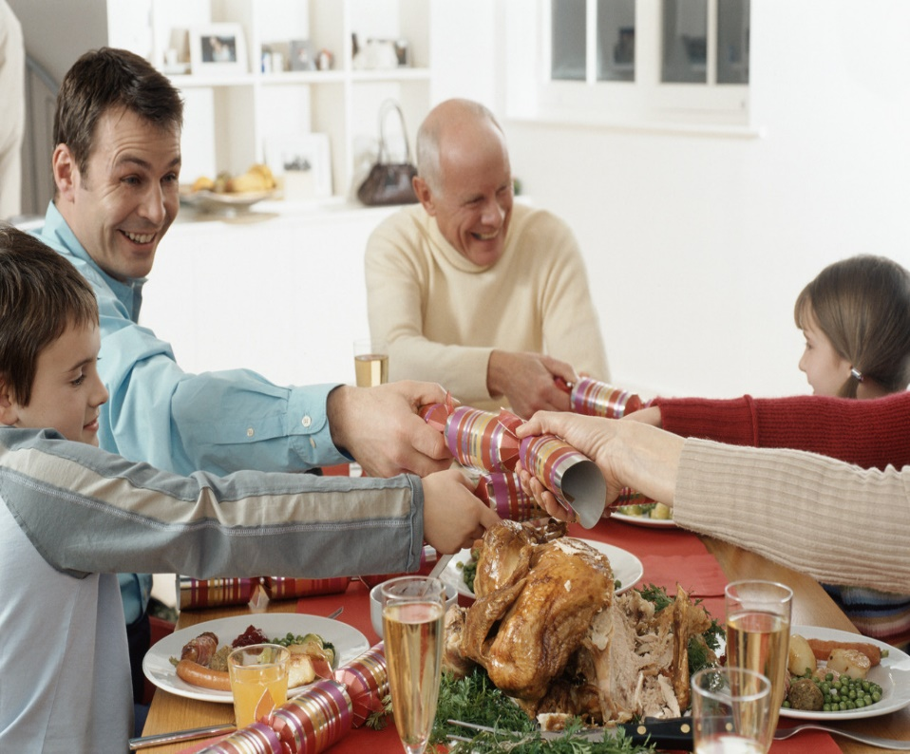
Types of Traditions
  Cultural
  Family
  Religious
  School
Notes:
Discuss school traditions, such as college traditions that bring alumni and current students together. Also give examples of religious, cultural and family traditions.

Slide 29

Family Traditions
  Build memories and define us as a family
  Preserve our heritage and culture
  Provide consistency
  Teach members the value of family
  Unify and create bonds

Slide 30
Questions?

Slide 31
References and Resources
  Images:
    Microsoft Clip Art: Used with permission from Microsoft.
  Textbooks:
    Johnson,Leona.(2004). Strengthening family & self. Tinley Park, IL: Goodheart-Willcox Company.
    Parnell, Baynor Frances. (2004). Skills for personal and family living. Tinley Park, IL: Goodheart-Willcox Company.
    Ryder/Harter (2004). Contemporary living. Tinley Park, IL: Goodheart-Willcox Company
  Websites:
    Becoming a Stepparent
    Becoming a parent by blending families or marrying someone with kids can be a rewarding and fulfilling experience.
    http://kidshealth.org/parent/positive/family/stepparent.html#cat168

Slide 32
References and Resources
  Websites:
    Nine Steps to More Effective Parenting
    Here are nine child-rearing tips that can help you feel more fulfilled as a parent — and enjoy your kids more, too.
    http://kidshealth.org/parent/positive/family/nine_steps.html?tracking=P_RelatedArticle#
  YouTube™:
    Families of All Kinds
    Compare how families are different and alike.
    http://youtu.be/POofYM4ZiKg
    Family Life and Structure
    Description of types of families.
    http://youtu.be/inafIc2M90o

