Slide 1
Urban Populations of Deer:
Management Techniques

Slide 3
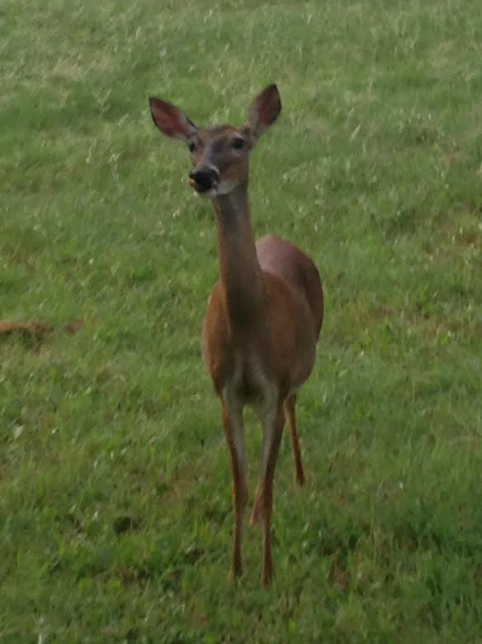
Deer sightings in Urban setting

Slide 4
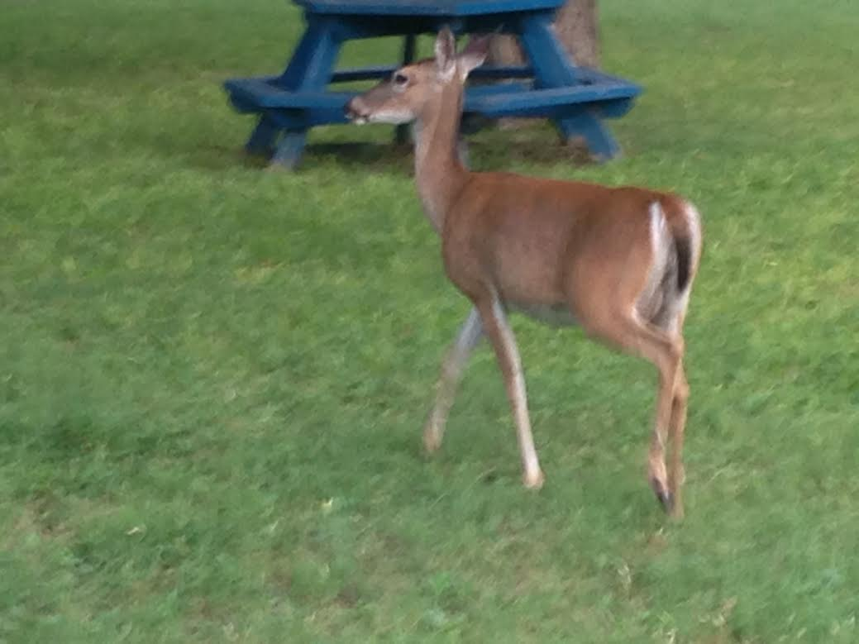

Slide 5
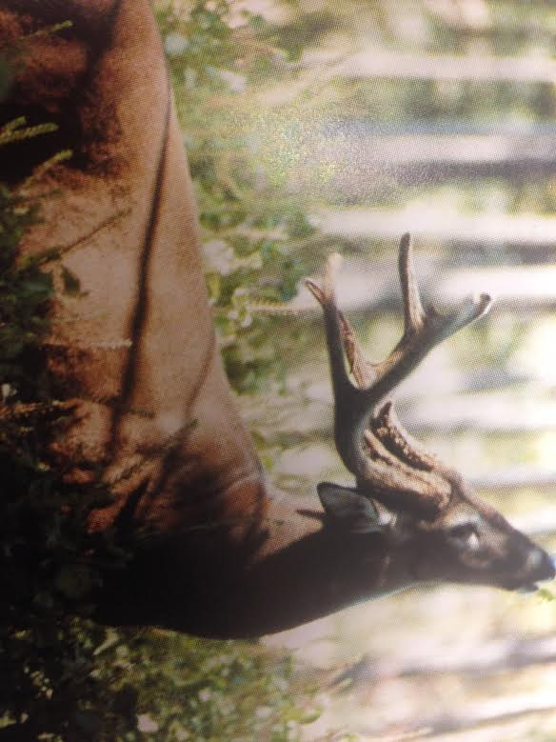

Slide 6
